Slide 1
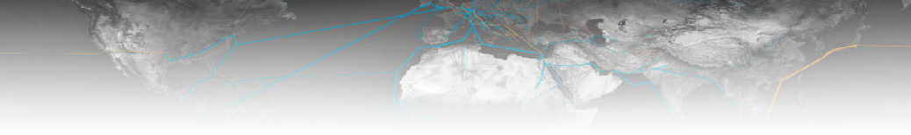


Multi-Region Input-Output frameworks and their use for global environmental policy
Manfred Lenzen
ISA, The University of Sydney
Australia

Slide 2
Multi-Region Input-Output frameworks … .
Manfred Lenzen
ISA, The University of Sydney
Australia

Slide 3
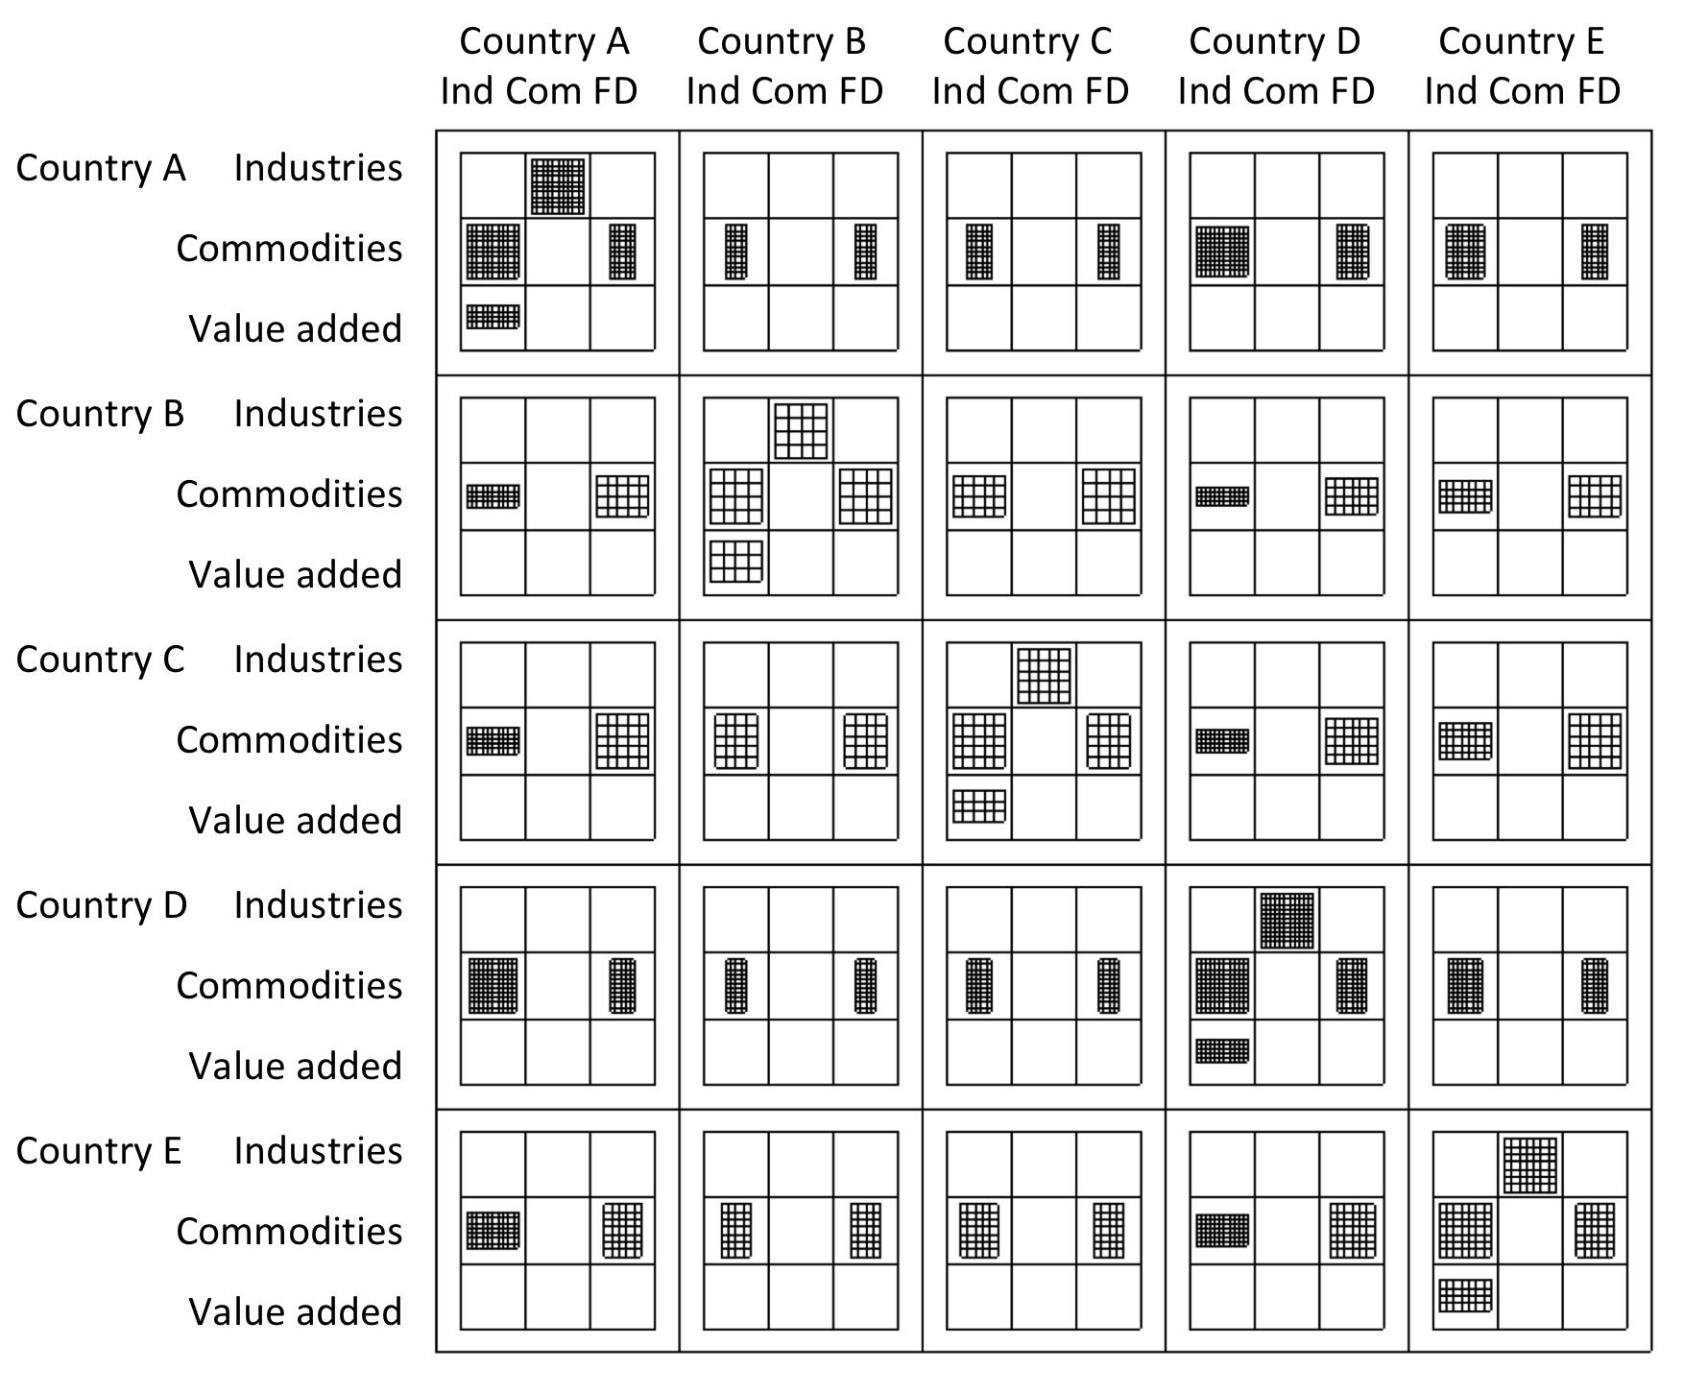
What is an MRIO table?

Slide 4
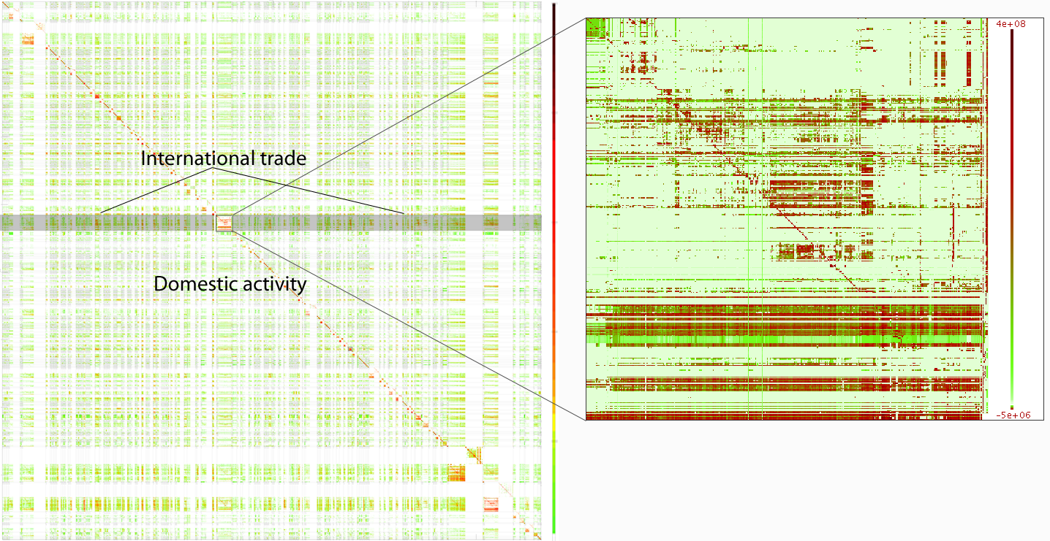
The Eora tables:
187 countries
15,909 sectors
5 valuations
20 years
=
3 Terabytes of information

Slide 6
… their use for global environmental policy
Manfred Lenzen
ISA, The University of Sydney
Australia

Slide 7
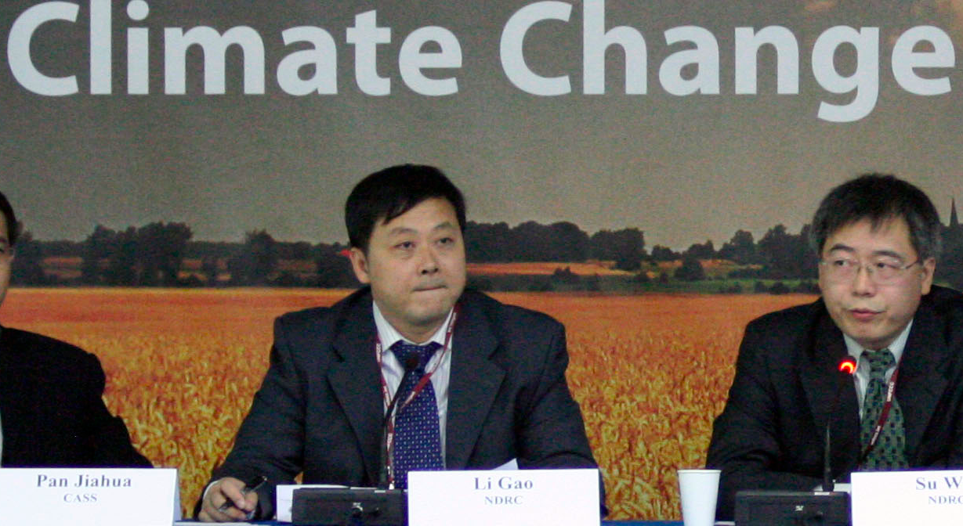
Li Gao, Director of the Department of Climate Change in China's National Development and Reform Commission

Slide 8
''We produce products and these products are consumed by other countries, especially the developed countries. This share of emissions should be taken by the consumers but not the producers''

Slide 9
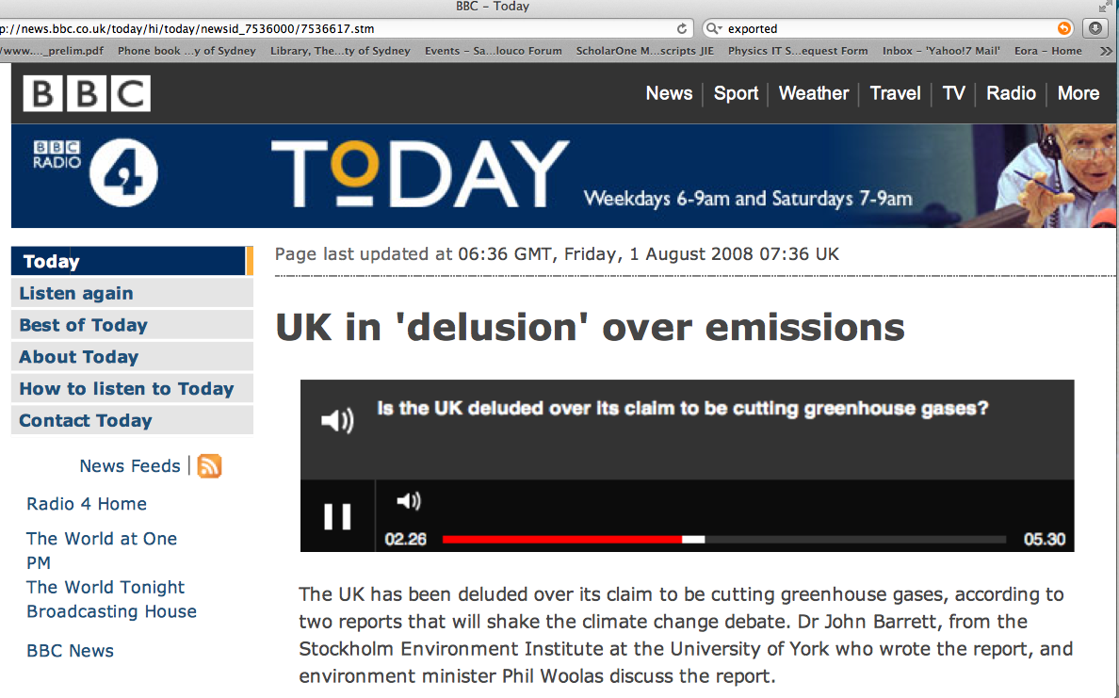

Slide 10
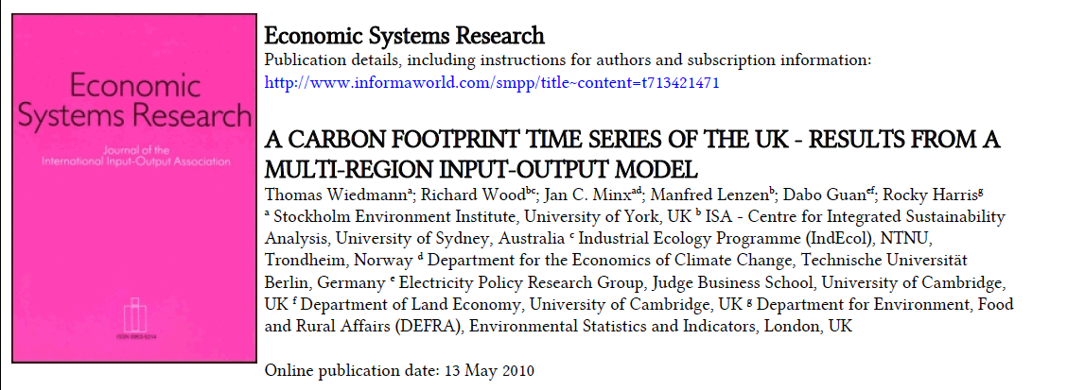
Carbon footprint of the UK

Slide 11

Trend analysis

Slide 12
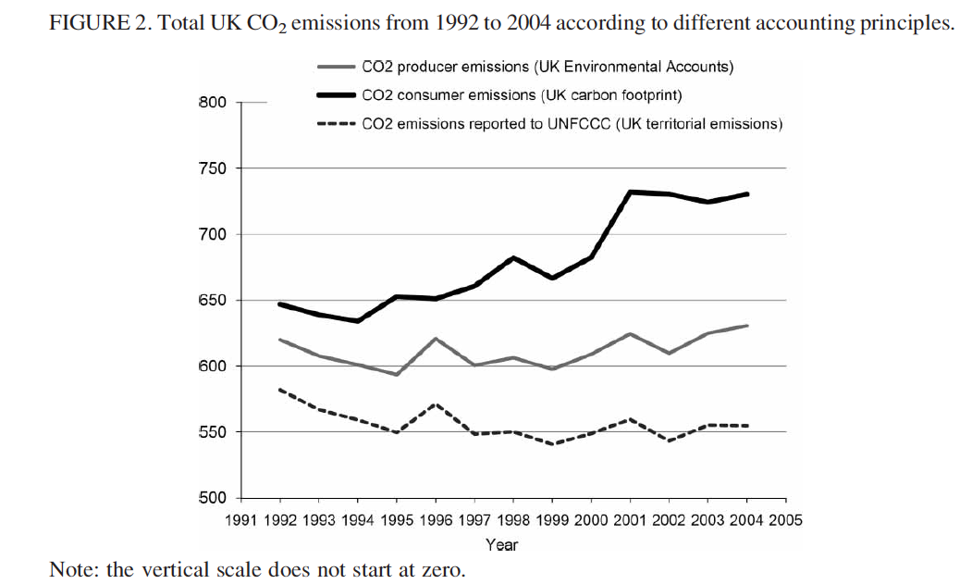
Trend analysis: UK carbon footprint

Slide 13

Key driver analysis

Slide 14
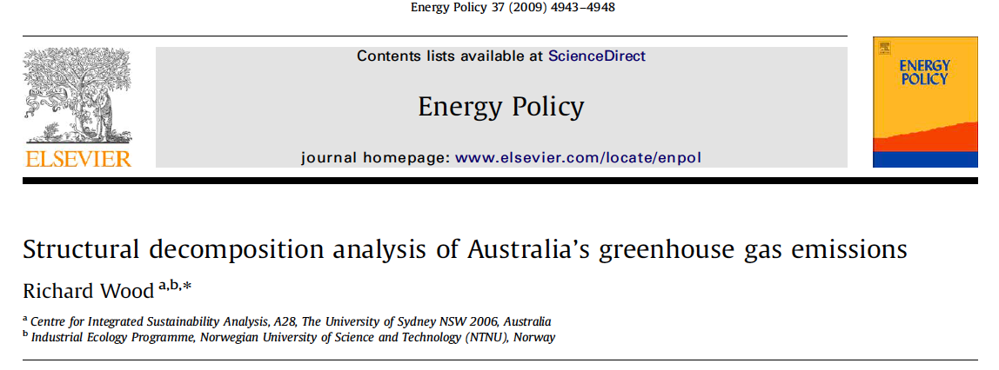
Key driver analysis: Australia’s GHG emissions

Slide 15
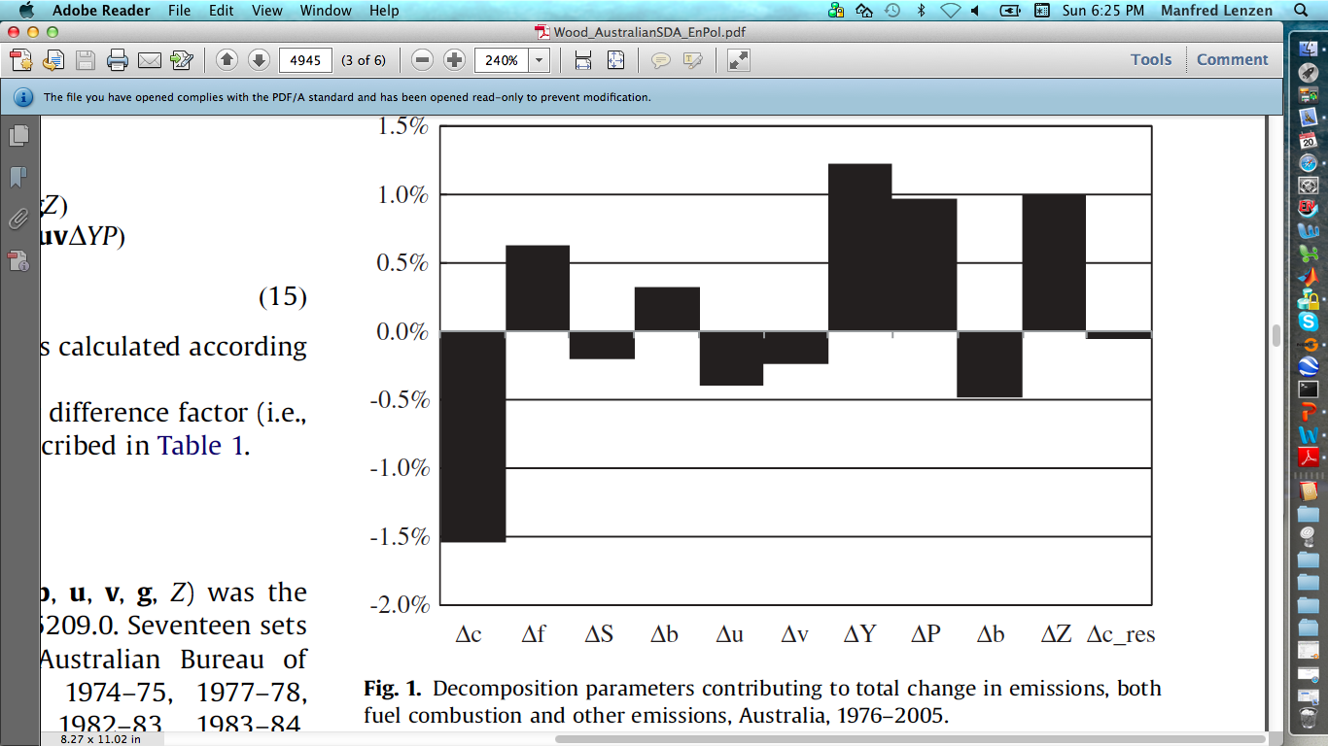
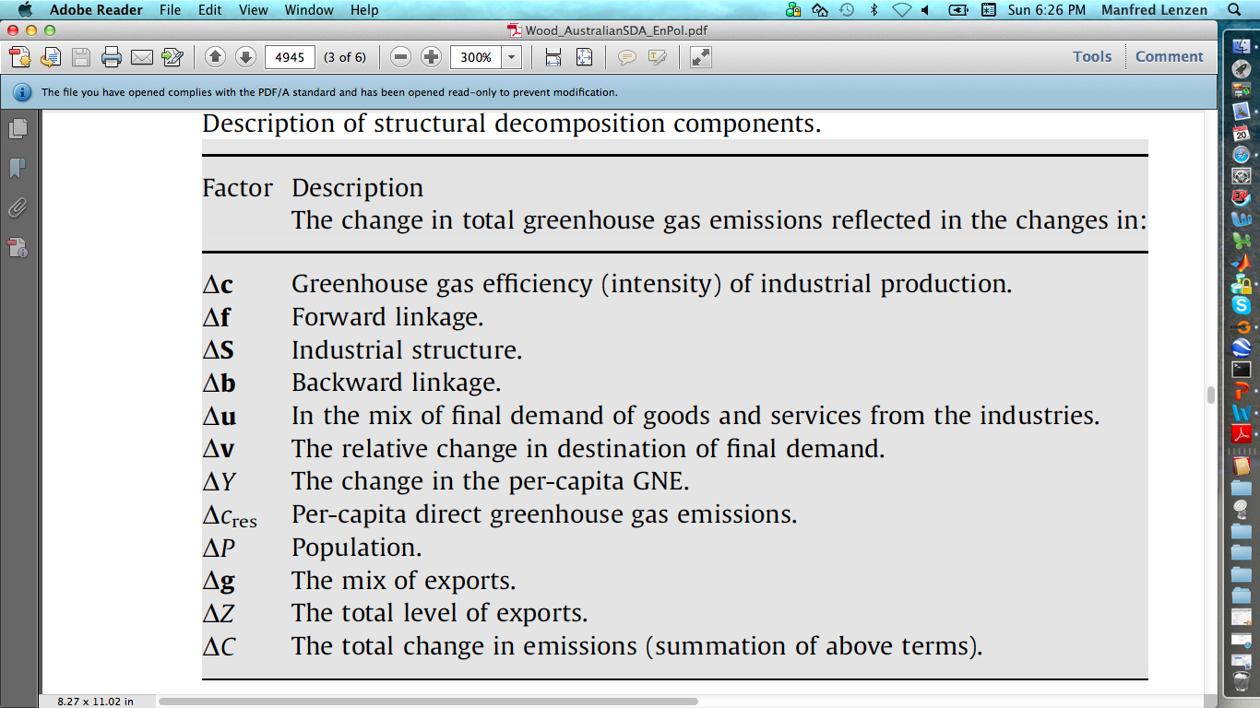
Key driver analysis: Australia’s GHG emissions

Slide 16

Supply-chain analysis

Slide 17
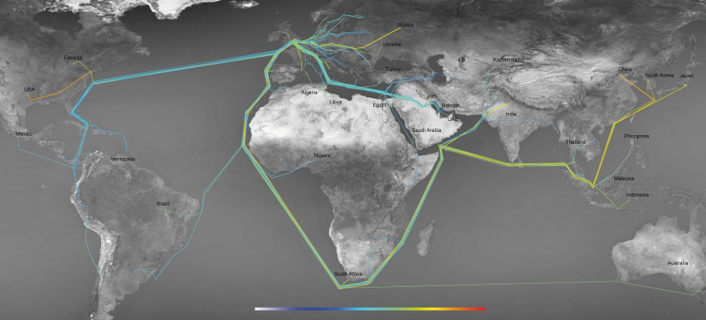
Supply-chain analysis: UK Carbon footprint

Slide 18
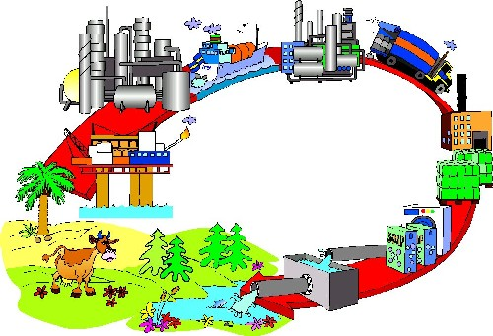
Life-Cycle Assessment

Slide 19
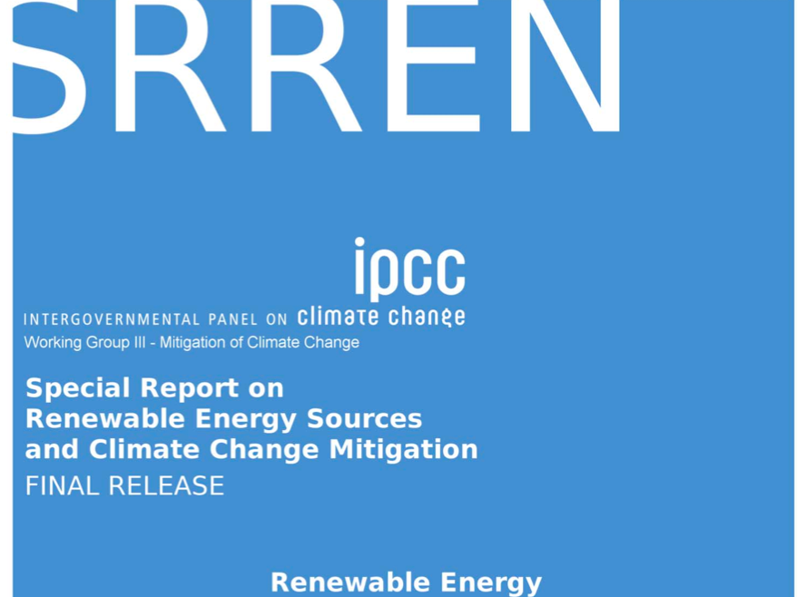
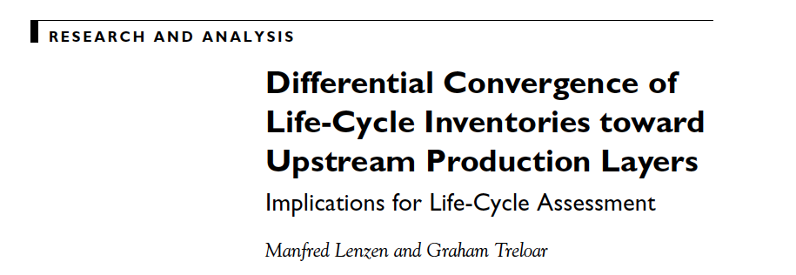
Life-Cycle Assessment: Renewable power

Slide 20
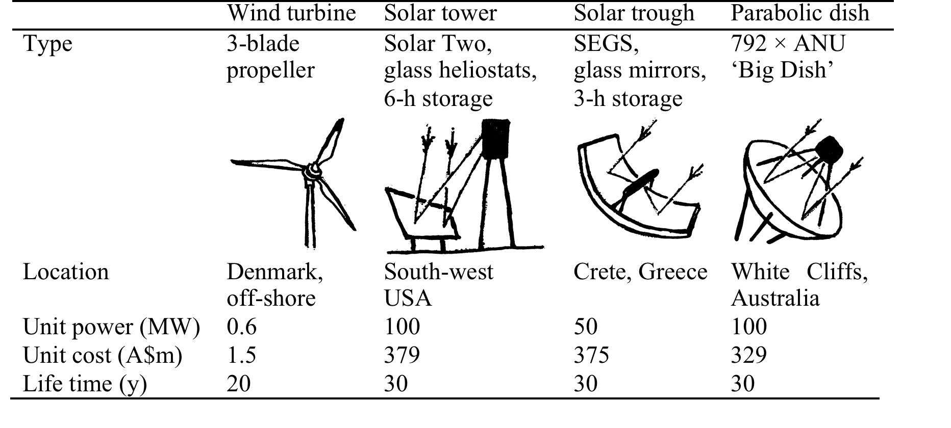
Life-Cycle Assessment: Renewable power

Slide 21
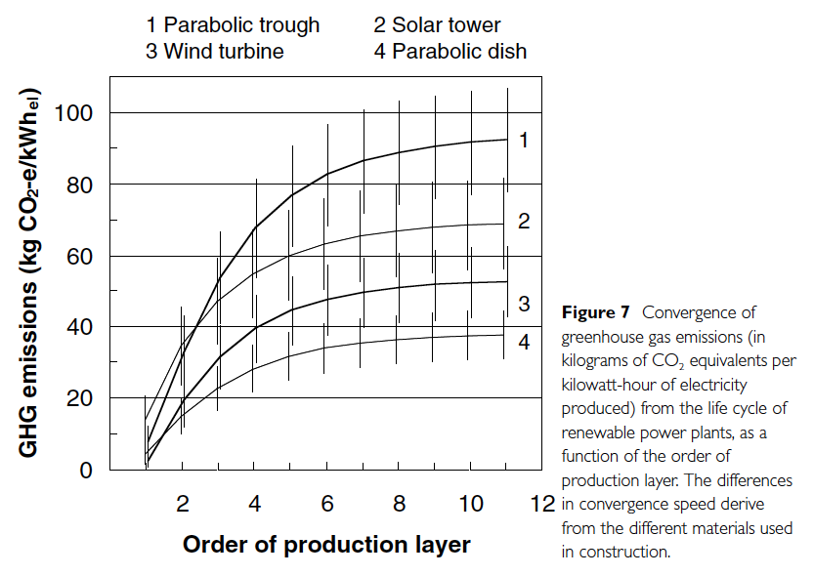
Life-Cycle Assessment: Renewable power
2
1
4
3

Slide 22
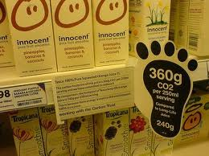
Product carbon labelling

Slide 23
Some qualifications …

Slide 24
Some qualifications: Data conflict

Slide 25
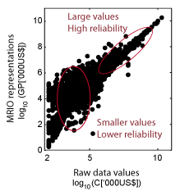
Some qualifications: Uncertainty

Slide 26
Wish-list:
- Sector and country detail
- Timeliness
- Cost
- Support data

Slide 27
Thank you ! www.isa.org.usyd.edu.au

