Slide 1

Multicriteria Systems Engineering (CC4920) interdisciplinary course
Roman Statnikov
rstatnik@nps.edu, rstatnik@yahoo.com
NAVAL POSTGRADUATE SCHOOL, MONTEREY, USA,
MECHANICAL ENGINEERING RESEARCH INSTITUTE, RUSSIAN ACADEMY OF SCIENCES, MOSCOW, RUSSIA,
HIGHER SCHOOL OF ECONOMIC
(NATIONAL RESEARCH UNIVERSITY), MOSCOW
SEPTEMBER, 9/24/2011

Slide 2
Outline
What is this course about and why it is important?
Course structure & contents
Online demonstration of the course and some of its interactive media elements
Overview of student final projects
Information about short version of this course for faculty, researchers, and graduate students

Slide 3
What is This Course About and
Why It is Important?
Or
How to State and Solve
Real-Life Optimization Problems?

Slide 4
The Basic Types of Real-Life Multicriteria Optimization Problems (Scope)
Design
Identification
Design of Controlled Systems
Operational Development / Improvement of Prototypes
Finite Element Models
Analysis from Observation Data (When Mathematical Model is Not Available)
Large-Scale Systems

Slide 5
Real-Life Problems and Application of Optimization Methods
There are many methods of searching for optimal solutions. It is tacitly assumed that by using these methods, the Expert can state a real-life optimization problem correctly. Unfortunately, this is not the case in reality. Existing optimization methods are not helpful in this situation so that the Expert end up solving ill-posed problems.
For the correct statement and solution of engineering optimization problems,
a method called Parameter Space Investigation (PSI method) has been
created and widely integrated into various fields of industry, science, and
technology.

Slide 6
The PSI method is implemented in the MOVI (Multicriteria Optimization and Vector Identification) Software System
Windows graphics user interface application.
Does not impose limitations on the number of parameters and criteria.
Can be run on several computers in a distributed mode.
Can be easily interfaced with mathematical models programmed in C/C++, Delphi, and Matlab.
Has many users world-wide.

Slide 7
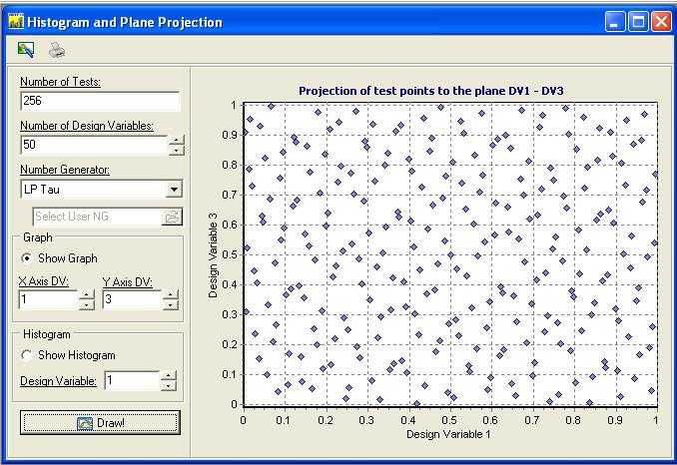
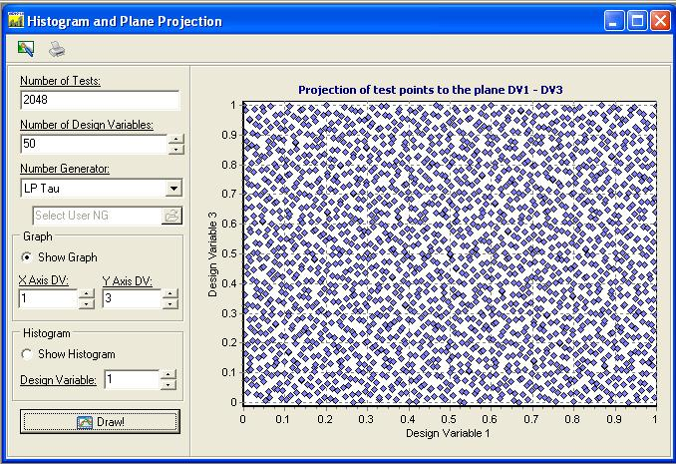
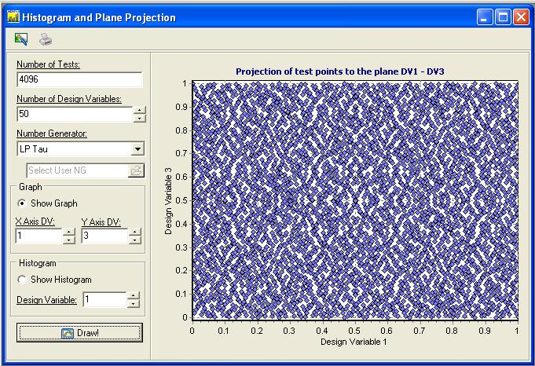
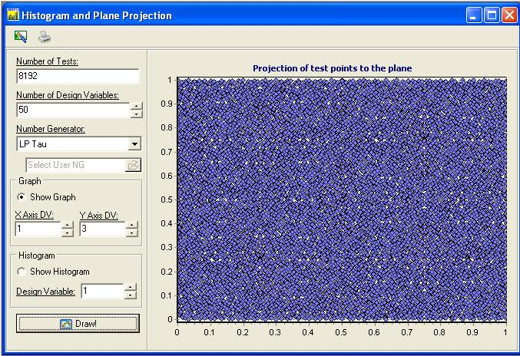
Projections of the 50-Dimensional Points (LP Sequences) onto the Plane of Two Design Variables
8096
N=256 points
N=2048
N=4096
N=8192

Slide 8
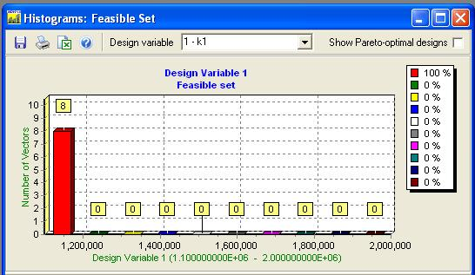
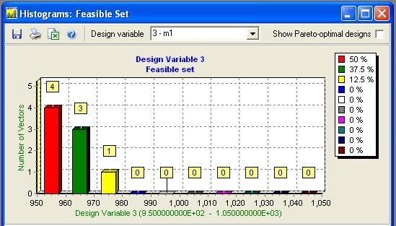
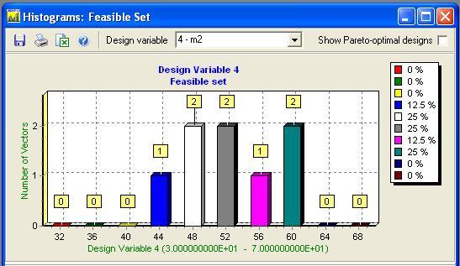
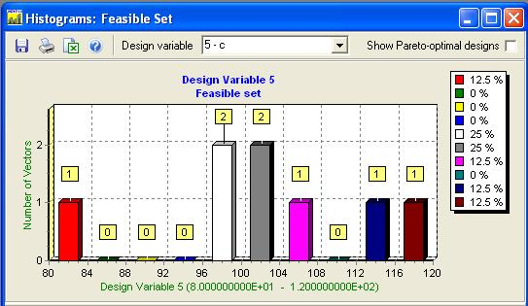
Visualization Tools: Histograms of the distribution of feasible solutions
1st design variable
3rd design variable
4th design variable
5th design variable
Analysis of histograms allows to see the “work” of constraints and is helpful for the correction of the initial design variable constraints.

Slide 9
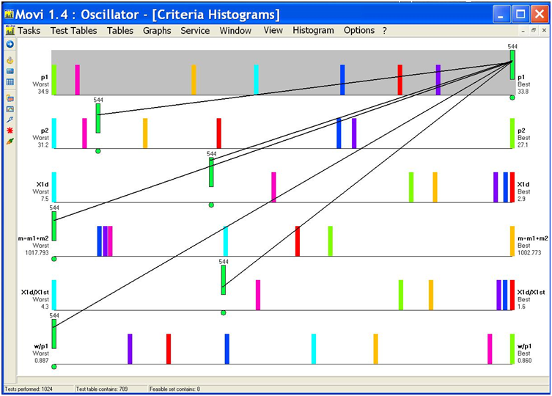
Criteria Histograms. Visualization of Contradictory Criteria

Slide 10
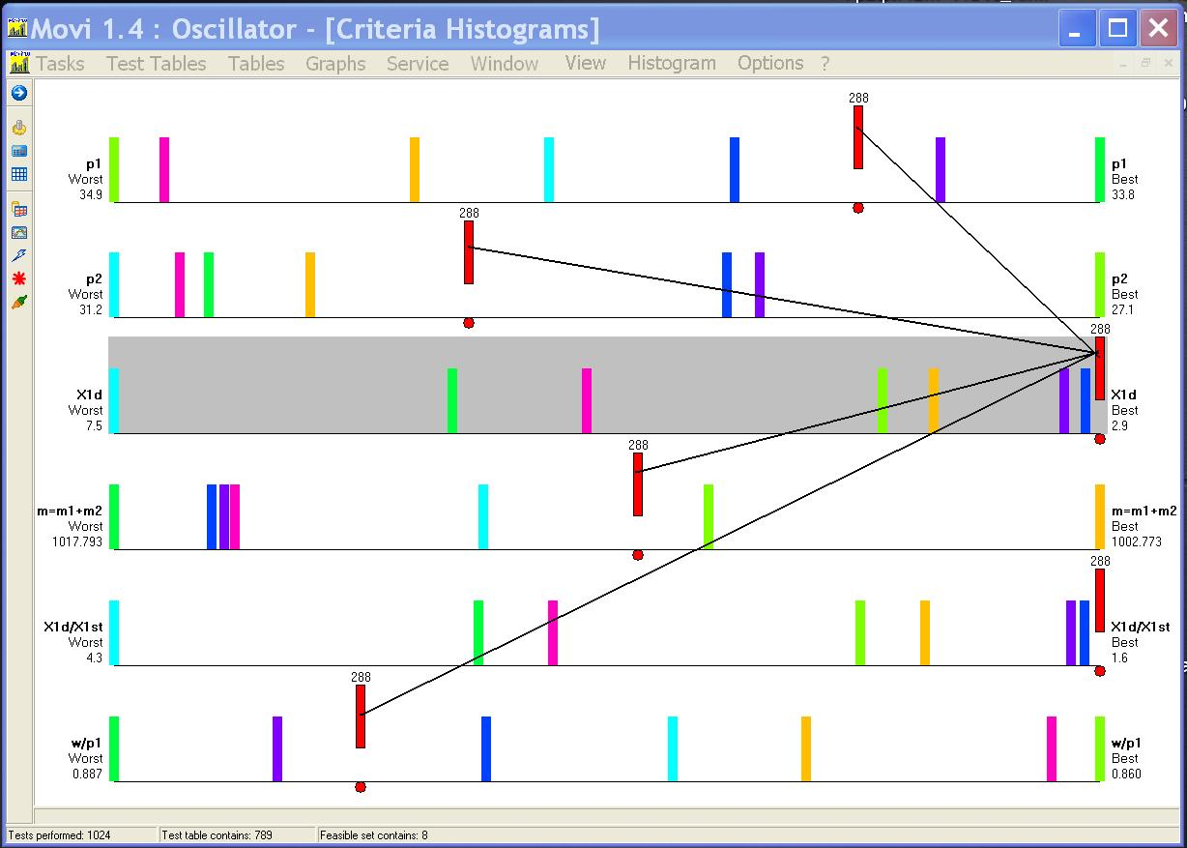
Criteria Histograms. Visualization of Contradictory Criteria

Slide 11
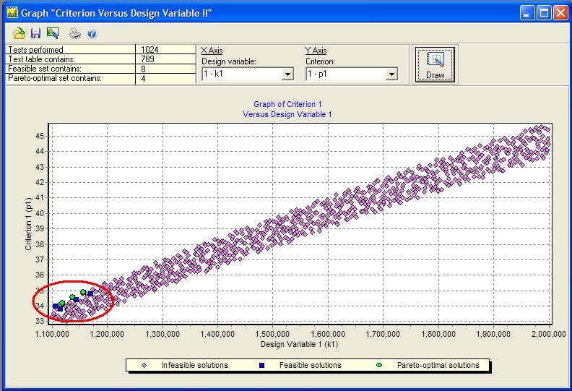
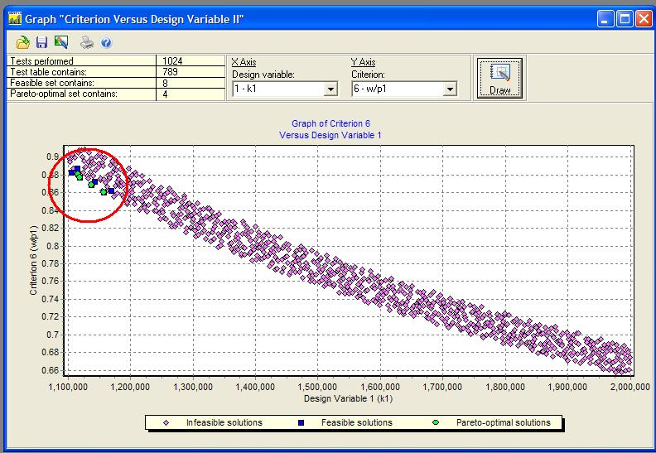
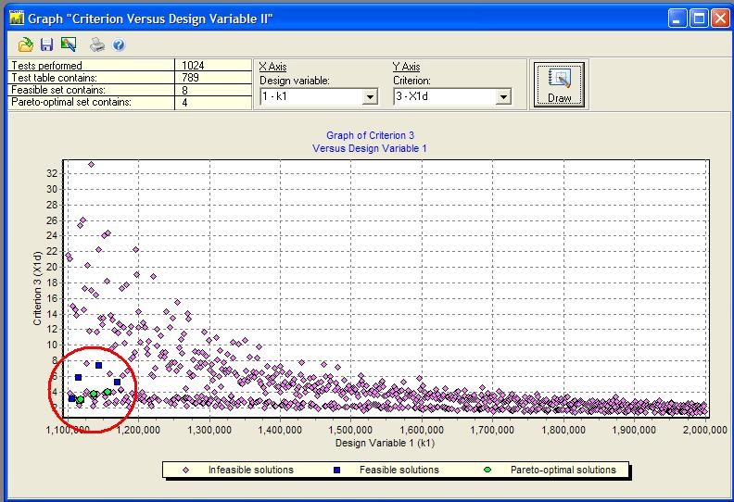
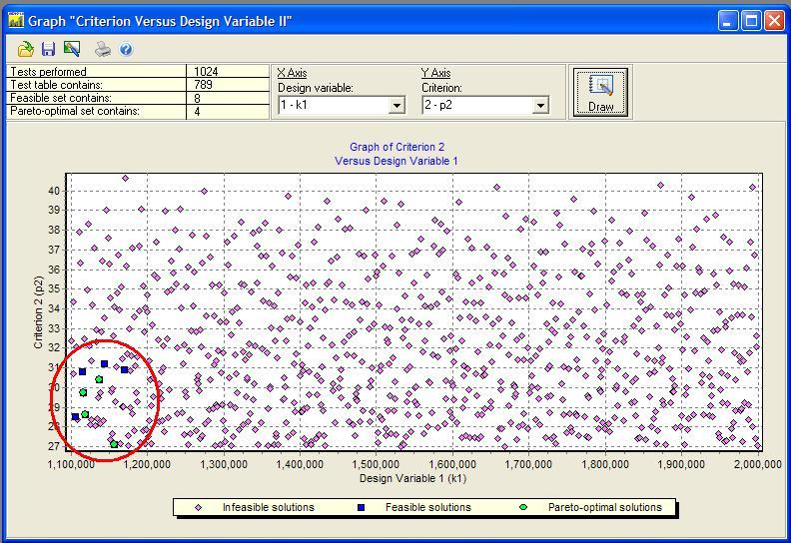
Visualization Tools: Graphs “Criterion vs. Design Variable”
First criterion vs. first design variable.
Sixth criterion vs. first design variable.
Third criterion vs. first design variable.
Second criterion vs. first design variable.
These figures show sensitivity of criteria to design variables. Moreover,
expert obtains very important information about location of feasible solutions.

Slide 12
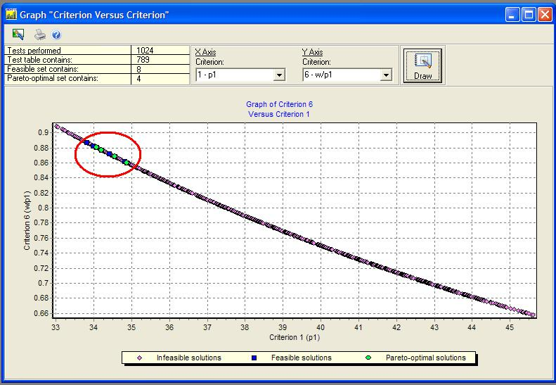
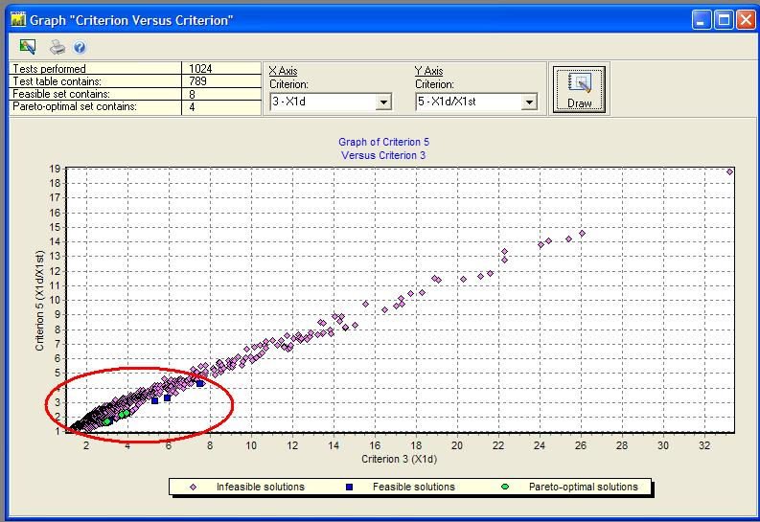
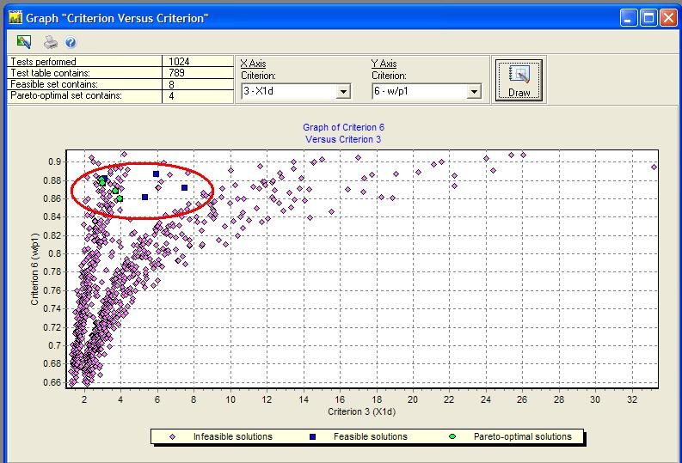
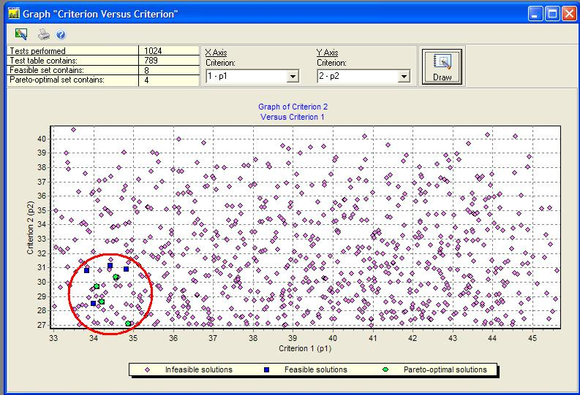
Visualization Tools: Graphs “Criterion vs. Criterion”
First criterion vs. sixth criterion.
Third criterion vs. fifth criterion.
Third criterion vs. sixth criterion.
First criterion vs. second criterion
These figures show dependencies between criteria and location of feasible solutions. These graphs help to improve the statement and solution of optimization problem and finally to estimate a correctness of the mathematical model, its shortcomings.

Slide 13
Improving the Pareto Optimal Set After Correcting the Parallelepipeds: Construction of Combined Pareto Set
P
P₂
P₁
Let’s look how changing the Pareto optimal set depend on correcting the parallelepiped.
Pareto Optimal Set P corresponds to initial parallelepiped .
Pareto Optimal Set P₁ corresponds to parallelepiped .
Pareto Optimal Set P₂ corresponds to parallelepiped .
Combined Pareto Optimal Set is presented by two curves AB⊂P₂ and BC⊂P₁.

Slide 14
Elements of Multicriteria Analysis.
Investigation of Design Variable Space (1/3)
Construction of the new regions for the search of optimal solutions – П₁ and П₂
П₂
П
П
П₁

Slide 15
Elements of Multicriteria Analysis.
Investigation of Criteria Space (2/3)
Most Pareto optimal solutions are located in this region
Φ₁ vs. Φ₂
Φ₁ vs. Φ₃
Φ₁ vs. Φ₄

Slide 16
Elements of Multicriteria Analysis.
Investigation of Criteria Space (3/3)
Most Pareto optimal solutions are located in these regions
Φ₃ vs. Φ₂
Φ₄ vs. Φ₂
Φ₄ vs. Φ₃

Slide 17
Multicriteria Analysis:
Distributions of feasible solutions for the 1st design variable in six experiments
The “gaps” in the initial range
of change, and “gaps” in the
2nd and 3rd experiments
are circled
Initial statement
2nd experiment
3rd experiment
4th experiment
Good distribution of feasible
solutions is observed in the
4th, 5th, and 6th experiments
5th experiment
6th experiment

Slide 18
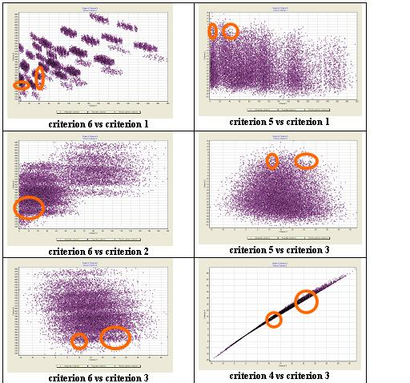
Multicriteria Analysis with MOVI 1.3:
Dependencies between criteria.
Location of Pareto solutions in criteria space (3rd optimization experiment)
We carried out
200,000 trails.
Number of Pareto
solutions = 3
Notes:
Next important tool. Graphs of dependencies between criteria. Earlier I told about three Pareto optimal solutions. Now you can see area of location these solutions.

Slide 19
Criterion 1 (Minimized) vs. Criterion 6 (Minimized) – 3rd Optimization
Each point has
number of dimension
equal to 6 in criteria
space and 45 in
design variable space.
The scale is increased
Notes:
I briefly show another dependencies between criteria and their details.

Slide 20
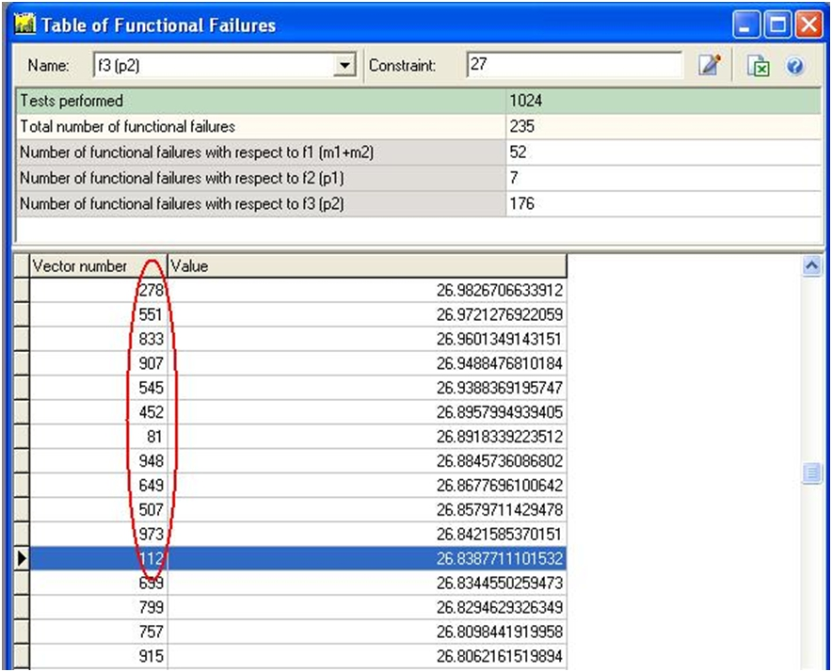
Table of Functional Failures, 1/2
Table of functional failures for the third functional constraint (fragment)

Slide 21
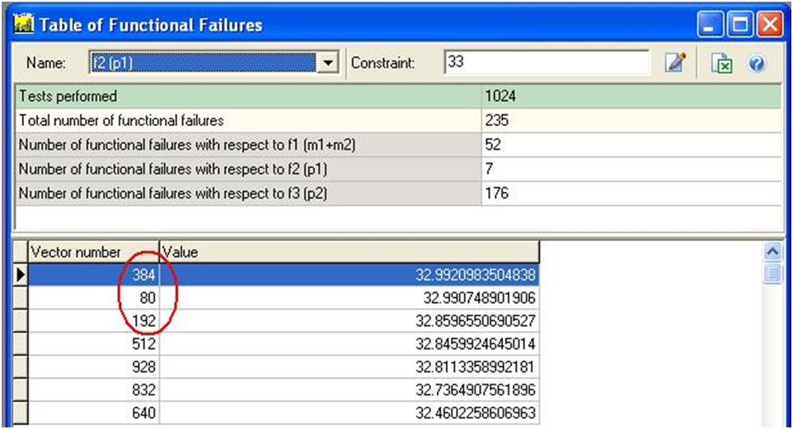
Table of Functional Failures, 2/2

Slide 22
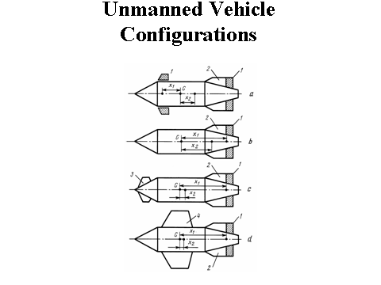
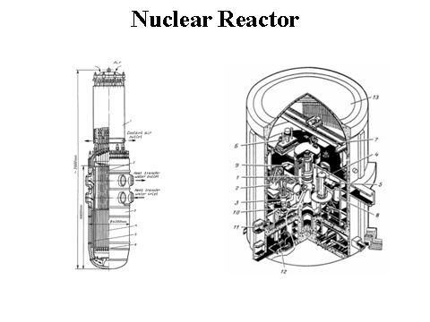
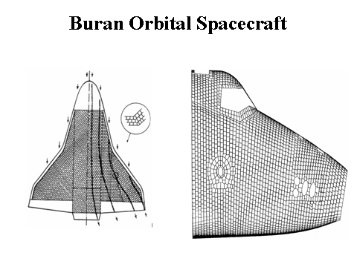
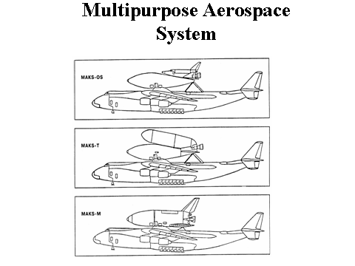
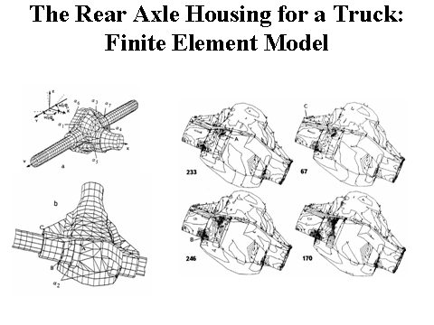
PSI Method and MOVI software are Widely Integrated into Various Fields of Industry, Science, and Technology
Some applications:
Naval Ship Design.
Multistage Axial Flow Compressor for an Aircraft Engine.
Controllable Descending System
Metal Cutting Machine Tools and Their Units.
Operational Development of a Vehicle.
Automobiles' Active Safety etc.

Slide 23
Course Structure & Contents

Slide 24
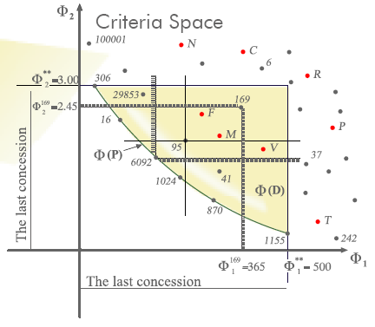
Course Overview
Main learning material:
6 main modules (lectures)
2 interactive assignments
4 interactive & animated presentations
MOVI software
Textbook “Multicriteria Analysis in Engineering”
Textbook “The Parameter Space Investigation
Method Toolkit”
PowerPoint presentations
Online tutorials
Research articles
Access to materials of the short course (I will talk about it further)
Assessment is based on:
3 projects (two mandatory and one extra-credit)
4 homework assignments and 5 quizzes (some of them are extra-credit)
Final exam
Participation in the discussion board forums

Slide 25
Main Modules
The course consists of 6 main modules
Module 1: Introduction: The Best Solutions and Where to Look for Them
Module 2: Multicriteria Optimization and Parameter Space Investigation Method
Module 3: MOVI (Multicriteria Optimization and Vector Identification) Software Package
Module 4: Multicriteria Design
Module 5: Multicriteria Identification
Module 6: Other Multicriteria Problems: Large-Scale Systems, Design of Controlled Engineering Systems, Multicriteria Analysis When Mathematical Model is Not Available
Project 1
(extra-credit)
Project 2
Final
Project
and 3 projects (two mandatory and one extra-credit)

Slide 26
Projects
Project 1 (extra-credit): The goal of this project is to study the process of construction of feasible and Pareto sets based on LP sequences and random number generator.
Project 2: The goals of this project are: (i) to learn how to construct feasible and Pareto sets, to perform their analysis and to choose the most preferable solution and (ii) to learn how to improve feasible and Pareto optimal solutions by means of correcting constraints of the design variables. This project is performed using MOVI software system.
Final Project: This project is devoted to all topics covered in the course. Each group of students works on the project related to their area of interest/work/research. This project may or may not involve using MOVI software.

Slide 27
Key Media Elements
Interactive Assignment: Multicriteria Optimization in Action (Module 1)
Interactive Assignment: Mastering PSI method (Module 2)
Intuitive Introduction to Statement and Solution of Multicriteria problems by the PSI Method (Module 2)
Animation: The geometrical interpretation of the PSI Method (Module 2)
Animation: Design of Controlled Engineering Systems
(Module 6)

Slide 28
Online Demonstration of the Course and Some of Its Media Elements

Slide 29
Overview of Student Final Projects

Slide 30
Ryan J Davis, (1/2)
Multicriteria design of a geared winch assembly
(that is used to pull a boat onto a trailer)
Basic Winch Design
Exploded View of Complex Winch Example

Slide 31
Ryan J Davis, (2/2)
Multicriteria design of a geared winch assembly
(that is used to pull a boat onto a trailer)
Object Selection
The specific object selected for analysis is a geared winch assembly used to pull a boat onto a trailer. The purpose of the analysis is to Provide a design with optimal performance that is capable of supporting
a maximum boat load. The design analysis will take many factors into account including volumetric size, weight, cost, load capacity, etc. The boat for this design analysis requires approximately 1500 lbs of force
to pull while in water.
The performance criteria are:
Weight – Minimize – Initial constraint is <= 50 lbs, based on the amount of weight that the average human can
comfortably carry.
2. Volumetric Size – Minimize – Initial constraint is <= 2 ft^3, based on the size of the enclosure that the assembly will
be mounted in.
3. Reel Speed – Maximize – Initial constraint is >= 10 ft/min, based on the initial requirement to be able to pull a boat
20 ft away completely into the trailer in under 2 minutes.
4. Corrosion – Minimize – No initial constraint set as the designer is initially unaware of the potential range of values.
5. Water Resistance – Maximize – No initial constraint set as the designer is initially unaware of the potential range
of values.
The design variables are:
1. Diameter of the main spool: 2.Diameter of the two spool constraining sides: 3.Diameter of spool gear; 4.Number of teeth on spool gear; 5. Diameter of handle gear; 6. Number of teeth on handle gear; 7. Density of chosen material

Slide 32
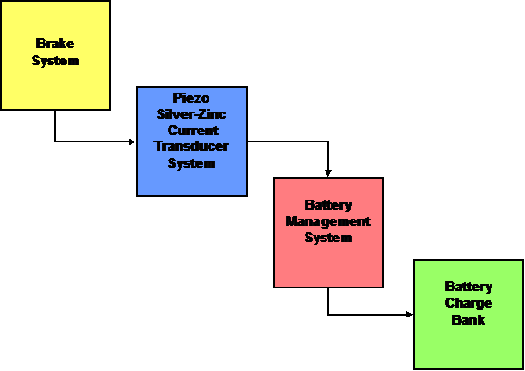
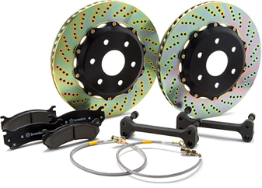
Barry D. Adams,
PD21 - Cohort #5, (1/2)
Multicriteria Optimization of the Advanced
Energy Retrieval / Regeneration System

Slide 33
Barry D. Adams,
PD21 - Cohort #5, (2/2)
Statement of the Problem
We will determine the consistent “flow-down” solutions of the subsystems for an automobile
power regeneration cycle, utilized in a hybrid / high efficiency drivetrain.
A. Brake System
Known Variables & Criteria:
Car Mass = Ф1
Car Speed (Initial) = Ф2
Brake Fluid Pressure = Ф3
Brake Pad Volume = α1
Brake Pad Material Friction Coefficient = α2
Rotor Volume = α3
Rotor Material Friction Coefficient = α4
Time Until Rotor Stop = Ф4 = (Ф3) / (Ф2) * (Ф1)
Heat Generated = Ф5 = (Ф4 * Ф3 * α1 * α2 * α3 * α4)
Piezo Silver-Zinc (Ag-Zn)
Current Transducer System
Known Variables & Criteria:
Heat Generated (From Brake System) = Ф5
Piezo Transducer System Design = α5
Current Backflow Arrest Design = α6
Electricity Generated = Ф6 = Ф5 * α5
Electricity Transmitted = Ф7 = Ф6 * α6
C. Battery Management System
Known Variables & Criteria:
Electricity Transmitted = Ф7
Voltage Regulator Efficiency = α7
Central Processing Unit Performance = α8
Regulated Current Transmitted = Ф8 = (Ф7) * (α7 / α8)
D. Battery Charge Bank
Known Variables & Criteria:
Regulated Current Transmitted = Ф8
Size of Battery Bank (# of Batteries) = α9
Battery Rate of Recharge = α10
Electricity Stored = Ф9 = (Ф8) * (α7 / α8)
CRITERIA VECTOR IS

Slide 34
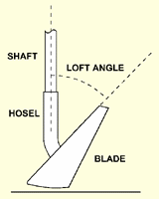
Eugene Park and Rick Tahimic, (1/2)
Multicriteria Design of a Driver for the Average Golfer
For those with an interest in multicriteria design, the question
arises as to whether it is possible to use multicriteria design
techniques to produce an even better driver design than those
that are currently available. The purpose of this project is to
describe the steps that could be used to identify a solution to the multicriteria design problem of producing a better driver design for the average golfer.
The following steps will be described in this project:
1. Identifying the performance criteria
2. Constructing a mathematical model of the object and an
algorithm/program for calculating its basic characteristics
3. Setting up the Multicriteria Optimization and Vector
Identification (MOVI) Software and the program indicated
in step 2
4. Constructing and analyzing the MOVI test tables
5. Correcting the source data and refining the performance
Specifications
5. Constructing and analyzing the feasible
solution set and Pareto optimal set
5. Multicriteria analysis and choice of the most
preferable design of the driver

Slide 35
Eugene Park and Rick Tahimic, (2/2)
Multicriteria Design of a Driver for the Average Golfer
The performance criteria for this analysis are the following:
Distance – this criterion will be maximized and is a combination of the carry distance and roll distance. This criterion is computed from the ball speed, departure angle and spin rate.
Accuracy – this criterion will be minimized and is the perpendicular distance from the target line. This criterion is also calculated from ball speed, departure angle and spin rate.
Durability – this criterion will be maximized and is computed from head face stress and shaft stress.
Cost – this criterion will be minimized and is a function primarily of material, size, and shaft characteristics.
Coefficient of restitution – the criterion will be maximized up to the legal limit of 0.83 as set by the United States Golf Association (USGA).
The model will produce the following
outputs:
Model inputs or design parameters for this
projects model are as follows:
Loft angle
Center of gravity position
Hardness of head material
Club head width
Club head depth
Club face height
Club face width
Shaft torque
Shaft bend point
Shaft mass
Shaft length
Grip mass
Ball speed
Departure angle
Spin rate
Coefficient of restitution
Head face stress
Shaft stress

Slide 36
Anh Nguyen, Bob Perkins, Fred Scali,
Robert Vik,
Multicriteria Development of a Spacecraft’s Subsystem
The purpose of this MULTICRITERIA PROJECT is to describe the step-by-step process of posing and solving the problem of improving a prototype. In keeping with the major theme of the degree program, the group chose to use a sample spacecraft.
The project will investigate the development of one of the spacecraft’s subsystems: the payload assist module (PAM). The PAM will allow the spacecraft to operate in HEO and GEO orbits so that it could better support communications missions.
This short paper takes the reader through the steps of first defining the mathematical model and determining its adequacy relative to the current prototype and then performing the optimization of the prototype. After optimization the process starts again with defining and determining the adequacy of the mathematical model of the now optimized prototype. It is understood that this process is iterative in that the cycle can be repeated many times before a final design is selected.

Slide 37
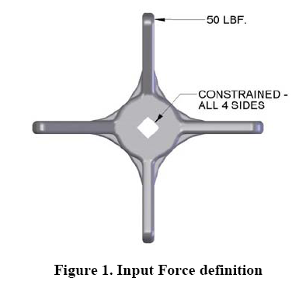
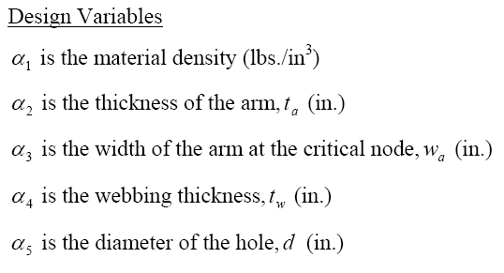
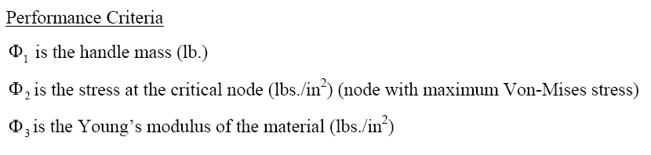
Paul Melancon and Ron Clemens, (1/2)
Multicriteria Optimization of Valve Handle Design

Slide 38
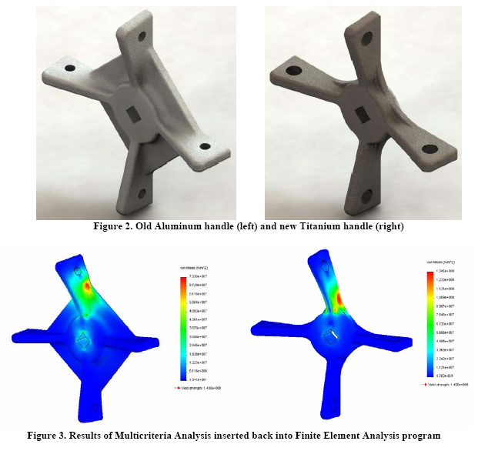
Paul Melancon and Ron Clemens, (2/2)
Multicriteria Optimization of Valve Handle Design

Slide 39
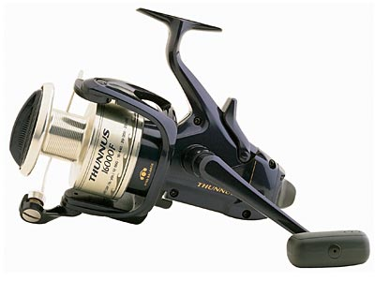
Romarico Figuerres, PD-21, Cohort 6
Multicriteria Design of Fishing Reel Used for Sea Water Fishing
Object Selection
The specific object selected for analysis is a fishing
reel used for sea water fishing. The analysis will
provide a design with optimal performance under
the harsh salt water environment. The design analysis
will take many factors into account including size,
weight, cost, line capacity, load/drag poundage,
gear ratio, and line retrieve per crank.
Salt Water Fishing Reel Design
Performance Criteria

Slide 40
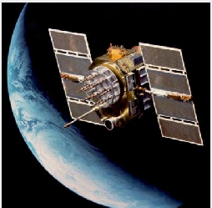
Jeremiah B. Stahr, SEM-PD 21, Cohort-5,
Satellite Upgrade Program: Multicriteria Identification
Assumptions:
All performance criteria from the existing satellite are known and measurable
Increases in performance capability can be parametrically related to the criteria; these relationships are known and measurable
Specific numbers are fictitious and not related to any existing satellite system
Basic Performance Capability:
Image resolution of camera (measured in meter resolution)
Data throughput of downlink (measured in MBps [mega-bits per second])
Criteria: cost of the satellite volume of the satellite service life mass of the satellite time to launch | Design Variables: mass of the imaging sensor mass of the communication system length of focal plane size of communication antenna power of communication system transmitter power of sensor electronics

Slide 41
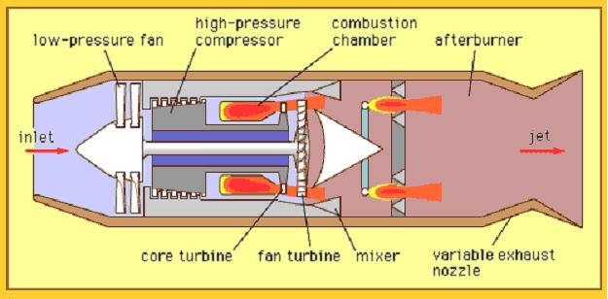
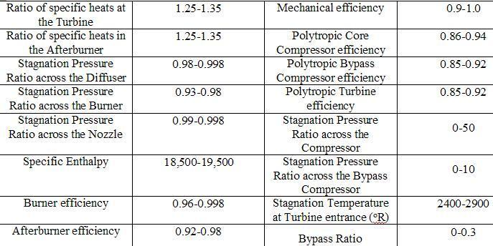
Matt Letourneau, Justin Loy, and Bill Traganza
Low Bypass Turbofan
Design
Design Variables
CRITERIA
COST (Minimize)
Specific Fuel Consumption (Minimize)
Weight (Minimize)
Thrust (Maximize)

Slide 42
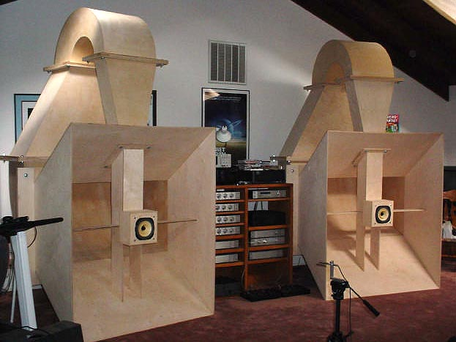
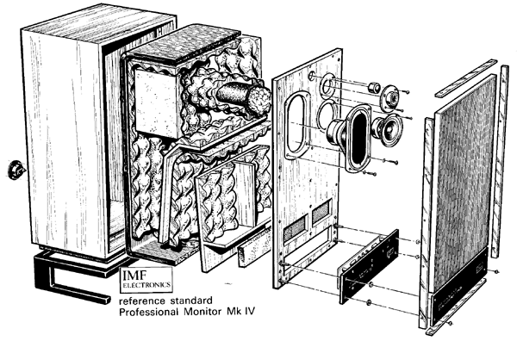
James W. New
Multicriteria Analysis of Closed-Box Acoustic Suspension (AS)
Loudspeaker Cabinet Design
Definition Transmission Line Cabinet
by IMF Electronics
Back Loaded Exponential Horn
Speaker Enclosures
Performance Criteria
Critically damped -- transient perfect
Butterworth response -- max fault amplitude response with minimum cutoff
Chebychev response -- max power handling and max efficiency

Slide 43
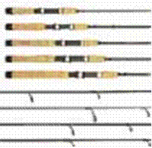
Michael R. Clendening
Optimizing a Tournament Grade Spinning Rod Using Multi-Criteria Design and Analysis Techniques
Spinning Rods with Multiple Rod Handle/Reel Seat Designs
Spinning Rod Components
PERFORMANCE CRITERIA
1) Rod Action – Ra is the measurement of deflection or flex the rod exhibits under load, and more importantly.
2) Rod Taper (Rt) – Rt will affect the casting speed and is used to determine the rod action.
(3) Rod Weight (Rw) – The lighter the fishing rod, the less fatigued an angler will become over time.
(4) Rod Power (Rp) - Defined as the amount of pressure required to flex the blank.
In addition to the above criteria, spinning rods must also be capable of performing in extreme temperatures and a wide range
of weather conditions in both saltwater and freshwater while maintaining optimum performance levels.
Design Variables
1) Rod Length. 2) Number and Style of Line Guides. 3) Rod Butt Diameter
4) Type of Rod Material (Split Bamboo, Fiberglass, Carbon Fiber and Graphite Fiber)

Slide 44
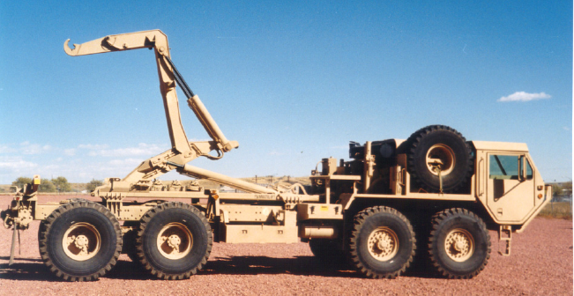
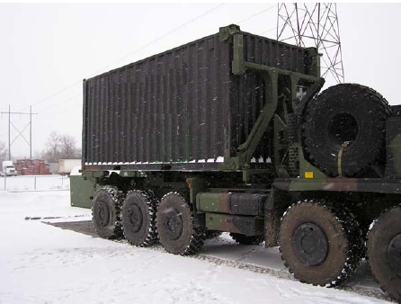
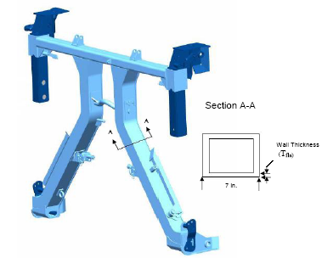
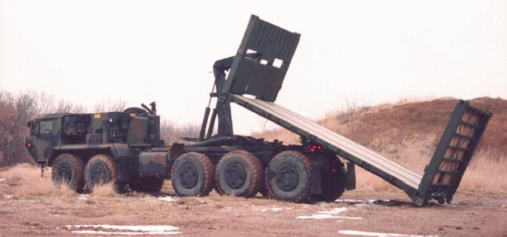
Michael Cheff
Enhanced Container Handling Unit (E-CHU) for the Heavy Expanded Mobility
Load Handling System (HEMITT-LHS) and the Palletized Loading System (PLS)
PLS with CHU and container
HEMITT-LHS
FLA with cross section
PLS lifting a flatrack

Slide 45
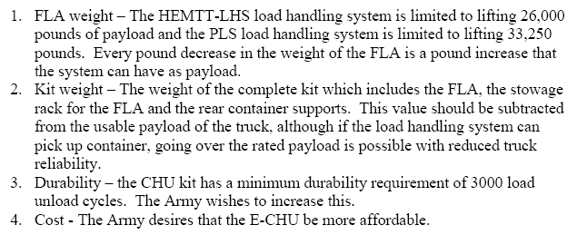
Michael Cheff
Performance criteria for the E-CHU are as follows:
Design variables are: wall thickness, material, and so on

Slide 46
Thank you for your attention!
Questions? Comments?
Please email me: rstatnik@yahoo.com

Slide 47
References

Slide 48
Backup

