Slide 1

Searching for the Best Solutions:
The Parameter Space Investigation Method Toolkit
Roman Statnikov
rstatnik@nps.edu, rstatnik@yahoo.com
Naval Postgraduate School, Monterey, USA,
Mechanical Engineering Research Institute, Russian Academy of Sciences, Moscow, Russia,
Higher School of Economic
(National Research University), Moscow
September, 9/23/2011

Slide 2
Introduction
Correct determination of the feasible solution set is a major challenge in real-life optimization problems
This work presents a universal mechanism for generating the feasible solution set on the basis of Parameter Space Investigation (PSI) method

Slide 3
Generalized Formulation of Multicriteria Optimization Problems
As a rule, an expert doesn’t know values of constraints. The process of constructing and analyzing the feasible solution set is of fundamental importance in real-life problems.

Slide 4
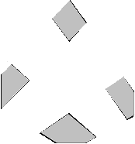
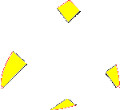
Construction of the Feasible Solution Set
The design variable vector:
The design variable constraints:
The functional
relations:
constraints:
The criteria constraints
The performance criteria:
The subset G in П
Parallelepiped П
Among feasible solutions we should find Pareto optimal ones. Solution is Pareto optimal if value of one
criterion can be improved only at the expense of worsening at least one of the other criteria. Pareto
Optimal solutions cannot be improved by all criteria simultaneously. Construction and analysis of the
feasible and Pareto optimal sets are crucial for selection of the most preferable solution.
Notes:
The design variable space which is defined by the design variable constraints forms kind of a “Parallelepiped” represented by “П” in the r-dimensional space. The dictionary definition of the “Parallelepiped” is: “a 6-faced polyhedron all of whose faces are parallelograms lying in pairs of parallel planes” [Merriam-Webster’s 11th Collegiate Dictionary]. The “Parallelepiped” is used as a term in PSI method, since the design variable space can be illustrated at most in three-dimension.
Unlike the functional constraints, the criteria constraints are selected during the analysis of the problem. They are not rigid, i.e. the designer can continually determine and revise the worst sensible value for them.

Slide 5
Some basic features of real-life optimization problems
These problems are essentially multicriteria ones.
The determination of the feasible solution set is one of the fundamental issues of the real-life problems. The construction of the feasible set is an importance step in the formulation and solution of such problems.
As a rule, the feasible solution set may be obtained only in the process of solving a problem and analysis of results. Analysis of the feasible set allows one to not only correct the initial constraints, but also to revise the original mathematical models and list of criteria. The multicriteria problems should be formulated and solved in the interactive mode. The formulation and solution of a real-life problem should be a single process.
Mathematical models can be complex systems of equations (including differential and other types of equations) that may be linear or nonlinear, deterministic, or stochastic, with distributed or lumped parameters.
The feasible solution set can be multiply connected, and its volume may be several orders of magnitude smaller than that of the domain within which the optimal solution is sought.
Both the feasible solution set and the Pareto optimal set are nonconvex in the general case. As a rule, information about the smoothness of objective functions and functional dependences is absent. These functions are usually nonlinear; they may be nondifferentiable as well.
A real-life optimization problem may contain a large number of constraints, and the dimensionality can reach: (1) many hundreds and thousands for the design variable vector, and (2) many dozens, if not hundreds, for the criterion vector.
Very often experts do not encounter serious difficulties in analyzing the Pareto optimal set and in choosing the most preferred solution. This is because experts have a sufficiently well-defined system of preferences in this type of problems and the Pareto optimal set often contain a small number of solutions due to stringent constraints.

Slide 6

Search in Multidimensional Domains by Using Uniformly Distributed Sequences
The features of the problems under consideration make it necessary to represent vectors α by points of uniformly distributed sequences in the space of design variables. In the following we briefly consider this issue.
H. Weyl was the first to give the definition of uniformity. Let us consider a sequence of points P₁, P₂,...,P_{i},... belonging to a unit r-dimensional cube K ^{r}. By G we denote an arbitrary domain in K ^{r}, and by S_{N} (G) the number of points P_{i} belonging to G ( l ≤ i ≤ N ). A sequence P_{i} is called uniformly distributed in K ^{r}, if
where V(G) is the volume of the r-dimensional domain G. (If, instead of the unit cube, a parallelepiped П is considered, then the right-hand side of (5) transforms into V(G)/V(П).)
The meaning of the definition is quite clear: For large values of N, the number of points of a given sequence belonging to an arbitrary domain G is proportional to volume V(G):
S_{N}(G)~NV(G).
For many applied problems the following situation is typical. There exists a multidimensional domain in which a function (or a system of functions) is considered whose values may be calculated at certain points.

Slide 7

Quantitative Characteristics of Uniformity
Let us fix a net consisting of the points P₁,...,P_{N} ∈ K. To estimate the uniformity of distribution of these points quantitatively, we introduce the quantity D(P₁,...,P_{N}) called the discrepancy, implying the discrepancy between the ‘ideal’ and actual uniformities.
Let P be an arbitrary point belonging to K and G_{P} be an n-dimensional parallelepiped with the diagonal OP and faces parallel to the coordinate planes. Denote by the volume of G_{P} and by S_{N}(G_{P}), the number of points P_{i} which enter G_{P} and whose subscripts satisfy the inequalities 1≤ i ≤ N.
The discrepancy of the points P₁,...,P_{N} is the number
where the supremum is taken over all possible positions of the point P in the cube. It is natural to consider that the smaller D(P₁,...,P_{N}) is, the more uniformly the points P₁,...,P_{N} are arranged. We mention here works by J.H. Halton, J.M. Hammersley, E. Hlawka, H. Faure, L. Kuipers and H. Niederreiter, in which uniformly distributed sequences and nets (in the sense of the uniformity estimates) have been constructed. Among uniformly distributed sequences known at present the so-called LP_{τ} sequences are among the best ones as regards uniformity characteristics.

Slide 8
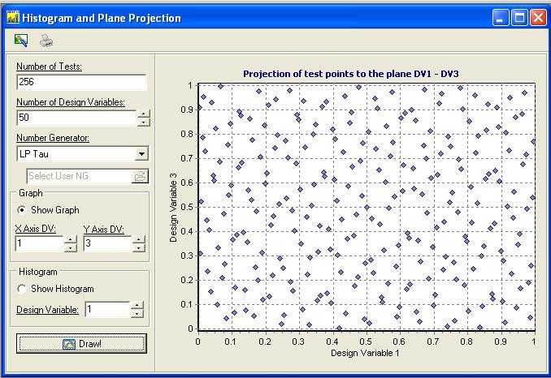
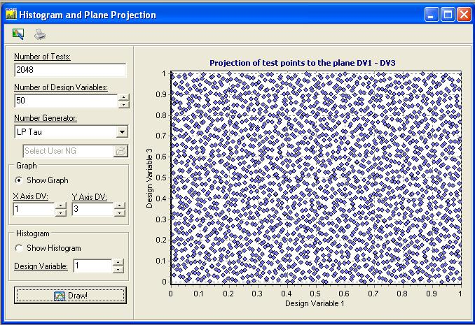
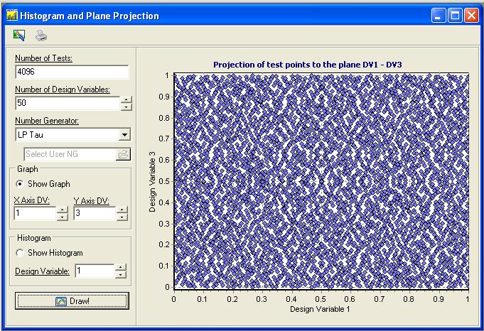
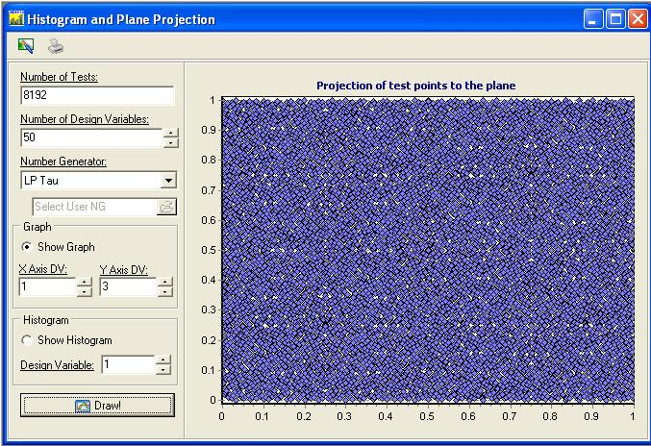
Projections of the 50-Dimensional Points (LP Sequences) onto the Plane of Two Design Variables
8096
N=256 points
N=2048
N=4096
N=8192

Slide 9
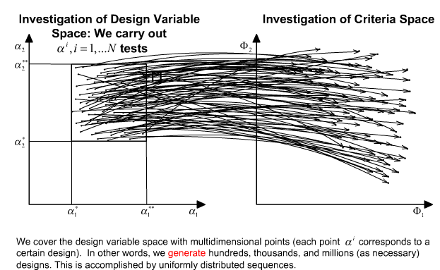
GENERATION OF DESIGNS USING UNIFORMLY DISTRIBUTED SEQUENCES
N’ tests
N’<=N

Slide 10
Functional Constraints
We have two kinds of functional constraints: rigid and “soft”. Usually “soft” functional constraints can be changed, if these revisions lead to the improvement of criteria values. Next we show how to define “soft” constraints.
In case of unjustifiably strong constraints on functional dependences, many solutions can become unfeasible, i.e. do not satisfy criteria constraints. For this reason the feasible solution set can be poor or even empty. Therefore it is very important to help the expert determine the “soft” functional constraints correctly.

Slide 11
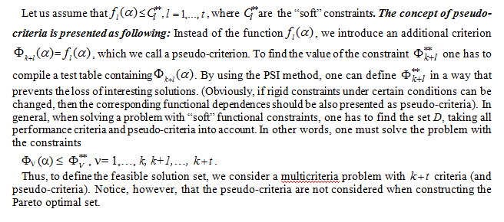
“Soft” Functional Constraints and Pseudo-Criteria

Slide 12
Real-Life Problems and Application of Optimization Methods
There are many methods of searching for optimal solutions. It is tacitly assumed that by using these methods, the Expert can state a real-life optimization problem correctly. Unfortunately, this is not the case in reality. Existing optimization methods are not helpful in this situation so that the Expert end up solving ill-posed problems.
For the correct statement and solution of engineering optimization problems,
a method called Parameter Space Investigation (PSI method) has been
created and widely integrated into various fields of industry, science, and
technology. PSI method is unique.

Slide 13
Example of Statement and Solution of Multicriteria Vibratory System Using PSI Method and MOVI Software.
Typical Difficulties for an Expert

Slide 14
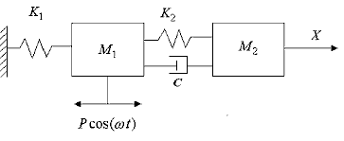
Example: Multicriteria Analysis of
Vibratory System (1/5)
The system consists of two bodies with masses М₁ and М₂:
The behavior of the system is described by:
5 design variables
4 (antagonistic) performance criteria
5 functional constraints (that depended on design variables):
  3 rigid functional constraints
  2 non-rigid functional constraints that are presented as pseudo-criteria

Slide 15
Example: Multicriteria Analysis of Vibratory System (2/5)
From expert's perspective, the values of design variable constraints can be changed, if that leads to the improving the main criteria

Slide 16
Functional Constraints
Example: Multicriteria Analysis of Vibratory System (3/5)
RIGID
CONSTRAINTS
NON-RIGID
CONSTRAINTD
There are three functional dependencies with five constraints (on the total mass and on the partial frequencies). Usually the expert can also revise the functional constraints in order to improve the main criteria.

Slide 17
Performance criteria and pseudo-criteria
In order to define “soft” constraints on functional relations f₂ and f₃, the latter should be interpreted as the pseudo-criteria, i.e. Φ₁= f₂ and Φ₂= f₃.
Example: Multicriteria Analysis of Vibratory System (4/5)
Since the criteria are antagonistic, the expert experiences difficulties in defining the criteria constraints

Slide 18
A Note From the Expert…
Example: Multicriteria Analysis
of Vibratory System (5/5)
Given that criteria are antagonistic, it was impossible to formulate a priori criteria constraints correctly.
From expert's perspective, the values of design variable and functions constraints
can be changed, if that leads to the improving the main criteria. Numerous experiences
have shown that the expert is often ready to change constraints, receiving information on
sufficient improvement of values of main criteria. Such information an expert receives on the
basis of PSI method.

Slide 19
PSI method is implemented in the MOVI (Multicriteria Optimization and Vector Identification) software
Live Demonstration of
MOVI System

Slide 20
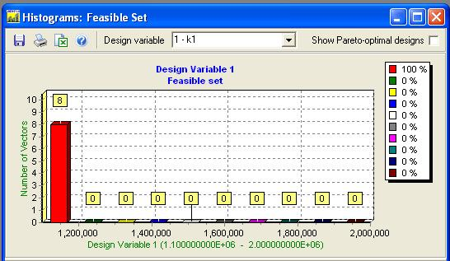
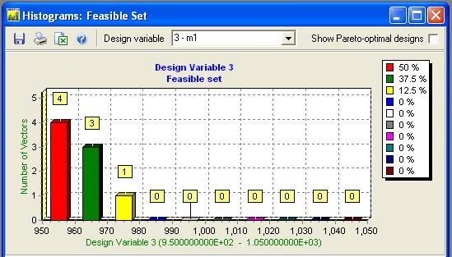
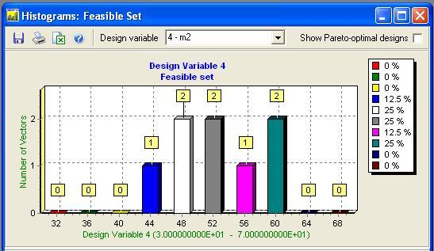
Visualization Tools: Histograms of the distribution of feasible solutions.
1st design variable
3rd design variable
From the histograms of 1st, 3rd, and 4th design variables it follows, that we can formulate new boundaries for these design variables. Thus we formulate problem Oscillator 1.
4th design variable

Slide 21
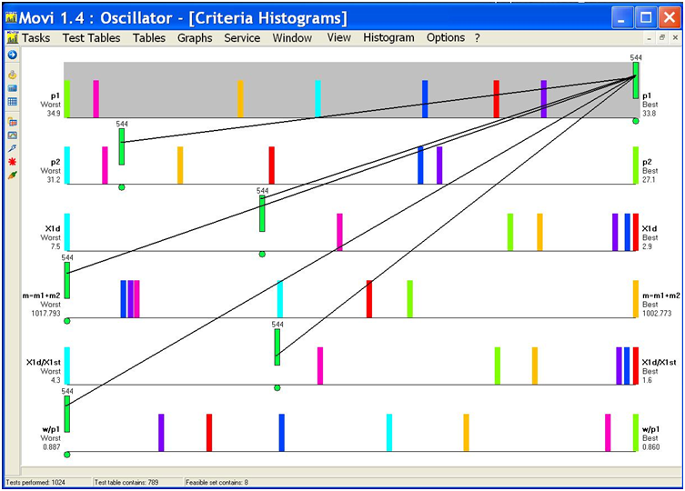
Criteria Histograms. Visualization of Contradictory Criteria

Slide 22
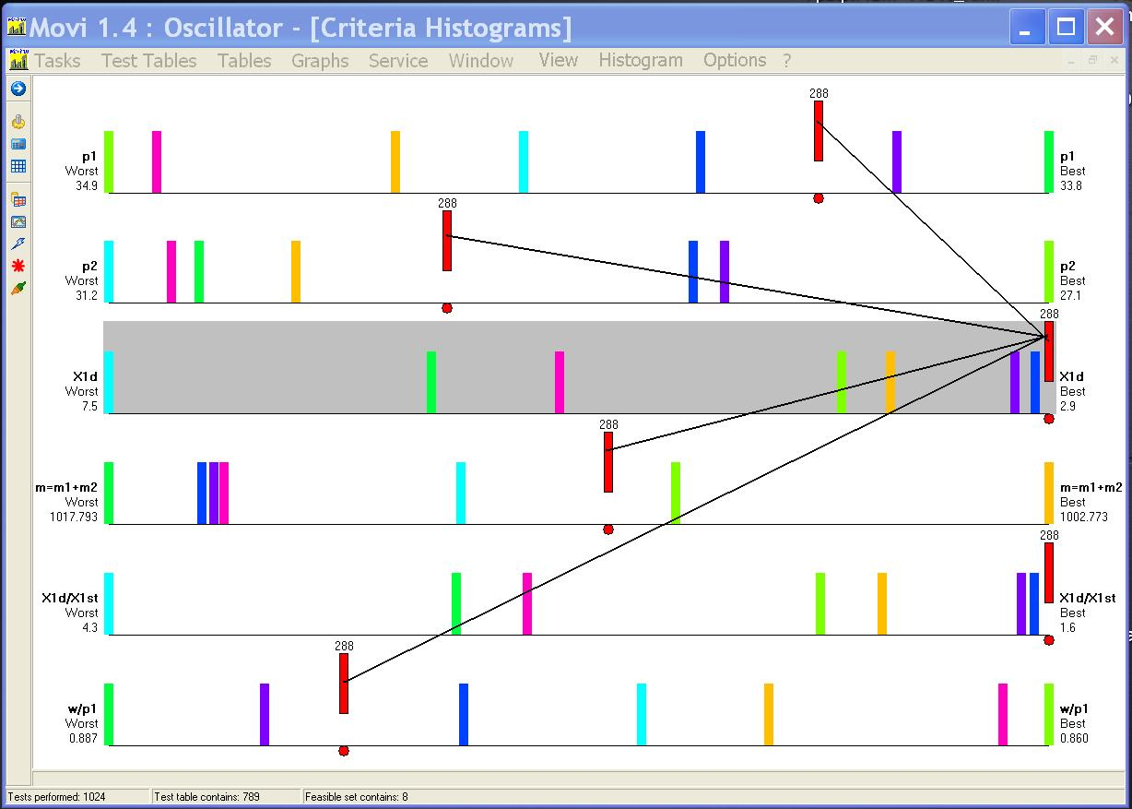
Criteria Histograms. Visualization of Contradictory Criteria

Slide 23
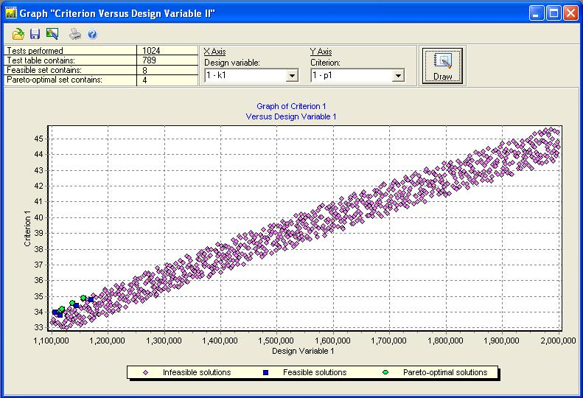
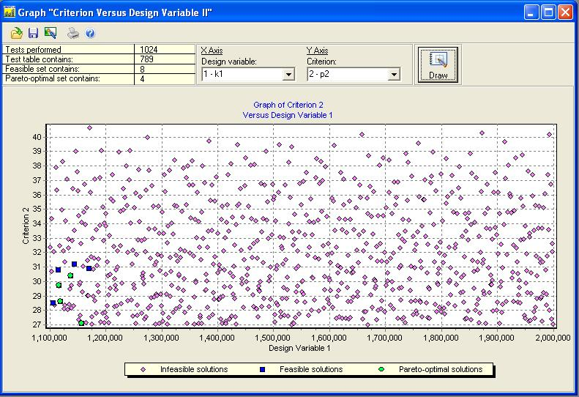
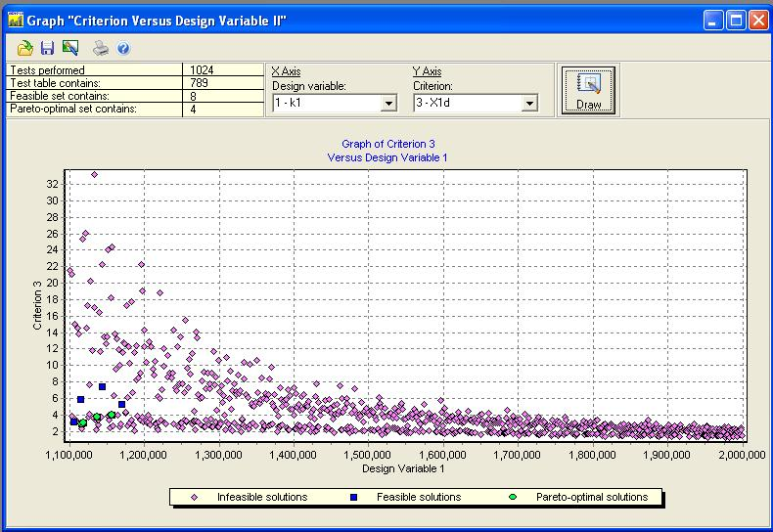
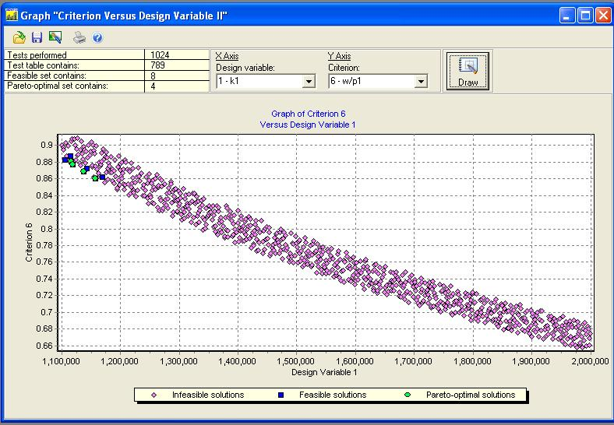
Graphs “Criterion vs Design Variable II”
Dependency Φ₁=F(α₁)
Dependency Φ₂=F(α₁)
Criteria Φ₁ and Φ₆ are antagonistic with respect to α₁ and strongly depend on that parameter
Dependency Φ₃=F(α₁)
Dependency Φ₆=F(α₁)

Slide 24
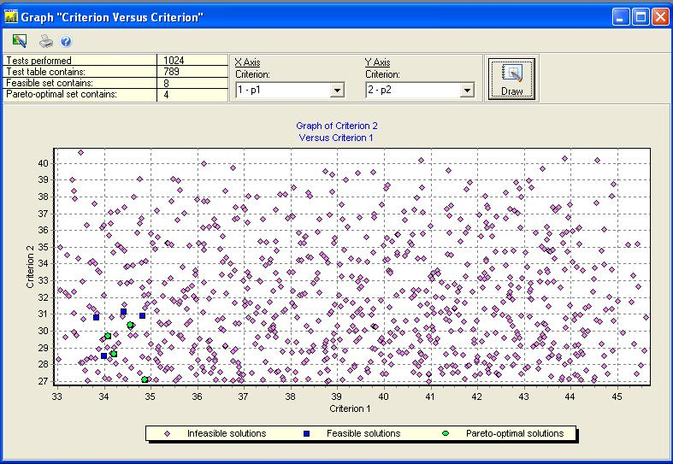
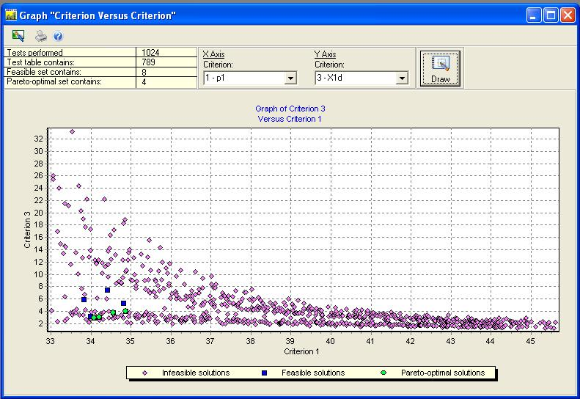
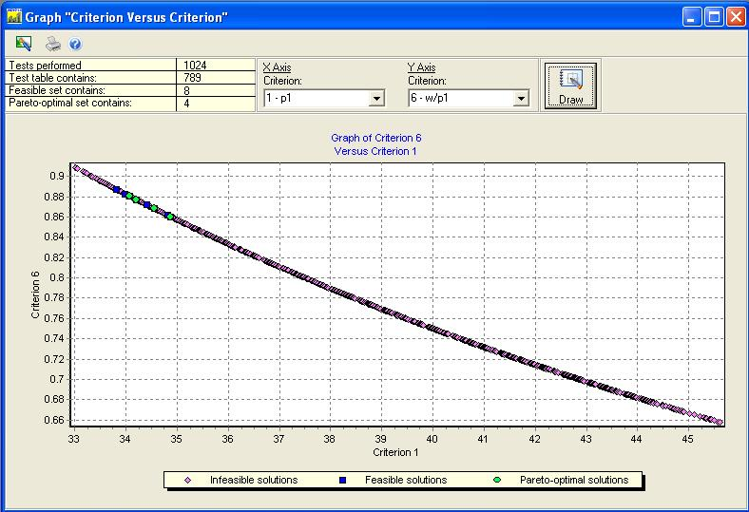
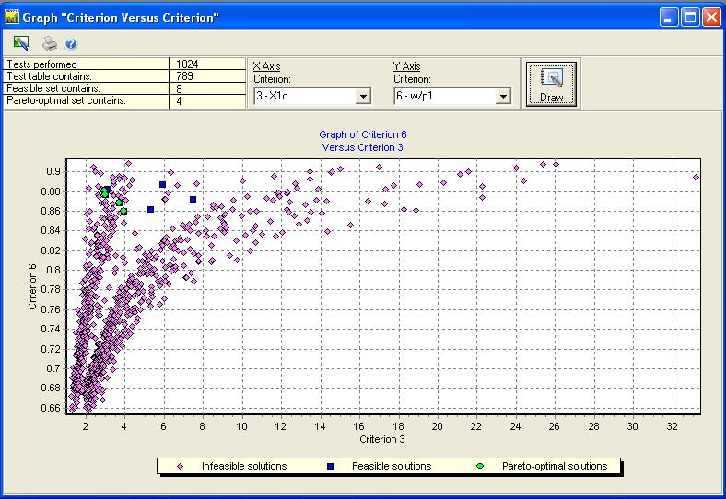
Graphs “Criterion vs Criterion”
Dependency Φ₂ =F(Φ₁)
Dependency Φ₃ =F(Φ₁)
Dependency
is not obvious
Dependency Φ₆ =F(Φ₁)
Non-linear
dependency
Dependency Φ₆ =F(Φ₃)
Strong linear dependency

Slide 25
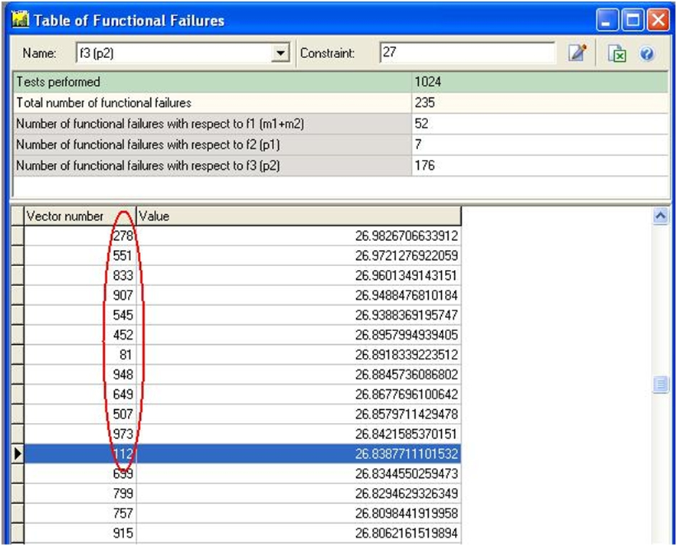
Table of Functional Failures (1/2)
Table of functional failures for the third functional constraint (fragment)

Slide 26
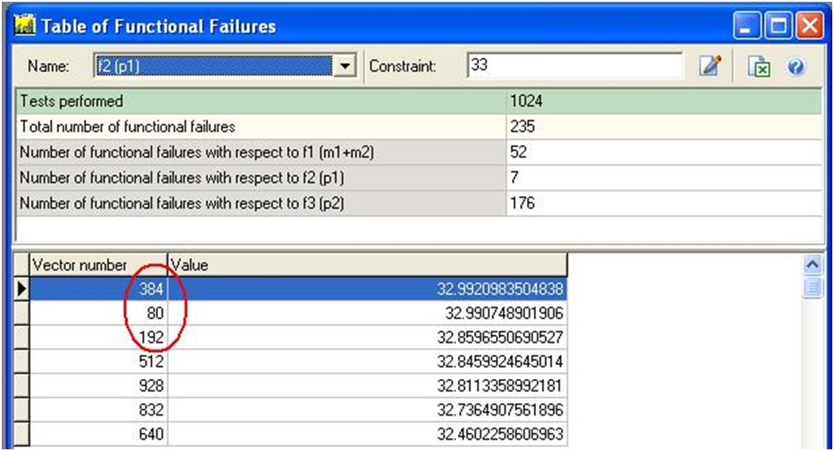
Table of Functional Failures (2/2)

Slide 27
Refining Initial Design Variable Constraints. New Problem

Slide 28
Initial and New Ranges of Change
New ranges of change
(1st design variable)
FSS (Feasible Solution Set)
Initial ranges of change (1st design variable)
FSS
Initial ranges of change (2nd design variable)
New ranges of change
(3rd design variable)
FSS
Initial range of change (3rd design variable)
FSS
Initial ranges of change (4th design variable)
New ranges of change
(4th design variable)
FSS
Initial ranges of change (5th design variable)

Slide 29
New Problems And Construction Of The Combined Pareto Optimal Set
Live Demonstration Of
MOVI System
(Continued)

Slide 30
Scope of the PSI Method
The PSI method successfully is applied to solve the following multicriteria problems:
design,
design of controlled systems,
identification,
operational development of prototypes,
large-scale systems,
finite element models,
forecasting from observational data.

Slide 31
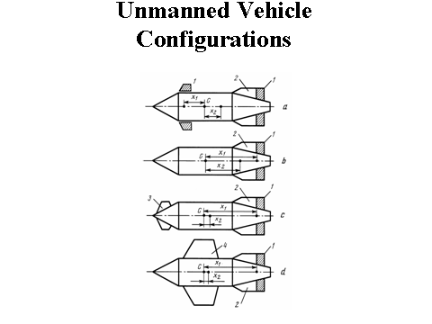
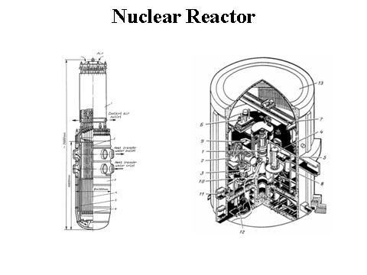
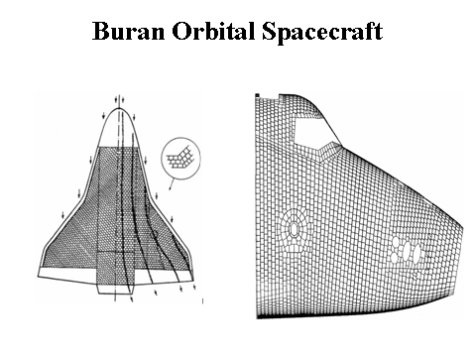
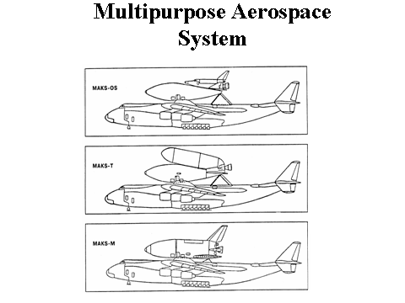
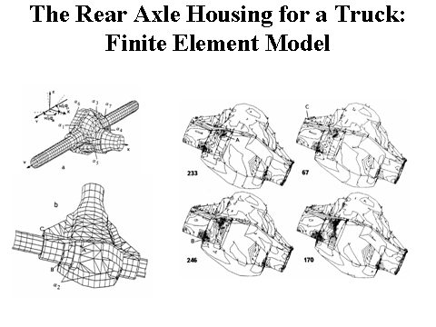
PSI Method is Widely Integrated into Various Fields of Industry, Science, and Technology
Some applications:
Naval Ship Design.
Multistage Axial Flow Compressor for an Aircraft Engine.
Controllable Descending System
Metal Cutting Machine Tools and Their Units.
Operational Development of a Vehicle.
Automobiles' Active Safety etc.
NASA.

Slide 32
Example 1. Multicriteria Analysis in Naval Ship Design: Improving a Ship Prototype
The ship prototype is described by 45 design variables and
the following 6 criteria:
1. CRITERION (MIN) PROPULSION POWER FACTOR (%)
2. CRITERION (MIN) ELECTRICAL POWER FACTOR (%)
3. CRITERION (MAX) VOLUME FACTOR (%)
4. CRITERION (MAX) AREA FACTOR (%)
5. CRITERION (MAX) WEIGHT FACTOR
6. CRITERION (MIN) COST

Slide 33
Solution Process
Notes:
18-19. First parallelepiped corresponded to initial statement of a problem.
After first and second experiments we could not improve the prototype. 18, 17.
Only in the third parallelepiped the area of interesting solutions has been discovered. Three interesting solutions were defined. For example, the project 108455 surpasses the prototype by five criteria.
In the area of these three solutions the fourth parallelepiped has been constructed. Its volume was considerably less then third parallelepiped volume. 20. As a results, a lot of feasible and Pareto optimal solutions (respectively 2161 and 208) were found in the 4th experiment. 21 solutions surpassing the prototype by all six criteria are found in the forth experiment, for example project 238194. Thus we can consider the problem of improving the prototype has been solved.
In the sixth experiment criteria constraints have been significantly strengthened.

Slide 34
Solution Process
Improvement of the prototype is obvious

Slide 35
Main Results
In the 4th experiment: 21 solutions surpassed the prototype by all (!!!) criteria
Notes:
To summarize, I’ll show now the main results of our work.

Slide 36
Multicriteria Analysis:
Distributions of feasible solutions for the 1st design variable in six experiments
The “gaps” in the initial range
of change, and “gaps” in the
2nd and 3rd experiments
are circled
Initial statement
2nd experiment
3rd experiment
4th experiment
Good distribution of feasible
solutions is observed in the
4th, 5th, and 6th experiments
5th experiment
6th experiment

Slide 37
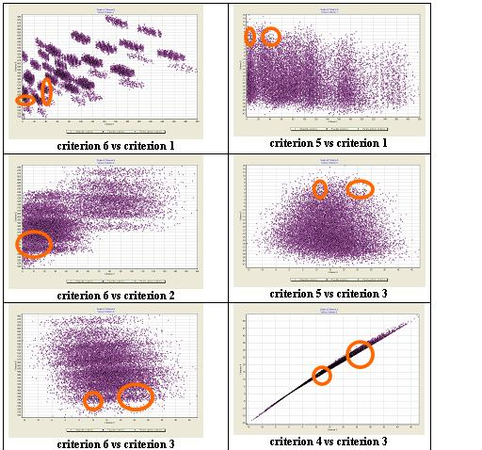
Multicriteria Analysis with MOVI 1.3:
Dependencies between criteria.
Location of Pareto solutions in criteria space (3rd optimization experiment)
We carried out
200,000 trails.
Number of Pareto
solutions = 3
Notes:
Next important tool. Graphs of dependencies between criteria. Earlier I told about three Pareto optimal solutions. Now you can see area of location these solutions.

Slide 38
Criterion 1 (Minimized) vs. Criterion 6 (Minimized) – 3rd Optimization
Each point has
number of dimension
equal to 6 in criteria
space and 45 in
design variable space.
The scale is increased
Notes:
I briefly show another dependencies between criteria and their details.

Slide 39
Multicriteria Analysis with MOVI:
Dependencies between criteria (4th optimization experiment)
.
We carried out
200,000 trails
Number of feasible solutions = 2,161;
Number of Pareto solutions = 208
Blue and green points are feasible and Pareto optimal solutions respectively
Notes:
I earlier noted that in the forth parallelepiped we have obtained more than 2,000 FS. Very interesting images of distributing these solutions.

Slide 40
Using PSI Method and MOVI Software to Improve Preliminary Ship Design Prototype. Example 2

Slide 41
Problem Statement (1/2)

Slide 42
Problem Statement (2/2)

Slide 43
Dependency Between Criteria:
Initial Statement
Feasible solutions ND=238; Pareto optimal solutions NP=3.
An expert has preferred a vector # 75527.

Slide 44
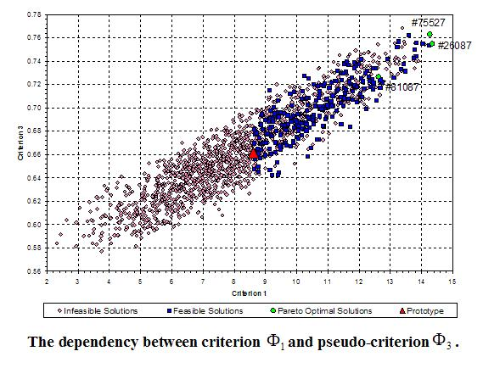
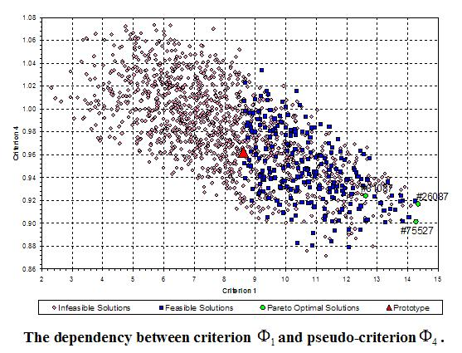
Dependency Between Criteria:
Initial Statement
Seakeeping Rank vs. Waterplane Area Coefficient forward of amidships
Seakeeping Rank vs. Waterplane Area Coefficient aft of amidships

Slide 45
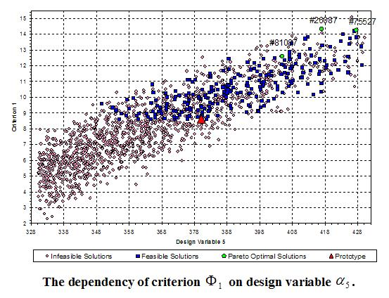
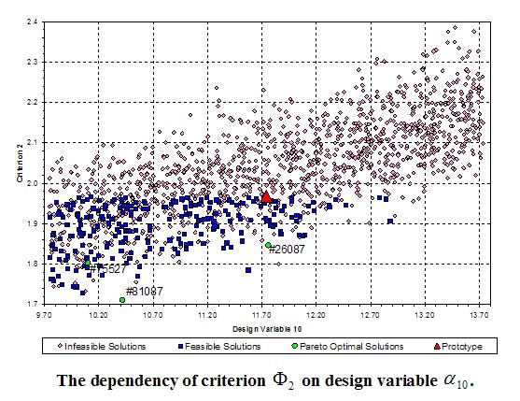
Dependency of Criteria On Design Variables: Initial Statement
Seakeeping Rank vs. Waterplane area forward of amidships
Residuary Resistance Coefficient vs. Projected Transom Area

Slide 46
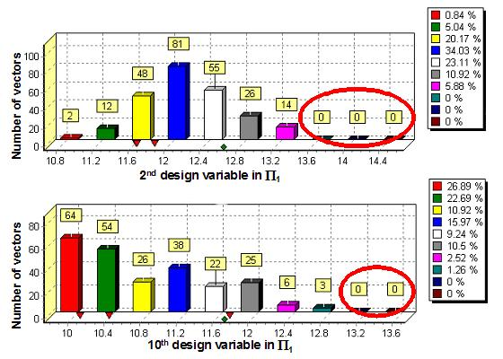
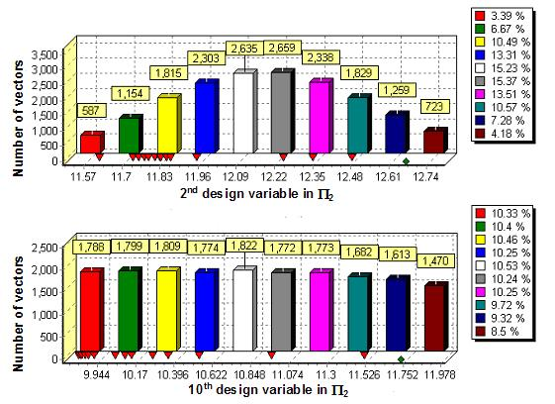
Histograms of the Distribution of Feasible and Pareto Optimal Solutions
a)
b)
Histograms for the 2nd and 10th design variables: a) corresponds to initial
parallelepiped Π₁ and b) corresponds to parallelepiped Π₂. The “gaps” of the initial
range for the 2nd and 10th design variables are circled. Similar distributions with
“gaps” are observed for the 5th, 6th, and 9th design variables.

Slide 47
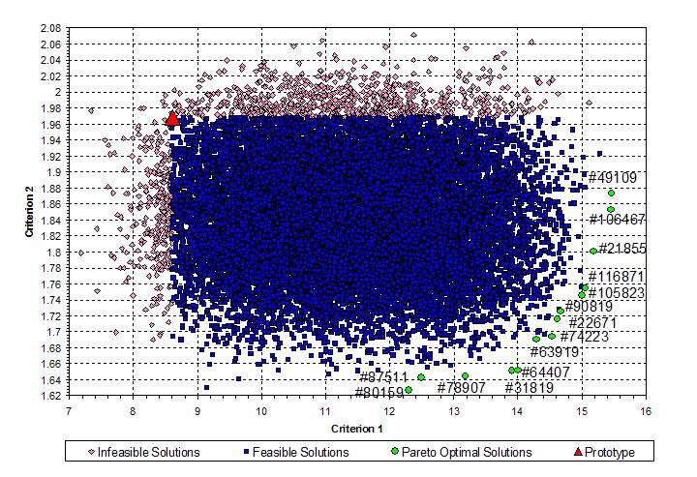
Dependency Between Criteria:
Second Statement
Feasible solutions ND=17,302; Pareto optimal solutions NP=14.
An expert gave the preference to the vector # 74223. This vector surpassed all solutions in the initial statement by two criteria simultaneously.

Slide 48
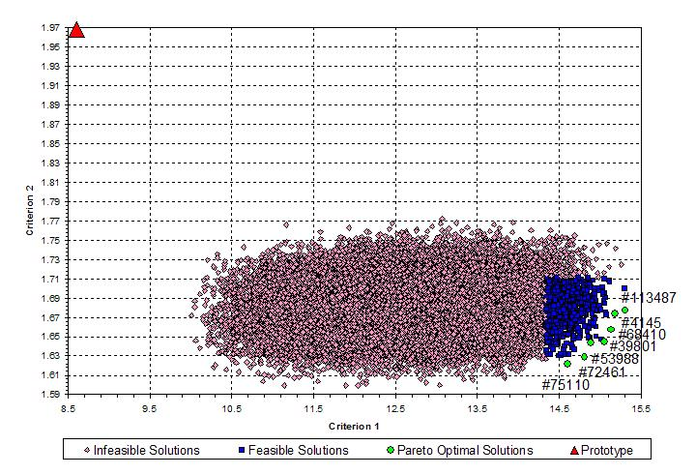
Dependency Between Criteria:
Final Statement
Feasible solutions ND=847; Pareto optimal solutions NP=7.
Finally, an expert defined the most preferable solution # 113487
from the third statement.

Slide 49
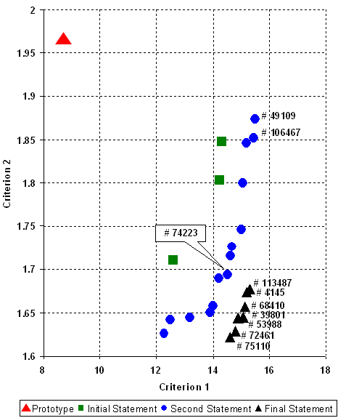
Pareto Optimal Solutions in the Three Statements and the Combined
Pareto Optimal Solutions
The most preferable
solution is the vector
# 113487
Pay attention to the change of expert's
understanding about the most preferable
solutions in the process of multicriteria
analysis.

Slide 50
Example 3. The Rear Axle Housing for a Truck: Finite Element Model (1/4)
The performance criteria to be optimized involve: total mass of the structure; maximum deflection in the structure; maximum equivalent stresses in the structure, change in the angular positions of the half-axles with respect to the final drive axis, etc. Dimension of the criteria vector
equals to 17.

Slide 51
The Rear Axle Housing for a Truck (2/4)

Slide 52
Results of Multicriteria Analysis (3/4)
The feasible set comprised 22 designs, of which 14 were Pareto optimal designs: 21, 43, 62, 67, 79, 110, 113, 158, 174, 181, 229, 233, 246, and 254.
Most preferable
Design 233
After analyzing the results obtained the expert preferred design 233.
Compared with the prototype, the design was improved in all criteria; in particular, the mass was reduced by 5 kg and the maximum deflection, by 15%. Note that optimal design 233 is the best for none of the particular criteria.

Slide 53
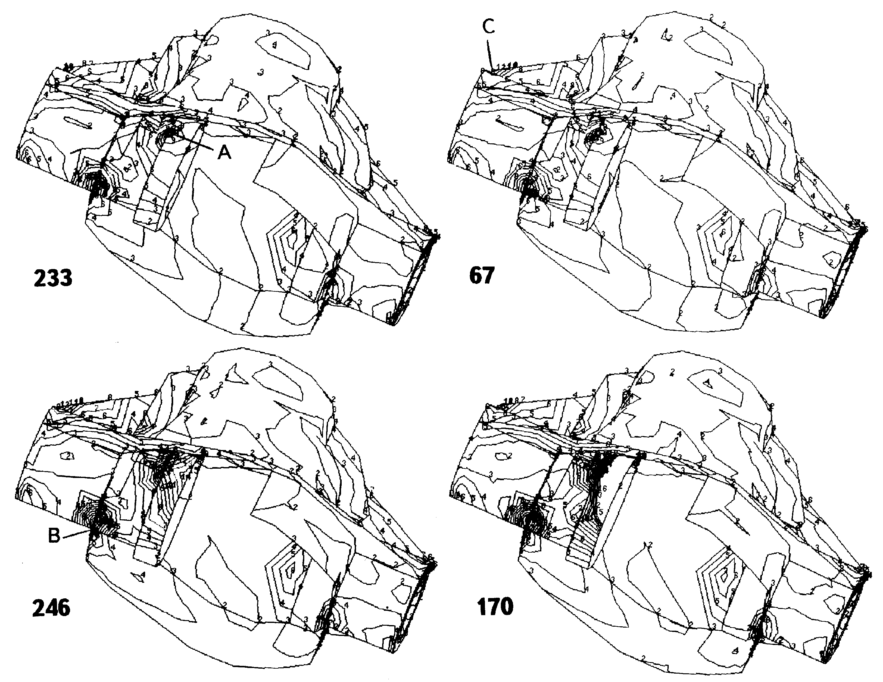
Visualization of the Action of Stresses at the Most Dangerous Places of the Housing (4/4)
Most preferable design
Unfeasible design

Slide 54

Multicriteria Optimization of Orthotropic Bridges (1/2)
Suez Canal Bridge in Egypt
This work was carried out by Dr. Eng. Mohamed Eltantawy Elmadawy and Dr. Eng. Mohamed Ahmed El Zareef (Mansoura University, Faculty of Engineering, Structural Engineering Dept., Egypt).

Slide 55
Multicriteria Optimization of Orthotropic Bridges (2/2)
Conclusion
The previous study concludes that there is a possibility to make an efficient
combination between the PSI method and the finite element program. The
efficiency of the new technique is proved through its application to the orthotropic
closed deck of the Suez Canal Bridge in Egypt. The optimal solution
#196 shows a reduction of 7.2% in weight in comparison with the existing
deck, while the deflection is reduced by 1.87%.

Slide 56
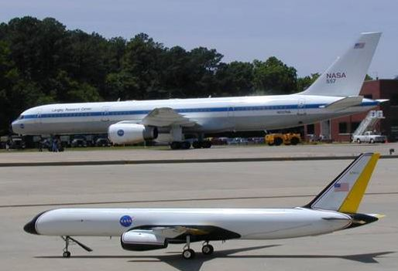
Multicriteria Analysis of L1 Adaptive Flight Control System, NASA
Work presents results of the application of the Parameter Space Investigation method for the design of the L₁ flight control system implemented on the two turbine-powered dynamically-scaled GTM AirSTAR aircraft.
Enric Xargay, Naira Hovakimyan, University of Illinois at Urbana-Champaign, Urbana, Vladimir Dobrokhodov. Roman B. Statnikov,
Isaac Kaminer, Naval Postgraduate School, Monterey, Chengyu Caok University of Connecticut, Storrs, Irene M. Gregory NASA Langley Research Center, Hampton

Slide 57
Main Conclusions
  Correct determination of constraints is a major challenge in real-life optimization problems.
  The most promising solution approach involves two stages. First, the feasible solution set is constructed and analyzed. Analysis of the feasible solution set shows the “work” of all constraints and the cost of making concessions in various constraints. Only then one can apply popular optimization methods, including stochastic, genetic and other algorithms

Slide 58
Thank you for your attention!
Questions? Comments?
Please email me: rstatnik@yahoo.com

Slide 59
Backup

Slide 60
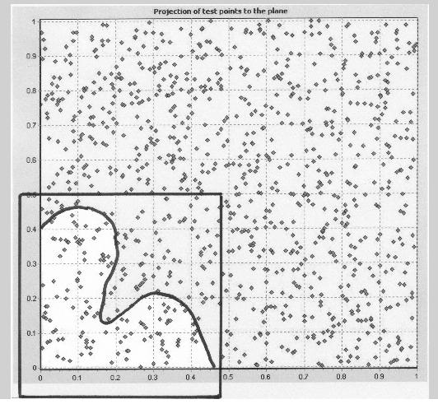
Elements of Multicriteria Analysis.
Investigation of Design Variable Space (1/4)
П
Initial design variable constraints,
parallelepiped П
П₁
We noticed that feasible solution set is located in
the border of initial parallelepiped П.
We decide to consider a new parallelepiped П₁
which can result in a larger feasible solution set.
Feasible solution set

Slide 61
Elements of Multicriteria Analysis.
Investigation of Design Variable Space (2/4)
Construction of the new regions for the search of optimal solutions – П₁ and П₂
П₂
П
П
П₁

Slide 62
Elements of Multicriteria Analysis.
Investigation of Criteria Space (3/4)
Most Pareto optimal solutions are located in this region
Φ₁ vs. Φ₂
Φ₁ vs. Φ₃
Φ₁ vs. Φ₄

Slide 63
Elements of Multicriteria Analysis.
Investigation of Criteria Space (2/2)
Most Pareto optimal solutions are located in these regions
Φ₃ vs. Φ₂
Φ₄ vs. Φ₂
Φ₄ vs. Φ₃

Slide 64
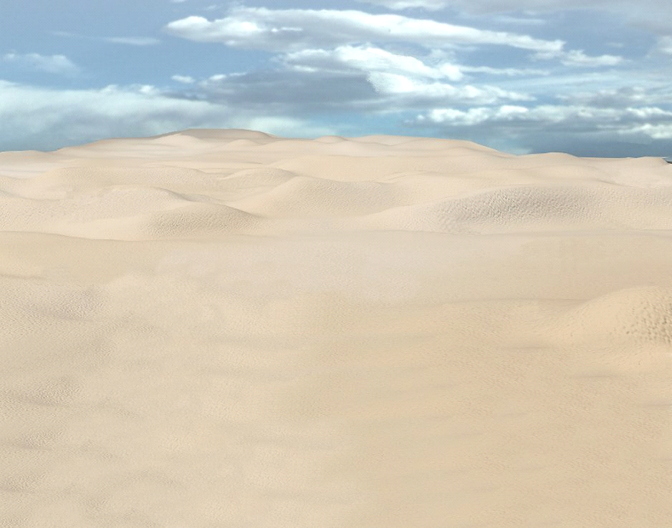
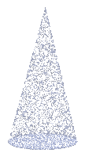

25th Combat Aviation Brigade
25th Combat Aviation Brigade
A MODEL of the FLGHT against TERRORISM
ScanEagle
Wave Relay
NAI
NAI
Radio
Ground Station
Three Steps for Decision-Making :
1. Obtaining Observation Data
2. Construction of mathematical model on the basis of neural networks
3. Multicriteria analysis using PSI method
Radio
Ground Station
LZ

Slide 65
Adequacy of Mathematical Models
In the most common usage, the term “identification” means construction of the mathematical model of a system and determination of the parameters (design variables) of the model by using the information about the system response to known external disturbances. In a sense, identification problems are inverse with respect to optimization problems.
When solving optimization problems, we have used the concept of performance criteria. In identification problems we will deal with particular adequacy (proximity) criteria. By adequacy (proximity) criteria we mean the discrepancies between the experimental and computed data, the latter being determined on the basis of the mathematical model.

Slide 66
PSI Method in Multicriteria Identification Problems

Slide 67
The Search for the Identified Solutions

Slide 68
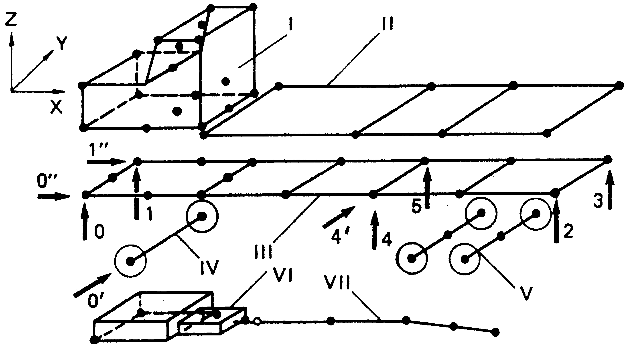
Operational Development of a Vehicle.
Location of the characteristic points on an automobile at which the experimental values are measured
Arrangement of the vibration exciters. I⎯cab, II⎯body, III⎯frame, IV⎯front axle,
V⎯rear axle, VI⎯engine, and VII⎯transmission.

Slide 69
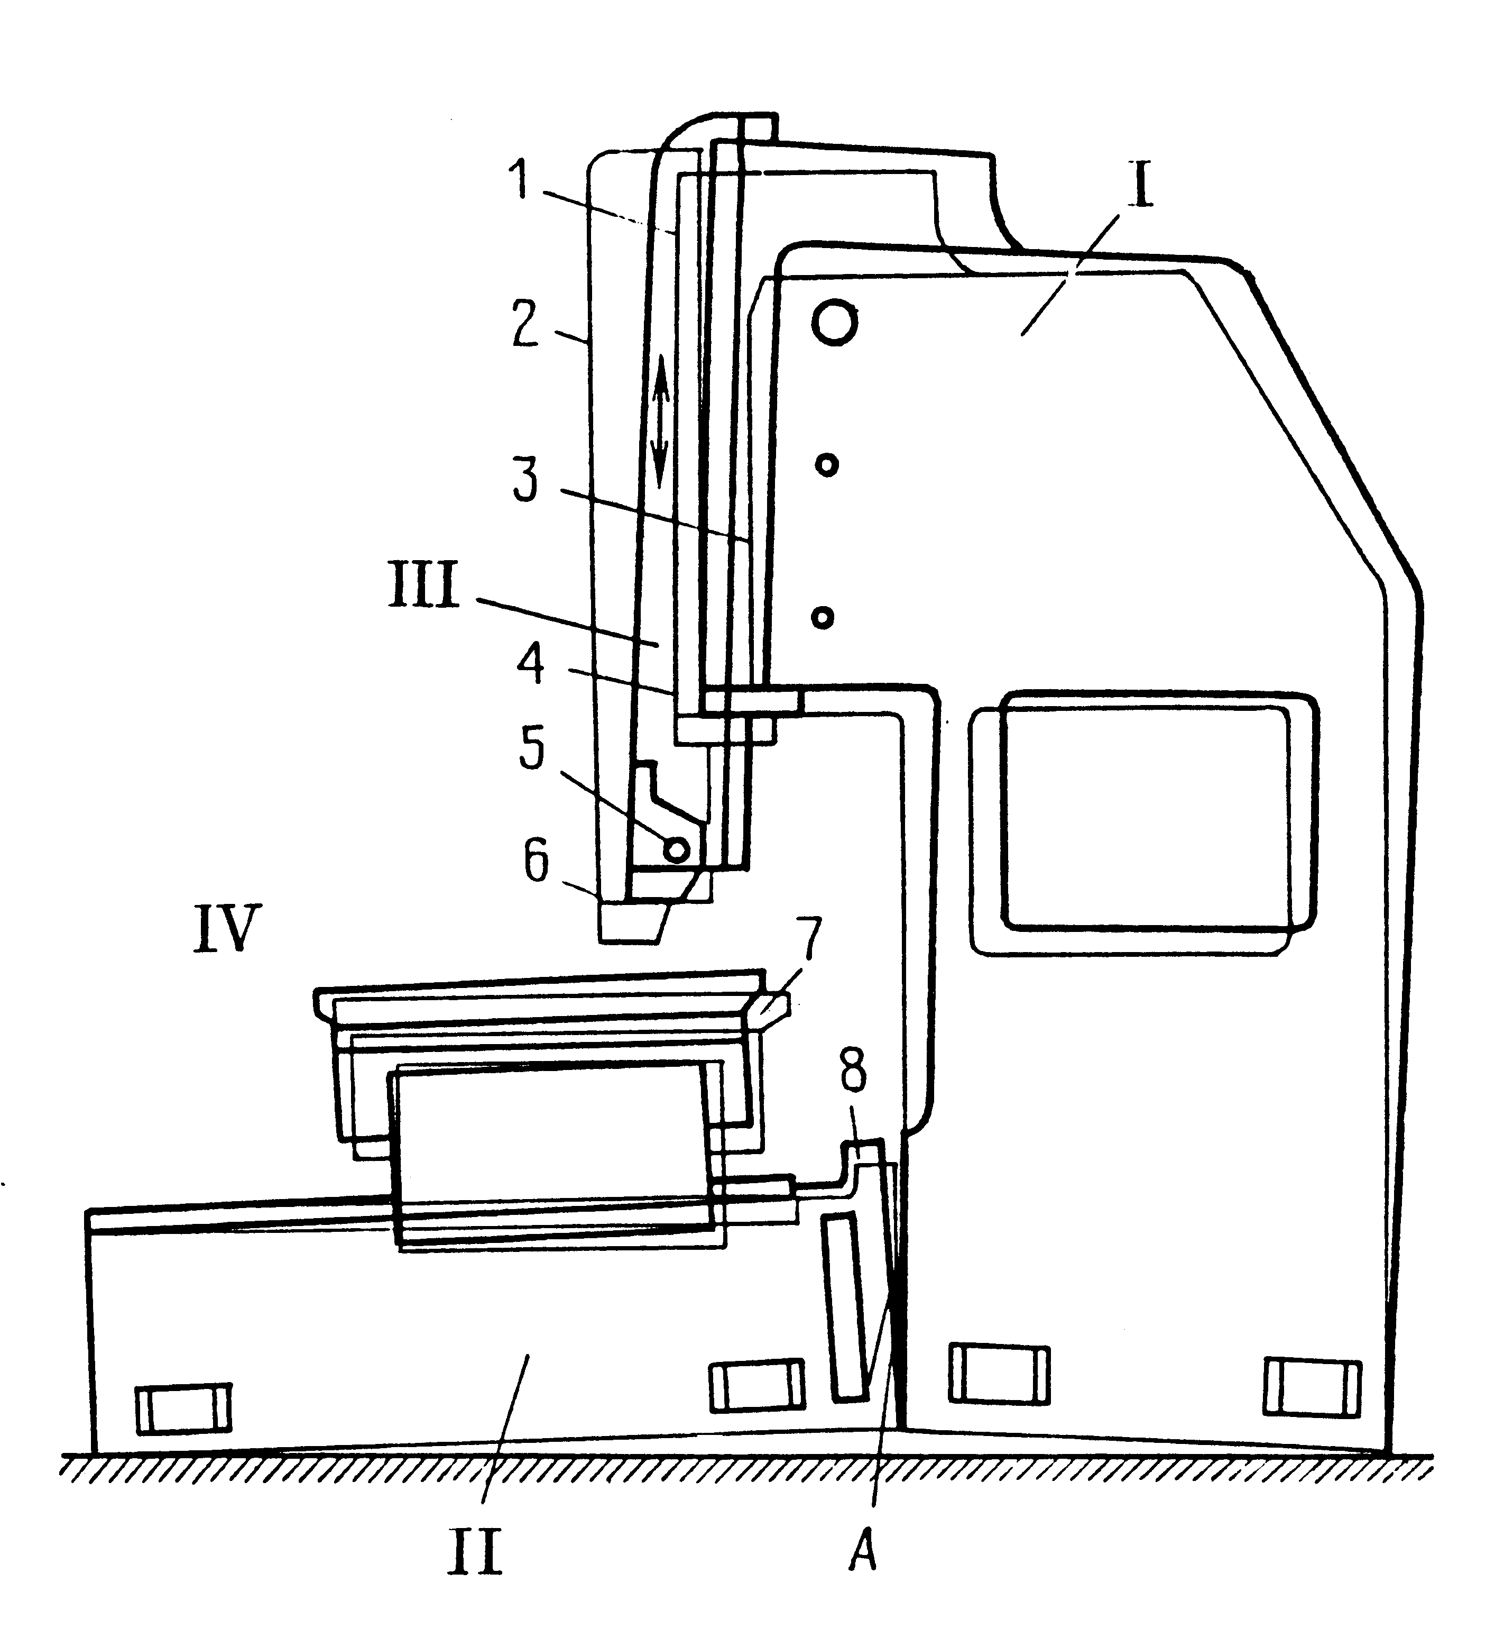
Multicriteria Identification of the Parameters of a Slotter
The layout of transducers on the machine tool. The 'opening’ of joint A

Slide 70
Multi-Objective Identification of a Controllable Descending System
System of axes and definition of aerodynamic terms

Slide 71
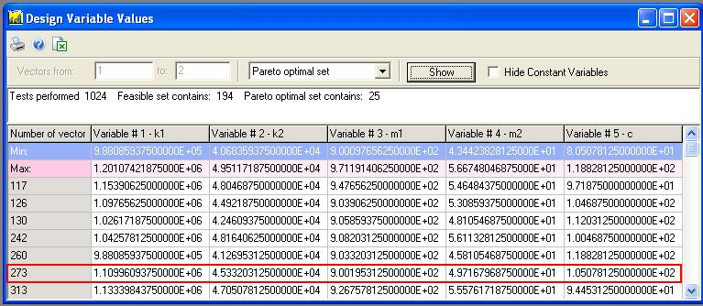
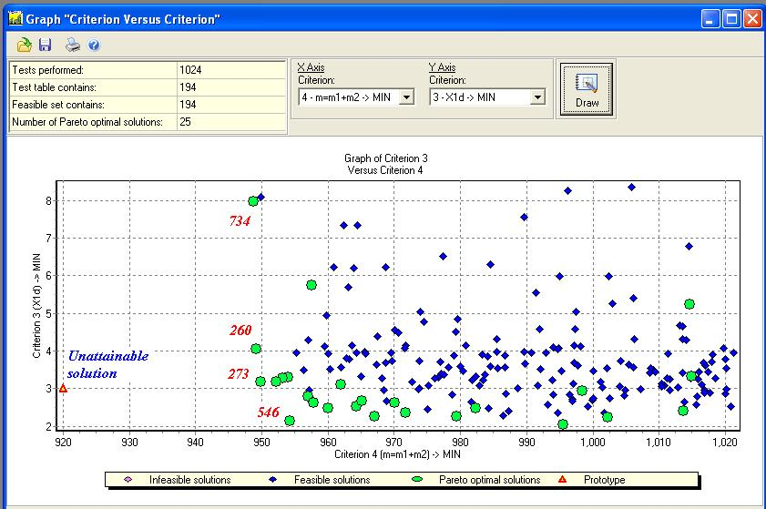
SEARCH FOR THE COMPROMISE SOLUTION WHEN THE DESIRED SOLUTION IS UNATTAINABLE
(34; 29; 3.0; 920; 1.5; 0.86)
Compromise solution is vector # 273

Slide 72
Multicriteria Analysis from Observational Data (1/2)
For this class of problems, there are no a priori specified mathematical models. However, there are available observations in the form of tables that give an indication of the behavior of the system under investigation. These problems are often encountered in medicine, biology, economics, materials science, information science, and other fields. An approximate mathematical model is constructed on the basis of the observations and multicriteria analysis.

Slide 73
Multicriteria Analysis from Observational Data (2/2)
Step 1. Obtaining observational data and constructing an approximate model
Step 2. Multicriteria analysis: construction of a pseudo-feasible solution set and the search for the best solutions

Slide 74
Systematic Search in Multidimensional
Domains by Using Uniformly Distributed Sequences
Consider r design variables α_{j} with the following boundaries of variation:
j = 1, …, r
Generate N r-dimensional points using LP sequences:
i = 1, …, N
Example of LP sequences for N=16, 32, 64 and 128 points

Slide 75
The PSI method is Implemented in the MOVI (Multicriteria Optimization and Vector Identification) Software System
Windows graphics user interface application.
Does not impose limitations on the number of parameters and criteria.
Can be run on several computers in a distributed mode.
Can be easily interfaced with mathematical models programmed in C/C++, Delphi, and Matlab.
Has many users world-wide.

Slide 76
References

Slide 77
Basic Single-Criterion Approaches (1/2)
B. Optimization of the Most Important Criterion
In this approach we should answer the question:
What is «the most important criterion»?

Slide 78
Basic Single-Criterion Approaches (2/2)
Using these approaches it is difficult (or sometimes impossible) to answer correctly the questions mentioned previously. As a rule, these approaches fail to provide acceptable results.
However, even if we manage to answer those questions, the most important question, namely, how to construct the feasible solution set D (i.e., to define design variable, functional, and criteria constraints), would remain without answer.
Therefore there are no guarantees that we will be searching for the optimal solutions in the “right place”.

Slide 79
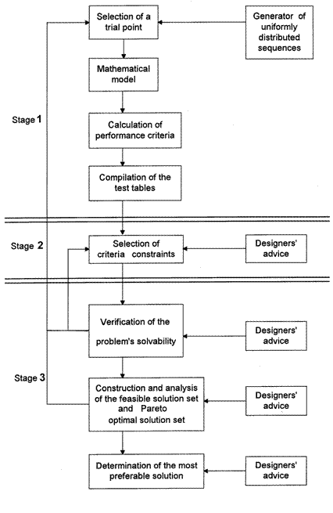
Flow Chart Of The Algorithm (Interactive Mode)

