Slide 1
AN INTEGRATED THEORY OF CREATIVITY AND INNOVATION
FIRST STEPS
HSE spring conference
Peter Schmidt
(University of Giessen and Higher School of Economics(HSE))

Slide 2
Table of Content
Introduction and Relevance
Some Tools: Theory construction and SEM
State of the Art and Selected Theories:
3.0 Routinization of Innovation Research
3.1. Aizen and Fishbein`s Reasoned Action Approachas an extended rational choice approach
3.2. Schwartz extended Value Theory
3.3. Sternberg`s investment theory of creativity
3.4. Social Capital
3.5. Social-Structural Approach
4. Komparsin and conclusions

Slide 3
1 .Introduction and Relevance
The explanation of creativity and innovation is increasingly important for all post – industrial societies as they seek to become more and more knowledge based.
Psychology has largely focused on the measurement and explanation of creatvity, while sociology, political science, economcis and geography have dealt more with innovation adoption and diffusion.
In this paper we try to develop an integrated multilevel process model that combines these approaches.

Slide 4
Research Questions
Which Theories could be best used for the prediction of innovation and creativity?
How to integrate(synthesize) the best suited theories to predict creative behavior, entrepreneurial intention and the start of a new business?

Slide 5
SEM and Philosophy of Science
Lakatos-Kuhn-Scheme:
metaphysical Assumptions
Propositions of Core Theory
Correspondence Rules

Slide 6
Some Tools
Comparison of Concepts(Constructs)
Comparison of Theoretical Propositions(Core Theory)
Comparison of Operationalization (Measurement Theory)
Comparison of underlying Mechanisms

Slide 7
Structural Model and Measurement Model
What are the causal relationships among the theoretical (latent) variables and those between latent and observed variables(items)?
How strong are these relationships?
How strong is the stochastic error (d3) and the measurement error(e1,e2,d1,d2)?
d3
e1
x1
A
B
y1
d1
e2
x2
y2
d2

Slide 8
Moderation
Full or partial mediation
Soical mechanismus as mediation (Opp 2010, Hedström 2010)

Slide 9
State of the Art and Selected Theories:
3.0 Routinization of Innovation Research

Slide 10
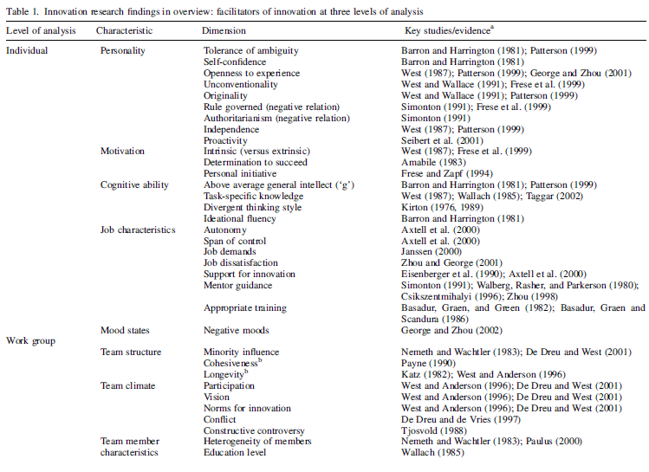
Anderson et. al. (2004) The routinization of innovation research: a constructively critical review of the state-of-the-science p. 150 -152

Slide 11
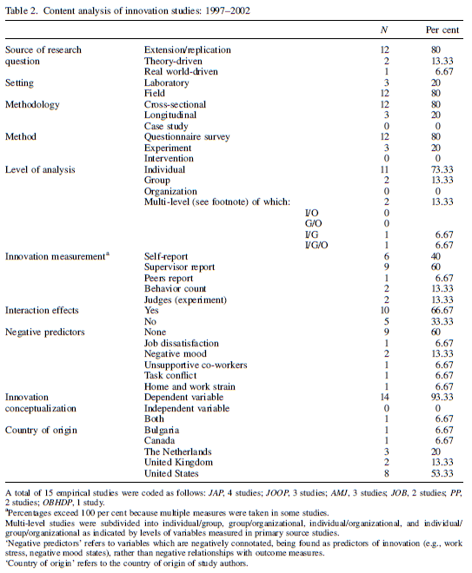
Anderson et. al. (2004) The routinization of innovation research: a constructively critical review of the state-of-the-science p. 156

Slide 12
FIVE PATHWAYS (Anderson et al. 2004)
INNOVATION AS AN INDEPENDENT VARIABLE
CROSS-NATIONAL GENERALIZABILITY AND CULTURAL DIFFERENCES
MULTI-LEVEL THEORIES AND DESIGNS
USE OF METAANALYSIS
TRIANGULATION OF RESEARCH METHODS

Slide 13
Theoretical background
As De Dreu et al (2011,p.298) argue creativity and innovation are often used interchangeably but to do so misses some important nuances. Therefore we introduce explicitly the following two definitions for creativity and innovations which they propose based on the following works (Amabile, 1996, Runco, 2004, West and Farr, 1990):

Slide 14
Theoretical background
D 1 Creativity can be defined as the generation of ideas, problem solutions, or insights that are novel and appropriate.
D 2 Innovation can be defined as the intentional introduction and application within a role , group or organization of ideas, processes, products or procedures, new to the relevant unit of adoption , designed to significantly benefit the individual, the group, the organization or wider society.

Slide 15
State of the Art and Selected Theories:
3.1. Aizen and Fishbein`s Reasoned Action Approachas an extended rational choice approach

Slide 16
Schematic presentation of the reasoned action model as a latent variable model (Fishbein/Aizen 2011,p. 22)
Instrumental Attitudes toward the behavior
Latent and observed Background factors
Individual:
Personality
Mood,emotion
values stereotypes
General attitudes
Perceived risk
Past behavior
Social:
Education
Age, gender
Income
Religion
Race, ethnicity
Culture
Information:
Knowledge
Media
Intervention
Behavioral beliefs
Experential Attitudes toward the behavior
Descriptive norm
Normative beliefs
Intention
Behavior
Injunctive norm
Control beliefs
Perceived behavioral control Capacity
Actual control:
Skills/abilities Environmental factors
Perceived behavioral control Autonomy

Slide 17
Application of TOPB to Entrepreneurship
Brand, M. J., Van Praag, M., Ombach, M., Bodewes, W., & Van Gelderen, M. (2004). Some advances in the explanation of entrepreneurial intentions. Advances in Interdisciplinary European Entrepreneurship Research, 3, 27- 44.
Engle, R. L., Dimitriadi, N., Gavidia, J. V., Schlaegel, C., Delanoe, S., Alvarado, I., et al. (2010). Entrepreneurial intent: A twelve-country evaluation of Ajzen's model of planned behavior. International Journal of Entrepreneurial Behaviour & Research, 16(1), 35-57.

Slide 18
Application of TOPB to Entrepreneurship
Purpose Design/methodology/approach: Ajzen's model was operationalized to address entrepreneurial intent and a questionnaire was developed consisting of previously used scales, as well as a new measure of entrepreneurial autonomy. A total of 1,748 usable questionnaires were collected from university business students in 12 countries. Findings: The results suggest that Ajzen's model of planned behavior, as operationalized in this study, does successfully predict entrepreneurial intent in each of the study countries, although as foreseen by Ajzen, the significant contributing model elements differ by country as does the percent of the variance explained by the model, although one model element, social norms, was a significant predictor of entrepreneurial intent in each country. Originality/value: This is the first paper to provide insight to the role of cognition in the entrepreneurial process by examining a model of planned behavior in countries representing all global regio nal culture clusters. The paper also provides guidance for future entrepreneurial research and individual development of entrepreneurs.

Slide 19
Application of TOPB to Entrepreneurship
Kolvereid, L. (1996). Prediction of employment status choice intentions. Entrepreneurship Theory and Practice, 21, 47-57.
Liñán, F., & Chen, Y.-W. (2009). Development and Cross-Cultural Application of a Specific Instrument to Measure Entrepreneurial Intentions. Entrepreneurship Theory and Practice, 33(3), 593-617.
Shook, C., & Bratianu, C. (2010). Entrepreneurial intent in a transitional economy: an application of the theory of planned behavior to Romanian students. International Entrepreneurship and Management Journal, 6, 231-247.
Shook, C., & Bratianu, C. (2010). Entrepreneurial intent in a transitional economy: an application of the theory of planned behavior to Romanian students. International Entrepreneurship and Management Journal, 6, 231-247.

Slide 20
Steinmetz et. al. (2012)

Slide 21
Steinmetz et. al. (2012)

Slide 22
TOPB Application : Explanation of Entrepreneurial Intention and Behavior
Attitude toward the behavior
Subjective norms
Explanation of Entrepreneurial Intention
Behavior
Perceived behavioral control

Slide 23
TOPB Application: Extended Model of Entrepreneurial Intention and Behavior
Instrumental Attitudes toward the behavior
Experential Attitudes toward the behavior
Commitment
Descriptive norm
Intention
Behavior
Injunctive norm
Implementation Intention
Perceived behavioral control Capacity
Perceived behavioral control Autonomy

Slide 24
State of the Art and Selected Theories:
3.2. Schwartz extended Value Theory

Slide 25
Schwartz et. al. (in press) Refining the theory of basic individual values
Schwartz et al. propose a refined theory of basic individual values intended to provide greater heuristic and explanatory power than the original theory of 10 values (Schwartz, 1992).
The refined theory more accurately expresses the central assumption of the original theory that research has largely ignored: Values form a circular motivational continuum.
The theory defines and orders 19 values on the continuum based on their compatible and conflicting motivations, expression of self-protection vs. growth, and personal vs. social focus.
Schwartz et al.(in press) assess the theory with a new instrument in 15 samples from 10 countries (N=6059). CFA and MDS analyses support discrimination of the 19 values, confirming the refined theory.

Slide 26
How many values
The proposed theoretical partitioning of the value circle into 19 values goes against the principle of parsimony.
However, the refined theory does not require that researchers use all 19 values. Asking whether we need 19 values when we already have 10 is like asking whether Schwartz et al. need millimeters when Schwartz et al. already have centimeters.
The answer is yes, for some purposes.
The theory gives researchers the option of working with as large or as small a set of values as is appropriate to their purpose.
They may choose to work with all 19 values or combine values and work with the original 10, the four higher-order values, or even two subsets (e.g., growth vs. protection values).
If only one part of the value circle interests a researcher, she may gain from the greater conceptual detail and clarity that the refined theory provides by discriminating more fine-tuned values in that part of the circle.

Slide 27
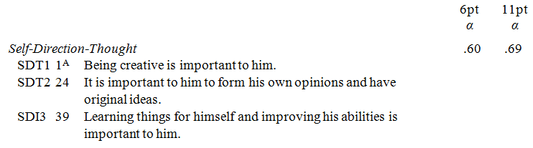
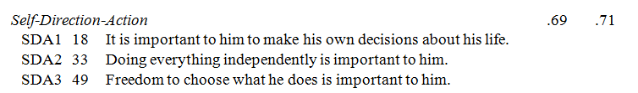
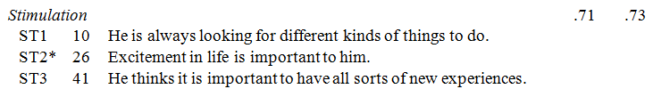
Item Wording PVQ5X Value Survey male Version

Slide 28
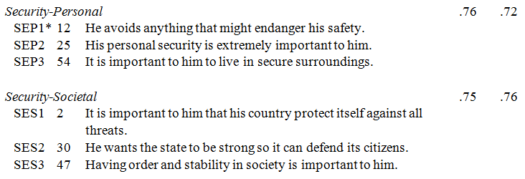
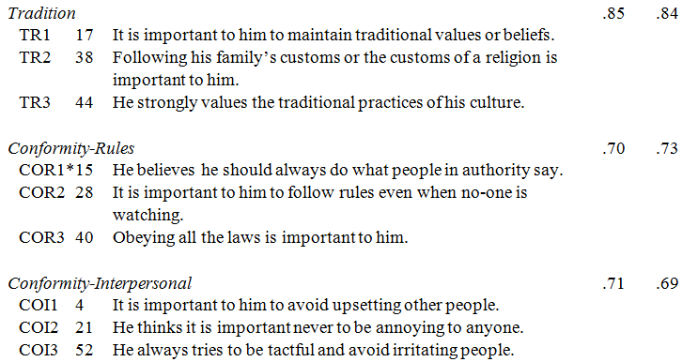

Slide 29
Value | Conceptual Definition^{A} | Definition Components
Self-Direction | Independent thought and action—choosing, creating, exploring | Autonomy of thought Autonomy of action
Stimulation | Excitement, novelty, and challenge in life | Excitement Novelty Challenge
Security | Safety, harmony and stability of society, of relationships, and of self | Societal security Personal security
Conformity | Restraint of actions, inclinations, and impulses likely to upset or harm others and violate social expectations or norms | Interpersonal: Avoiding upsetting others Compliance with social norms
Tradition | Respect, commitment and acceptance of the customs and ideas that traditional culture or religion provide | Single component: Maintaining cultural and religious traditions

Slide 30
Value | Conceptual Definitions in terms of Motivational Goals
Self-Direction—Thought | Freedom to cultivate one’s own ideas and abilities
Self-Direction—Action | Freedom to determine one’s own actions
Stimulation | Excitement, novelty, and change
Hedonism | Pleasure and sensuous gratification
Achievement | Success according to social standards
Power—Dominance | Power through exercising control over people
Power—Resources | Power through control of material and social resources
Face | Security and power through maintaining one’s public image and avoiding humiliation
Security—Personal | Safety in one’s immediate environment
Security—Societal | Safety and stability in the wider society
Tradition | Maintaining and preserving cultural, family or religious traditions
Conformity—Rules | Compliance with rules, laws, and formal obligations
Conformity—Interpersonal | Avoidance of upsetting or harming other people
Humility | Recognizing one’s insignificance in the larger scheme of things
Benevolence—Dependability | Being a reliable and trustworthy member of the ingroup
Benevolence—Caring | Devotion to the welfare of ingroup members
Universalism—Concern | Commitment to equality, justice and protection for all people
Universalism—Nature | Preservation of the natural environment
Universalism—Tolerance | Acceptance and understanding of those who are different from oneself

Slide 31
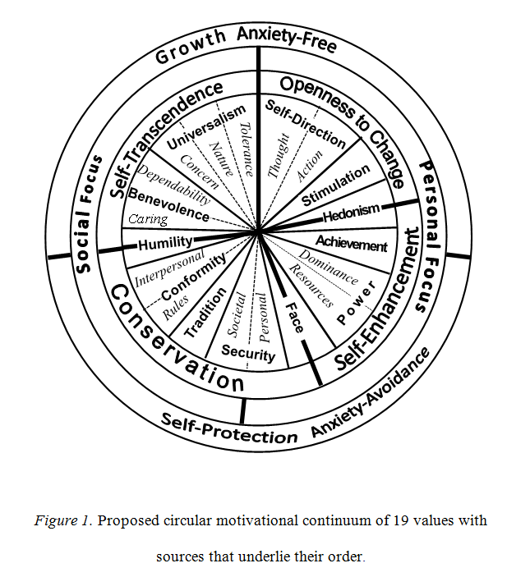

Slide 32
PVQR Extended measurement model
Value 1
Value 19
…….. ……… ……..
Item1
item2
…….. ……… ……..
item56
item57
Methodsfactor

Slide 33
Values and Innovation: Original Model
Self Direction
.
.
.
.
.
.
..
.
.
.
+
Stimulation
+
Conformity
-
Innovation and creativity
-
Tradition
-
Security

Slide 34
Refined Values and Creativity and Innovation
Which of the 19 values have an effect on creativity and innovation and how strong is it?
According to theory: Autonomy of Thought,Autonomy of Action(Self Direction); Excitement, Novelty and Challenge (Stimulation); Interpersonal Conformity, Compliance with Social Norms and Tradition (Conformity) and Tradition.
Differential predictions for the different subdimensions?

Slide 35
Values and Innovation/creativity : Extended Model
Autonomy of Thought
Interpersonal Conformity
+
-
Autonomy of Action
, Compliance with Social Norm
+
-
Excitement
+
Tradition
-
Creativity
Novelty and Challenge
+
-
Personal Security
.
.
.
.
.
.
..
.
.
.
-
Social Security
Innovation

Slide 36
State of the Art and Selected Theories:
3.3. Sternberg`s investment theory of creativity

Slide 37
Investment Theory (Sternberg 2012)
Creativity
abilities
knowledge
styles of thinking
personality
motivation
environment
analytical
contextual ability
peference for thinking
thinking in new ways
self efficacy
tolerance for ambiguity
organizational
societal culture
practical
risk-taking
intrinsic motivation

Slide 38
State of the Art and Selected Theories:
3.4. Social Capital

Slide 39
OBJECTIVE SOCIAL CAPITAL - Theorems of LIN (2001, p. 75- 76)
LIN formulated seven propositions derived from his theory
The advantages over other social capital approaches are summarized by Haueberer(2011,p.127) in five points as follows
Lin offers a formalized social capital concept
He conceptualizes social capital as a relational or structural asset
As the strength of strong tie and strength of weak tie propositions claim, social capital is produced in both open and closed structures
Neglected negative concepts of social capital are not conceptualized
No discussion of the potential of social capital to decrease inequality.
As a general condition he states that his concept is only valid in a hierarchically structured society.

Slide 40
Diagram of Lin`s Social Capital Model (Lin 2001a,p.21,
Haeuberer p.126)
Instrumental Returns (wealt, power etc.)
Collective assets
Accessibility of Ressources
Mobilization of Ressources
Structural and Positional Embeddedness
Expressive Returns (Life Satisfaction)
Inequality
Capitalization
effects

Slide 41
Dual pathway to creativity model as a latent variabel model C. DeDreu et. al. 2011 p.301
Many and broad mental categories
Cognitive Flexibility
Loose, and global processing style
Many ideas, Insights, solutions
Inclusiveness
Flat associative hierarchies
Motivation
Trait x State
Creative Fluency and Originality
Working Memory Capacity
Analytical probing of possibilities
Cognitive persistence
Uncommo, novel
Effourful search in Assoc, Memory
Perseverance
Focus on narrow set of categories

Slide 42
State of the Art and Selected Theories:
3.5. Social-Structural Approach

Slide 43
Social location and value priorities. A European-wide comparison of the relation between social-structural variables and human values.
Bart Meuleman, Eldad Davidov, Peter Schmidt & Jaak Billiet 2012
In this contribution, we focus on one of these aspects of value theory that has remained relatively underexposed, namely the relation between individual social location and human values.
Does one’s position in the social structure—indicated by socio-demographic variables such as age, gender, education and income—affect the values that one prioritizes?
We pay special attention to the cross-cultural robustness of the relation between social location and values: Can similar patterns be detected in various European countries?
Or do cross-national differences in the relation between structure and values depend on elements of the national context?

Slide 44
 | SEC | CO | TR | ST | SD
Gender (Femal vs. Mal) | 0 | 0 | 0 | - | -
Age | + | + | + | - | -
Income | - | - | - | + | +
Education | - | - | - | + | +

Slide 45

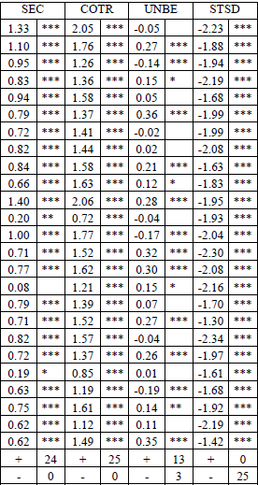

Slide 46

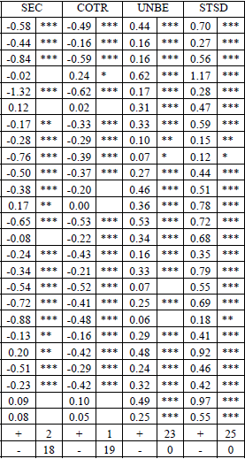

Slide 47
demographic factors and values: conservation values
Schwartz et al. begin with the three conservation values, conformity, security, and tradition.
The importance of these broad values is likely to increase as people grow older because they tend to become more embedded in social networks and more committed to habitual patterns (Glen, 1974).
In the earlier Italian study, conformity values correlated .21 with age.
Schwartz et al. would expect conformity to rules, laws, and formal obligations to be more important for upholding the established institutions to which people become committed than avoiding upsetting others is.
In line with this reasoning, in the current study, conformity-rules correlates with age significantly more positively than conformity-interpersonal does (r = .26 vs. .12, t = 2.24, p<.05).
In the earlier study, security correlated .25 with age, as expected.
Both subtypes of security are likely to become more important as people age.
Comparison of the correlations for the subtypes of security in the current study reveals, however, that societal security correlates more strongly with age than personal security does (r = .25 vs. .09, t = 2.67, p<.01).
Why might concern with security in the wider society be more closely linked to age than concern with security in one’s immediate environment?
Perhaps because people become more embedded in the institutions of society and aware of their dependence upon them as they grow older.
The refined theory splits the former broad tradition value into tradition and humility values.
The broad tradition value correlated .25 with age in the earlier study. Findings of the current study suggest that this correlation largely reflects the greater concern of older people for maintaining and preserving cultural, family, or religious traditions.
Here, the narrower tradition value correlates substantially more strongly with age than the humility value does (r=.26 vs. .02, t = 3.55, p<.01). Indeed, humbly accepting one’s circumstances is virtually unrelated to age.
All comparisons are for dependent correlations and significance levels are two-tailed unless noted.

Slide 48
The broad self-direction value correlated .19 with education in the earlier study.
Education likely enhances the ability and motivation to think and act independently, which, in turn, induces people to seek higher levels of education.
The thought and action subtypes of self-direction may not contribute equally to this association, however, especially in a relatively well-educated sample like ours (84% with 13 or more years of education).
The desire to cultivate one’s own ideas and abilities is more likely to motivate pursuit of higher education and to be enhanced by it than the desire to determine one’s own actions.
Consistent with this reasoning, self-direction-thought correlated more highly with education than self-direction-action in the current sample (r = .22 vs. .12, t = 1.65, p<.05, 1-tailed).

Slide 49
Self-Direction-Thought and Self-Direction-Action.
These two values differ in their emphases on freedom to cultivate one’s ideas and abilities vs. freedom to act as one wishes. In choosing a job, the opportunities for taking initiatives are likely to appeal to both types of self-direction and both are less likely to care about a high income.
Schwartz et al. would expect those motivated to cultivate their own ideas care more about opportunities for initiative and less about income, however, than those motivated to act as they please.
self-direction-thought predict an emphasis on initiative more than self-direction-action does.
The correlation difference for the importance of a high income in a job favors self-direction-action.
Self-Direction-Action and Stimulation.
Typically, people adapt their values to their life circumstances (Schwartz, 2006).
Various factors likely to affect stimulation more than self-direction suggest that stimulation values should relate more negatively to age.
Stimulation values emphasize the pursuit of pleasant excitement, novelty, and change. Physical aging leads to a gradual decline in strength, energy, and sharpness of the senses that make novelty and risk more threatening.
As people move through life stages, exciting experimentation and adventures becomes less acceptable, exposure to novel challenges decreases, and social roles increasingly constrain opportunities for striking out in new directions and raise the costs of doing so.
stimulation values correlate more negatively with age than self-direction-action values do, as expected. Stimulation values also correlate more positively with reporting that one’s daily life is filled with interesting things .

Slide 50
4. Komparsin and conclusions

Slide 51
 | Explicit propositions | Measurement Model | Time | level of unit | emp.evidence | cross-cultural test | mixed methods
Reasoned Action | given | fully given | static | individual | much evidence | some | some
Schwartz Values | part. given | fully given | static | individual, group, org. nation | much evidence | some | some for measurement model
Sternberg | part. given | part. given | static | individual, group, org. nation | partial evidence | unclear | some
Social Capital | given | given | static | individual, group, org. nation | partial evidence | some | no
DPCM Model | given | part. given | static | individual | measurment model less for the structural model | no | no
Socio-Demographic | part. given | fully given | static | individual, group, org. nation | experimental evidence | some | no
Generalized V x E | given | not. given | static | individual | No | no | no

Slide 52
Integrated Theorie for survey 2012
Instrumental Attitudes toward the behavior
Latent and observed Background factors
Individual:
11 values( Schwarz)
General attitudes
Perceived risk
Past behavior
Intrinsic motivation
Social:
Education
Age, gender
Income
Religion
Race, ethnicity
Culture
Occupation resp. Occupation parents
Education parents
Information:
Intervention
Experential Attitudes toward the behavior
Descriptive norm
Intention
Behavior
Injunctive norm
Perceived behavioral control Capacity
Actual control:
Skills/abilities (Sternberg,DCPM)
Objeciv social Capital (Nan, Lin)
Perceived behavioral control Autonomy

Slide 53
Thank you for your Attention!

