Slide 1
Reinterpreting the Public Space: Creativity in the City
Anna Zhelnina
National Research University – Higher School of Economics in St. Petersburg
Research Group “Creative City”

Slide 2
Bottom-up transformation of urban space by the means of art
New actors – new visions of comfortable urban spaces
Graffiti, guerilla gardening, do-it-yourself modifications: from “pure resistance and contestation” to “public place beautification” [Visconti et al. 2010]
Role of the social and political context of transformation
Dynamic, networked character of initiatives

Slide 3
Research Group “Creative City”
Mapping initiatives in St Petersburg
Studying the professional biographies and networks of activists
What are the different ways to (creatively) claim the right to the city?
Creativity as a resource of counter-public(s)?

Slide 4
Analytical frameworks
Right to the city (Lefebvre, Harvey)
City within a city, politicization (Kurt Iveson)
Counter-publics (Nancy Fraser)
Networked creativity
‘insurgent’, ‘do-it-yourself’ (DIY), ‘guerrilla’, ‘everyday’, ‘participatory’ and/or ‘grassroots’ urbanism (Iveson 2009)

Slide 5
The right to the city is, therefore, far more than a right of individual access to the resources that the city embodies: it is a right to change ourselves by changing the city more after our heart’s desire [Harvey 2003: 931].

Slide 6
“there are holes and chasms. These voids are not there due to chance. They are the places of the possible.” [Lefebvre, 1996: 156].
Cities as totalizing projects, but not totalizations [Amin, Thrift]

Slide 7
Urban Creativity
actions emerging between the cracks of formal urbanism [Iveson 2013: 943]
‘propose alternative lifestyles, reinvent our daily lives, and reoccupy urban space with new uses’ [Zardini 2008: 16]

Slide 8
Filling the urban gaps with creativity
Street-artists (ad-busters)
Public art festival
“Urban activists” aiming to change the environment [e.g. DIY urban festival]
Educational loft focusing on urban issues

Slide 9
“building a politics to connect the practices is a matter of both appropriation and political subjectivization, in which practitioners make themselves parties to a disagreement over the forms of authority that produce urban space” [Iveson 2013: 943]

Slide 10
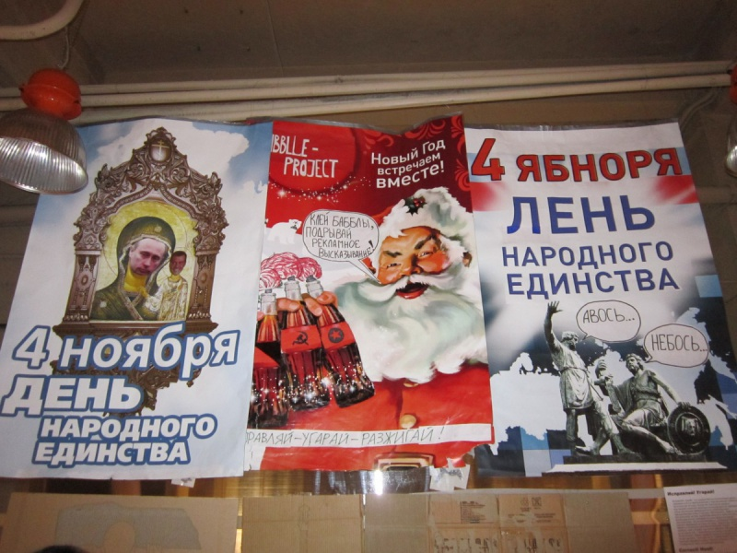
Исправляй!Угарай! / Modify!HaveFun

Slide 11
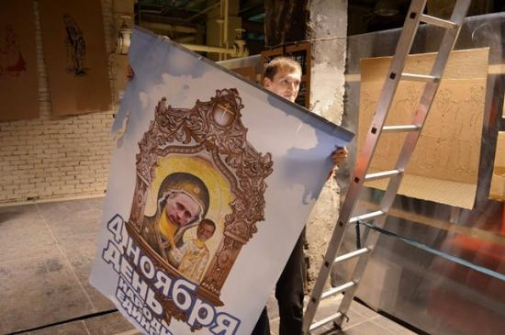
“Voice of the streets” scandal

Slide 12
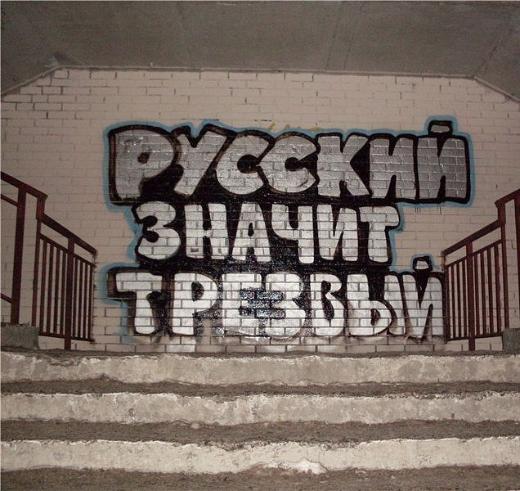
Russian means Sober

Slide 13
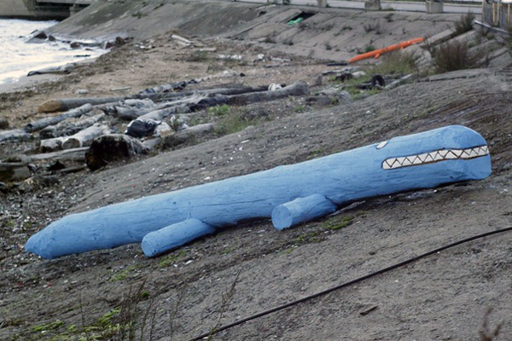
DIY urban action marathon

Slide 14
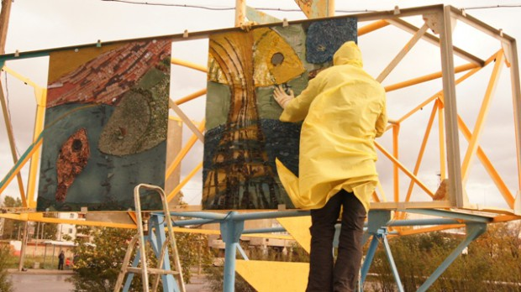

Slide 15
“Snail” | “Frame”
I knew I had to choose a different way, not fighting for the system. Not changing the system, but making my own system… Well, at least a small one, where I can do my work in peace and comfort… I’m not interested in non-expert opinions. It can really disturb you sometimes, unsettle you … One can work for commerce. Or to become famous. Of simply to change the place so much, so that people would say ‘thank you’ and think you are a hero. | Today you need to be out, in the streets, do it all with your own hands and put it in the street immediately. Galleries and institutions are outdated. And they [other artists - AZ] have their space and position. We’re kind of together, but everyone on her own. I can see when I loose compared to them, but altogether we win in the end. I like to take over new spaces, where new people are, the new contemporary people, who live their lives in these spaces. And they live, and they feel all this drive.

Slide 16
Direct changes, new visions of the ‘good urban space’, voice/ lifestyle/ values of a milieu / social group/ individual
Networked creativity (legitimization and support) – potential for collective action?
DIY as a new form of contentious politics? [Douglas 2011]
Creativity as ‘weapon of the weak’?

Slide 17
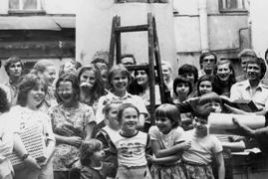
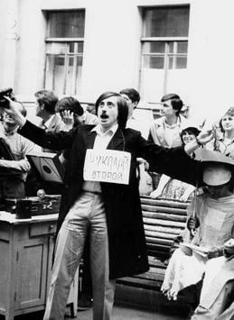
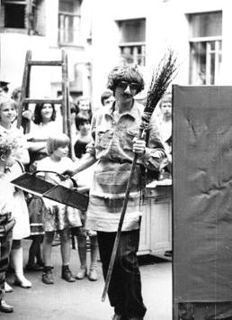
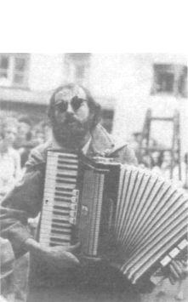
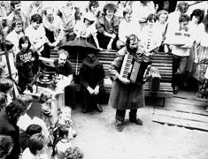
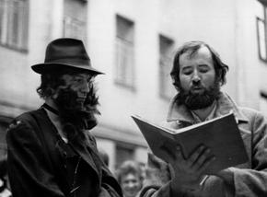

Slide 18
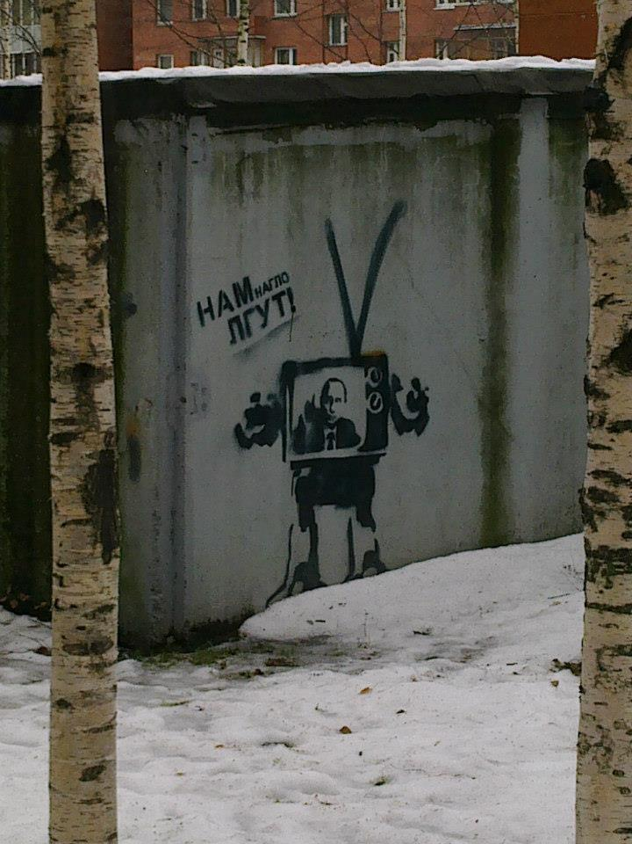

Slide 19
