Slide 1

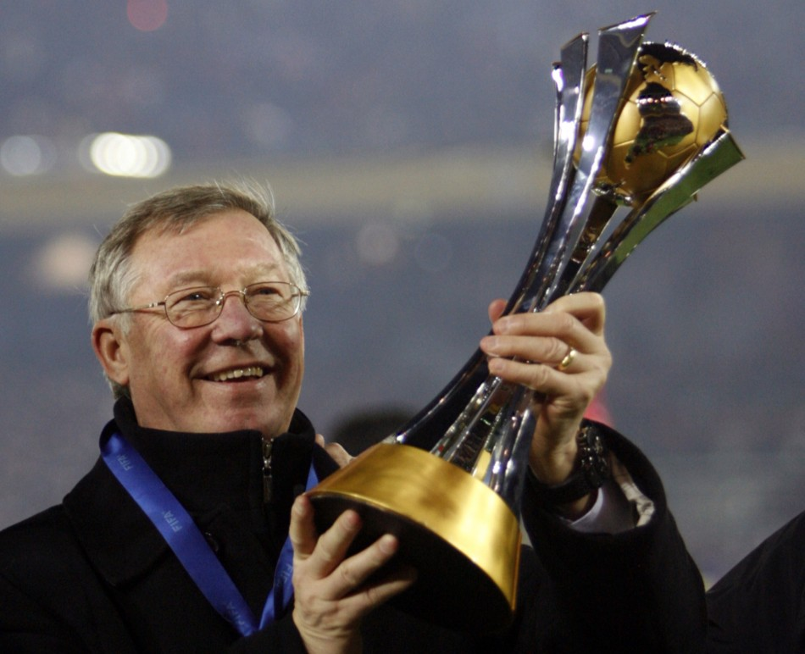
PERSONAL WELFARE AND INTELLECTUAL CAPITAL:
THE CASE OF FOOTBALL COACHES
Iuliia Naidenova
Marina Oskolkova
11.10.2013

Slide 2

Idea
Phenomenon of rich people
Intellectual capital
=> Personal (individual) intellectual capital

Slide 3
IC on different levels of analysis
 | Macrolevel | Mesolevel | Microlevel
Main actors | Regions or countries | Companies | Individuals
Human Capital | Labor force and its knowledge | Competences as source of productivity, quality of work, loyalty | Competences
Relational Capital | Diplomatic relations | Brand, image, relationships with external stakeholders | Image and networks
Structural Capital | Infrastructure, governability databases, etc. | Routines, codified organizational knowledge | Individual intellectual property

Slide 4
Literature review
Intellectual capital
Football
Individual welfare
Salaries of Spanish football players (Barajas, Rodriguez, 2010)
Income inequality of team sports (Szymanski, 2001)
IC disclosure by football clubs (Shareef and Davey; 2005)
Measurement of IC of football clubs (Gurel and Ekmekci ; 2011)
Rankings (Forbes; Sunday Times)
Tomé, E. (2004; 2012)

Slide 5
Phenomenon of very rich people existence
Microeconomics
Market structure (Frank, 2005)
Macroeconomics (ideologies)
Liberalism (Smith, 1977; Mill, 1848; Marshall, 1890)
Political power (BBC, 2011)
Crime activities (Barry, 2007, Le Grand et al., 2008)
Perceived uniqueness (Goal, 2012)
Technology (Rosen, 1981)
Luck (Daily Mirror, 2012)
Socialism (Marx, 2008)
Conservadorism (Pope Leo XIII, 1891)
Taxing social democracy (Keynes, 1936)

Slide 6
IIC proxy variables
Difference of team places in national league during the year
Leading places in national championships during the year
Image in media
Former football player
Played for the same team

Slide 7
Control variables
Wins in championships in previous years
Age
Place of birth
Team players’ quality

Slide 8
Research framework
Difference of team places in national league
Team’ leading places in national championships
HUMAN CAPITAL
Coach’s salary
Image of coach in media
Former football player
PERSONAL WEALTH
Played for the same team
RELATIONAL CAPITAL
Team wins in championships in previous years
Age
Place of birth
Team players’ quality
CONTROL VARIABLES

Slide 9
Sample and data
The clubs operate in Russia, England, Germany, Spain, Italy or France
The clubs achieved places in national championships from the 1st to the 10th
All analyzed variables relate to 2011, because of data availability
The final sample consists of 60 coaches

Slide 10
The model
SALARY = c + α₁·PLACE + α₂·IMAGE+ α₂·DOWN + α₃·UP + α₄·FPLAYER + α₅·SAMETEAM + β₁·PLAYERS + β₂·AGE + β₃·BIRTH + β₄·WINS + ∑ γ_{i}·D_{i}
Method - heteroscedasticity robust ordinary least squares

Slide 11
Results
Variable | Coefficient | Std. Error
C | -10.20 | 10.21
PLACE | -0.69 | 0.99
IMAGE | 0.98* | 0.57
DOWN | 0.32 | 0.66
UP | 1.34* | 0.81
FPLAYER | -1.19 | 1.53
SAMETEAM | -0.45 | 0.68
PLAYERS | 0.36** | 0.08
AGE | 0.45 | 0.41
BIRTH | 0.01 | 0.74
WINS | -0.12 | 0.75
FRANCE | 0.31 | 1.10
GERMANY | -0.59 | 0.77
ITALY | -1.39* | 0.80
RUSSIA | -0.93 | 1.02
SPAIN | -0.15 | 0.87
** indicates significant at the 1% level; * indicates significant at the 10% level

Slide 12
Future research

