Slide 1
The 32nd European Workshop on Cognitive Neuropsychology (Bressanone, Italy, January 26-31)
HSE, Yulia Akinina, 2014

Slide 2
European Workshop on Cognitive Neuropsychology
Plenary sessions & posters;
Plenary sessions:
Topographical orientation and environmental memory;
Inhibition and facilitation in recovery and rehabilitation;
Cognitive neurosurgery: new perspectives for anatomo-functional correlations;
Neuropsychology of motion perception.
Notes:
Рассказать о структуре конференции, моя роль, мой уровень, ну и что это скорее мой субъективный взгляд + компиляция информации

Slide 3
European Workshop on Cognitive Neuropsychology
Cognitive neuropsychology vs Neurolinguistics ??
«The CNP approach, as its name implies, embraces both cognition and the brain by linking the two via associations of neural damage and residual patterns of spared and impaired cognitive abilities»
Laine, M., & Martin, N. (2012). Cognitive Neuropsychology Has Been, Is, And Will Be Significant To Aphasiology. Aphasiology,
Notes:
Было немного и о языке тоже, хотя конференция действительно не профильная.
The CNP approach, as its name implies, embraces both cognition and the brain by linking the two via associations of neural damage and residual patterns of spared and impaired cognitive abilities. one can broadly define the CNP approach with three key features: its domain of study (inner workings of cognition), sources of data (people with developmental or acquired disor- ders of cognition), and methodology (systematic implementation of quantitative case study methods).

Slide 4
European Workshop on Cognitive Neuropsychology
Tim Shallice: « The cognitive neuropsychology research paradigm: dodo or phoenix? »
Single-case studies;
Individual differences;
Premorbidity at one end of the continuum;
Problems of falsifiability
The lack of falsifying power is compensated by the number of findings that could be explained by the same set of assumptions;
Medicalization of the domain.
Notes:
Снижение цитируемости когнитивно-нейропсихологических журналов по сравнению с 80-90 годами
В ЧАСТНОСТИ
Какое количество паттернов может быть?
Индивид. различия как панацея – «защитный пояс» Лакатоса
Надежда все же есть, но относиться внимательнее, осознавать эти вопросы

Slide 5
European Workshop on Cognitive Neuropsychology
Jenny Crinion: «Facilitating speech production by modifying inhibitory brain connections»;
Paolo Bartolomeo, Hugues Duffau: «Intra-operative mapping of cognitive functions: methodological considerations».
Notes:
Мои впечатления от «медикализации». Физиология, манипулятивные методы. Должна подчеркнуть, что здесь я тоже новичок, и в чем-то на том же уровне, что и остальные

Slide 6
Facilitating speech production by modifying inhibitory brain connections
Basics:
Inhibitory vs excitatory brain activity;
Inhibitory vs excitatory stimulation: tDCS.
Gottfried, S., Vijay, R., & Dinesh, N. (2008). Transcranial Direct Current Stimulation in Stroke Recovery. Archives of Neurology, 65(12), 1571–1576.
Notes:
Про автора: Jenny Crinion: language therapist neuroscientist and speech and language therapist my current research aims to understand why only some patients recover from anomia (word finding problems) following aphasic stroke, and for those who don’t, how the treatment of anomia might be more effective.
Воздействие на мембраны нервны клеток, увеличивая или уменьшая способность клеток возбуждаться

Slide 7
Facilitating speech production by modifying inhibitory brain connections
Suppress contralateral activity or stimulate perilesional activity?
Evidence from motor rehabilitation;
Not so evident in cognitive rehabilitation: suppression of contralateral activity is not always beneficial.
Notes:
1. Рассказать про контралатеральную и перилизионную активность. 2. Рассказать про свидетельство о моторной реабилитации.

Slide 8
Facilitating speech production by modifying inhibitory brain connections
a-tDCS (excitatory) on perilesional areas + speech therapy;
Control group: speech therapy + sham tDCS.
RESULTS: the first group is much better:
Time;
Efficiency;
Generalization;
In some patients – improved everyday language.
Notes:
Точно не помню, какая генерализация – другие айтемы или same-different items.
Проблемы: эпилепт., не совсем понятен механизм, насколько длителен эффект (может быть, я просто не запомнила детали дизайна?)

Slide 9
Intra-operative mapping of cognitive functions:methodological considerations
Method: electrical stimulation of the brain during awake neurosurgery due to gliomas;
Stimulation of white matter;
Profit:
For patients: prolonged life + quality of life;
Reveals crucial curcuits for a function.
« Brain hodotopy » : topology + hodology (the study of interconnections of brain cells)
Notes:
Hugues Duffau: neurosurgeon. РИСУНОК ! Просто потому, что для меня это было поразительно. Ходотопия – из нейрохирургии, но очень применимо!

Slide 10
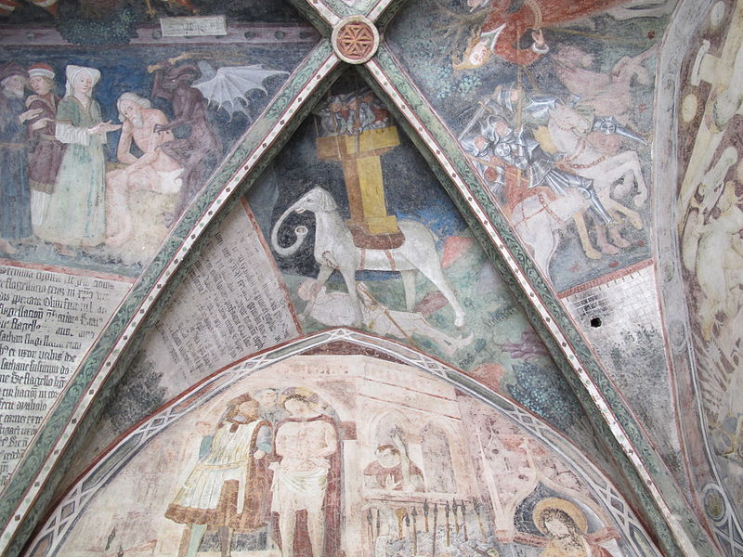
THANK YOU!
Фотки города или академии
http://commons.wikimedia.org/wiki/File:Bressanone,_duomo,_chiostro_22_elefante.JPG#filelinks
Notes:
Пара слов про город

