Slide 1
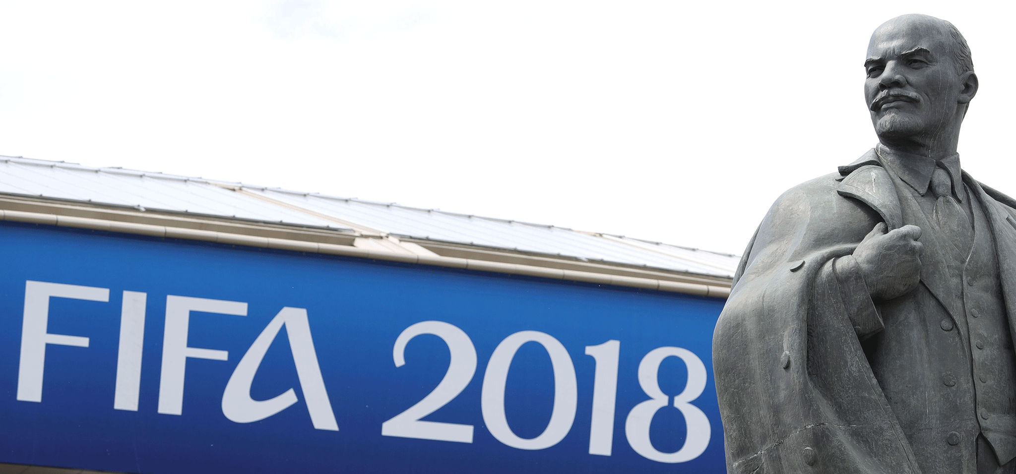
The impact of mega-events on international image of a hosting country: the 2018 FIFA World Cup in Russia
Iuliia Naidenova
Sofia Paklina
Marina Zavertiaeva
Petr Parshakov

Slide 2
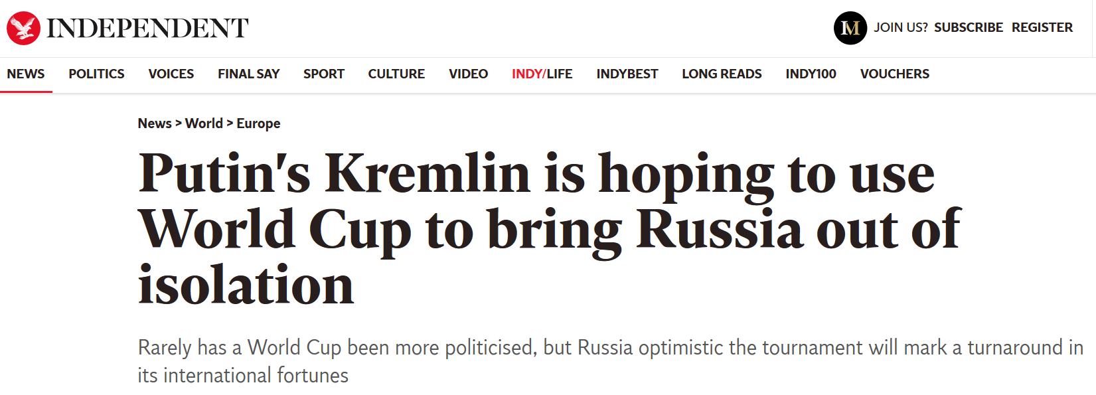
Motivation
14 June – 15 July 2018: FIFA World Cup in Russia
Russia spent over 13 billion U.S. dollars for the 2018 FIFA World Cup (one of the most expensive WC since 1990)
It is not only about sport, but also about politics:

Slide 3
Russian context
2014 – Crimea crises
2015 – Doping scandal
2018 – Skripals’ poisoning

Slide 4
Research question
How did FIFA World Cup 2018 as mega-event influence the international and destination image of Russia?

Slide 5
Background
Non-financial benefits of mega-events:
Urban regeneration (Harvey and Young, 2013)
Civic pride (Frawley, 2016)
Nation branding – “a process by which a nation’s images can be created, monitored, evaluated and proactively managed in order to improve or enhance the country’s reputation among a target international audience” (Fan, 2010)

Slide 6
Surveys’ results
Usually national branding is estimated qualitatively using the surveys (Gibson et al., 2008) and interviews (Knott et al., 2016).
Surveys support the positive influence of mega-events on country image and destination image (Heslop et al., 2010; Hahm et al., 2018).
The effect is different for different countries (Hahm et al., 2018).
Internal effect is generally larger than international (Heslop et al., 2010; Kenyon and Bodet, 2018).
Surveys generally cover 2 month before and 2 month after the event (Heslop et al., 2010; Armenakyan et al., 2012).

Slide 7
Triangular relations (Hahm et al., 2018)
Country image
Event image
Destination image

Slide 8
Role of media
Media coverage affect the image creation process:
Intensive media coverage creates image (Heslop et al., 2010).
Negative media coverage was assumed to be a reason of no positive change in the image of the host country after 2016 Summer Olympics in Brazil (Hahm et al., 2018; Tasci et al., 2019).
Online reviews both reflect the post-visit destination image and creates pre-visit destination image (Rosario Gonzalez-Rodriguez et al., 2016)

Slide 9
Data and methodology
Methodology:
Image of hosting country in media = sentiment analysis of news about Russia
Correlation analysis and mean-comparison test
Data:
Daily news from international version of The Guardian (12.2010 - 05.2019)
Quarterly official data on tourism (01.2014 - 12.2018): China, USA, UK, France, Germany

Slide 10
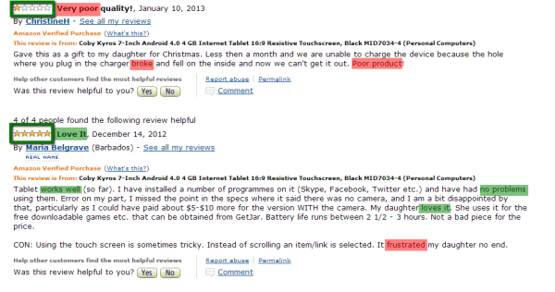
Example of sentiment analysis

Slide 11
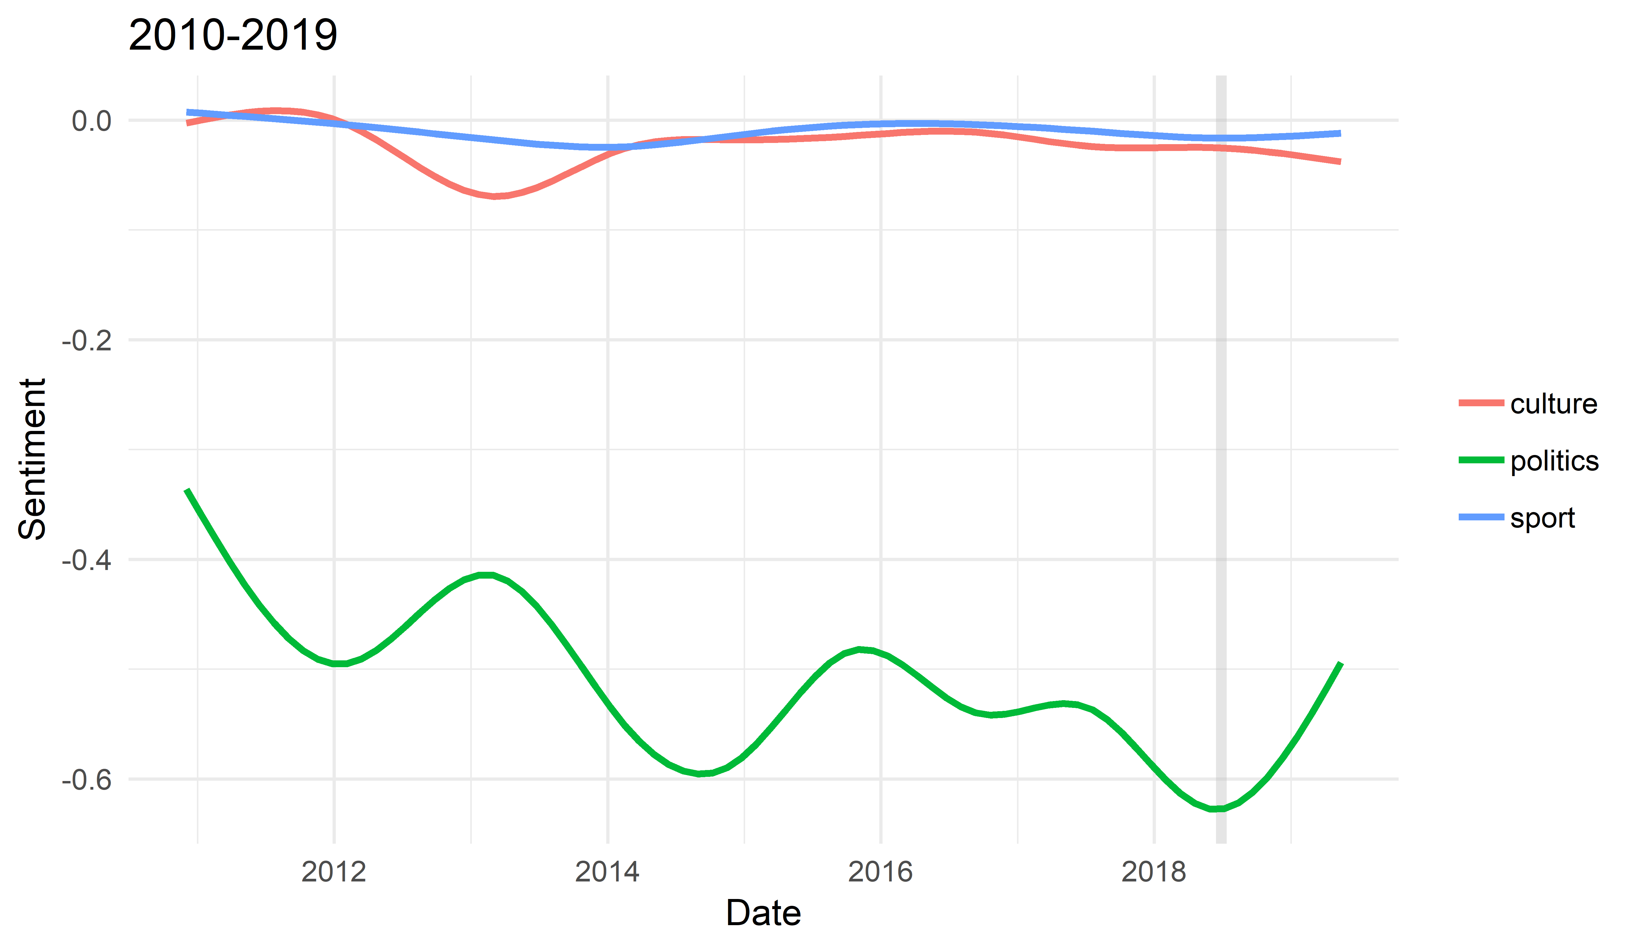
Sentiment of news about Russia
Notes:
Different topics of news
Political news dominate (almost 90% of news)
Sentiment of political news has a negative trend
Mostly the sentiment is negative (under 0, sentiment varies from +1 to -1)

Slide 12
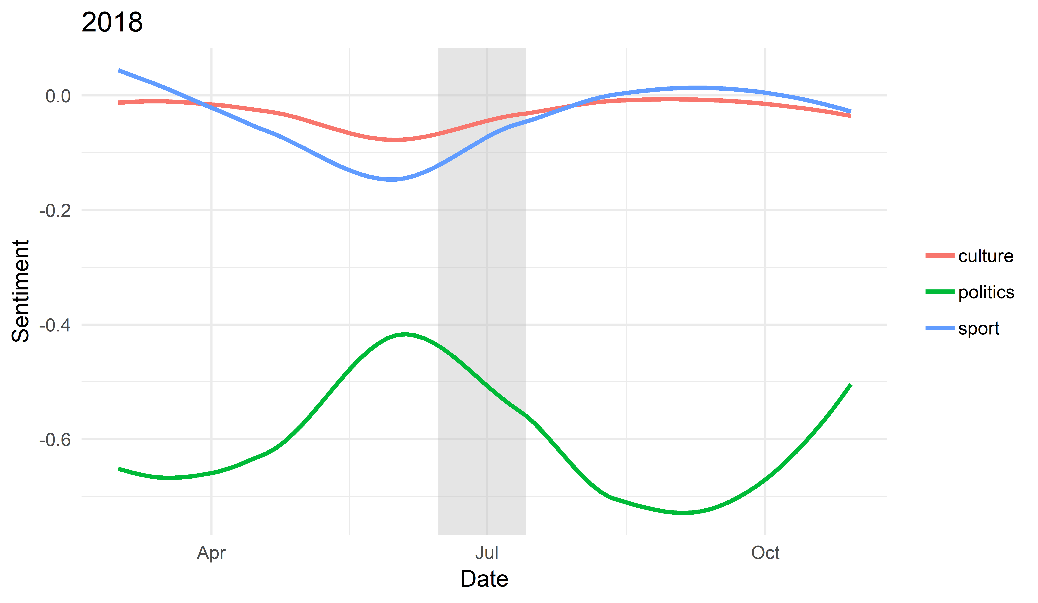
Sentiment of news before and after WC
Notes:
Closer look at 2018
Opposite pattern for political and non-political news (sentiment for culture and sport news has improved)
Maybe we should distinguish different types of country image

Slide 13
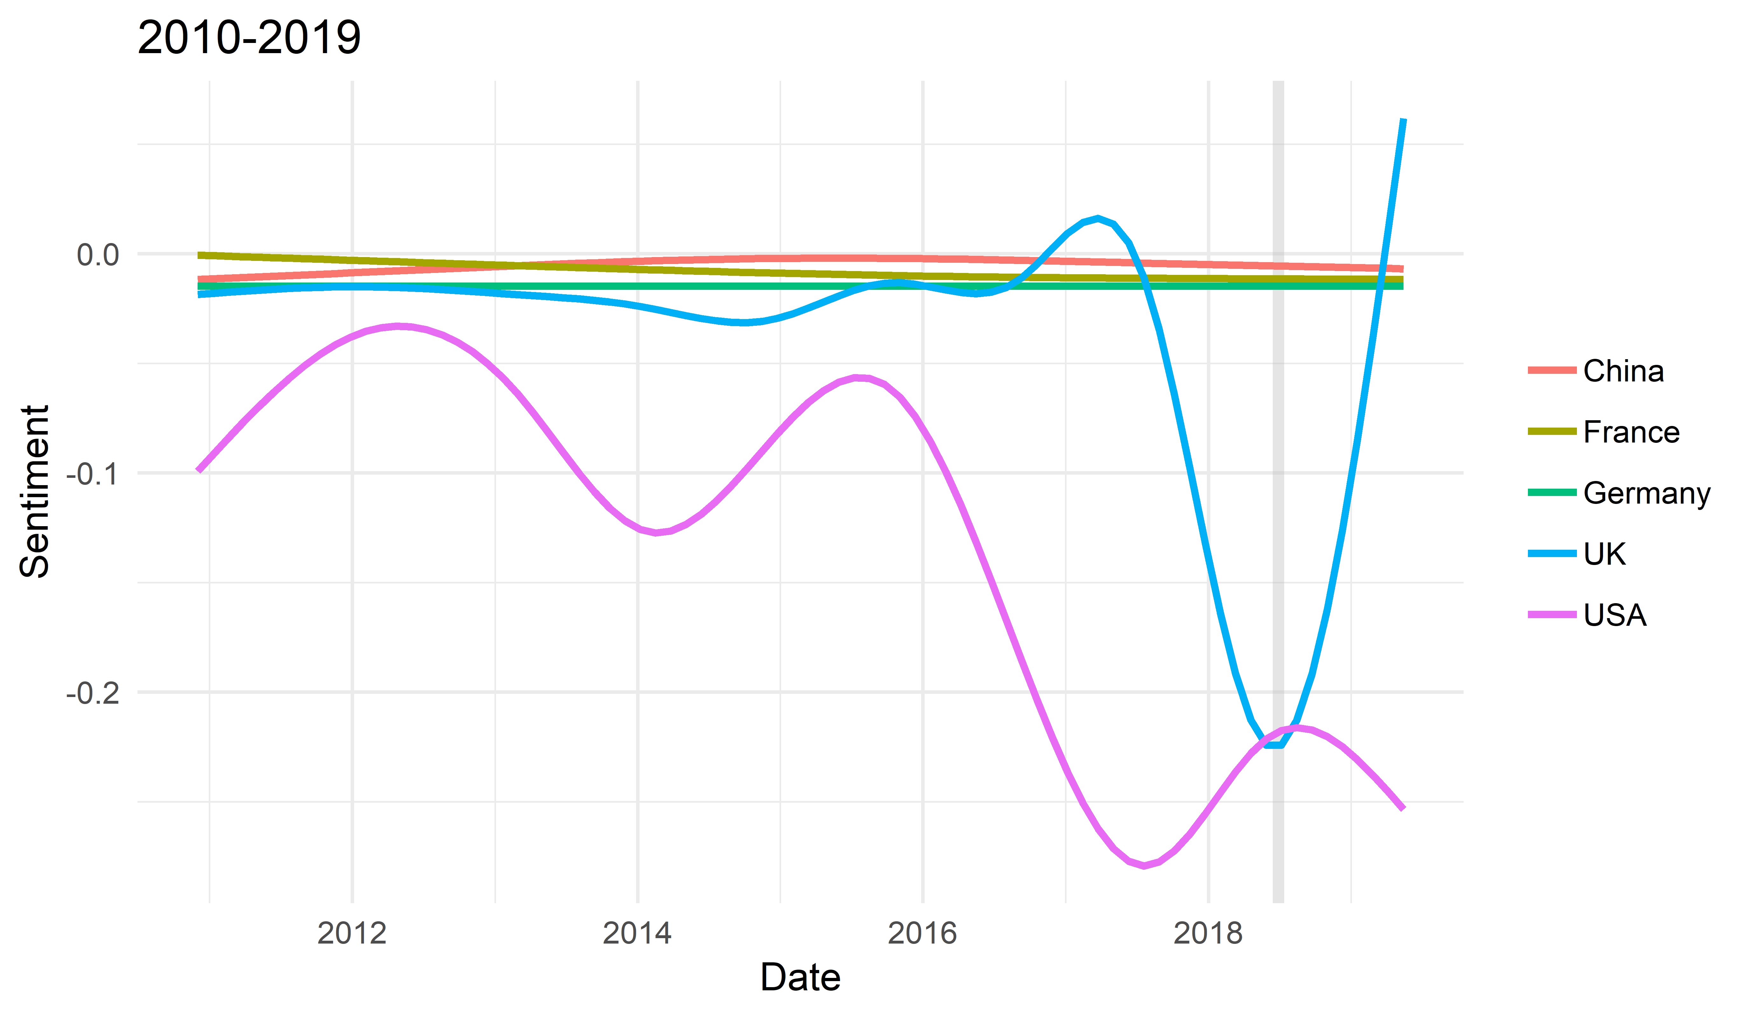
Sentiment of news by countries
Notes:
Since we used the international version of The Guardian, it is reasonable to see the sentiment of news
5 countries with most intense tourists flow during WC
Time period from 2010 to 2019
Again different patterns: 3 – almost no fluctuations, the opposite pattern for UK and USA (however, before WC the pattern is similar)

Slide 14
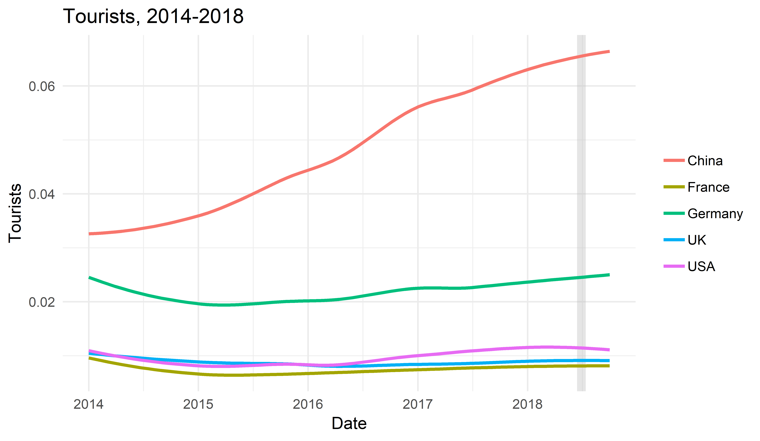
Tourism
Notes:
Since we are talking about country image with the relation to countries, it is interesting to look at tourists flows from them
Here data from 2014 to 2018 due to availability
At this time period we can not say that there is any significant effect of WC on number of tourists from these countries

Slide 15
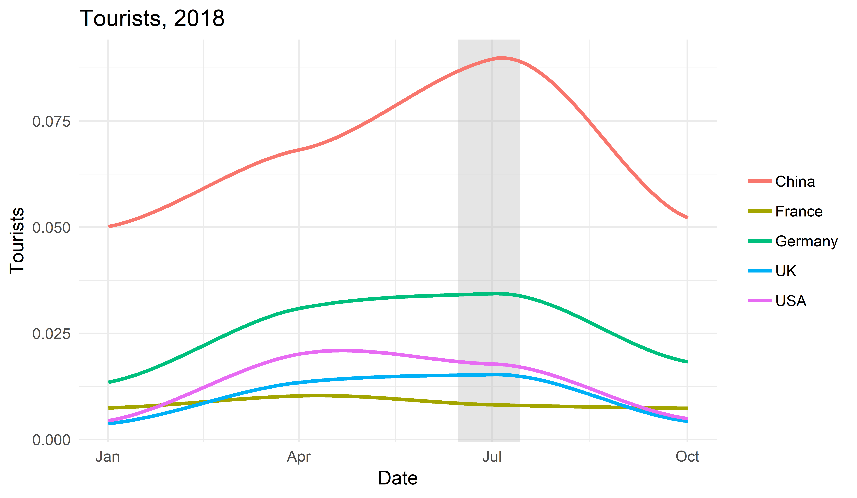
Tourism before and after WC
Notes:
Closer look at 2018
High peak is really observed for China
Other countries show some increase in number of tourists, but we hardly can suppose that it is the effect of WC

Slide 16
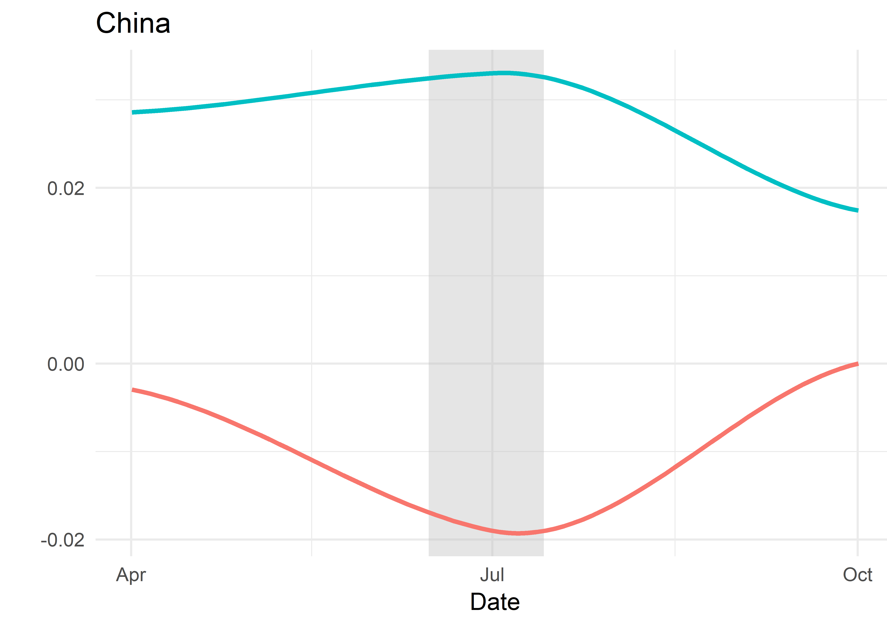
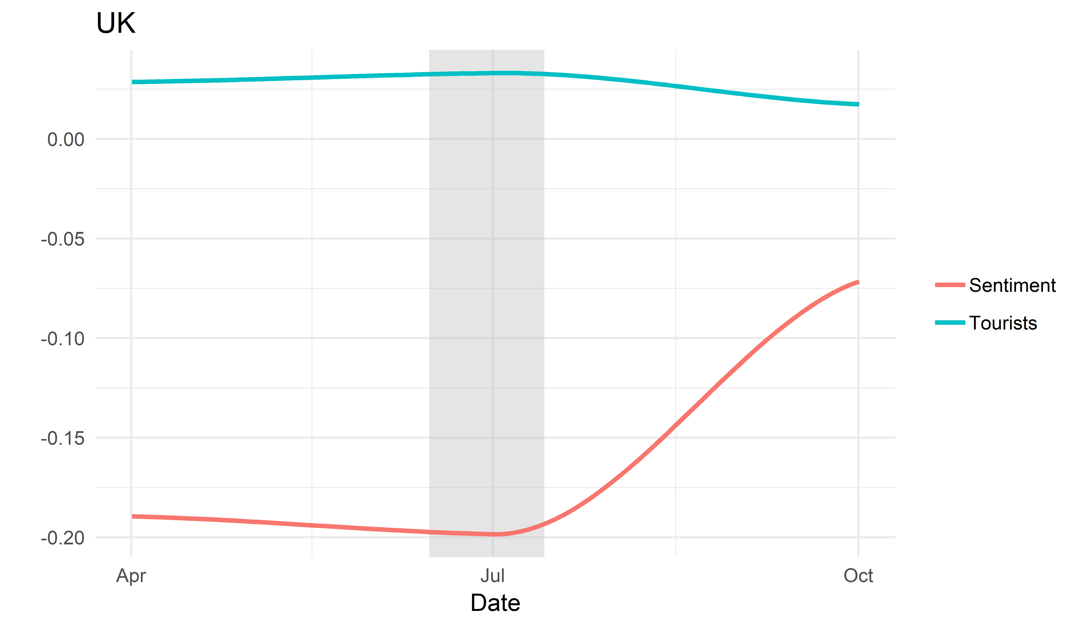
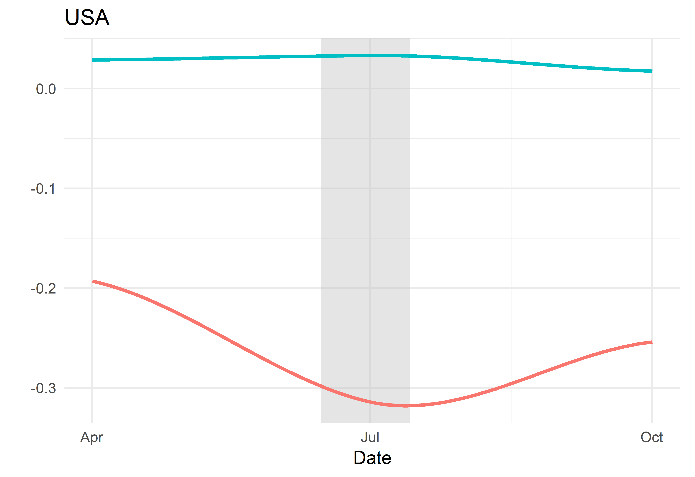
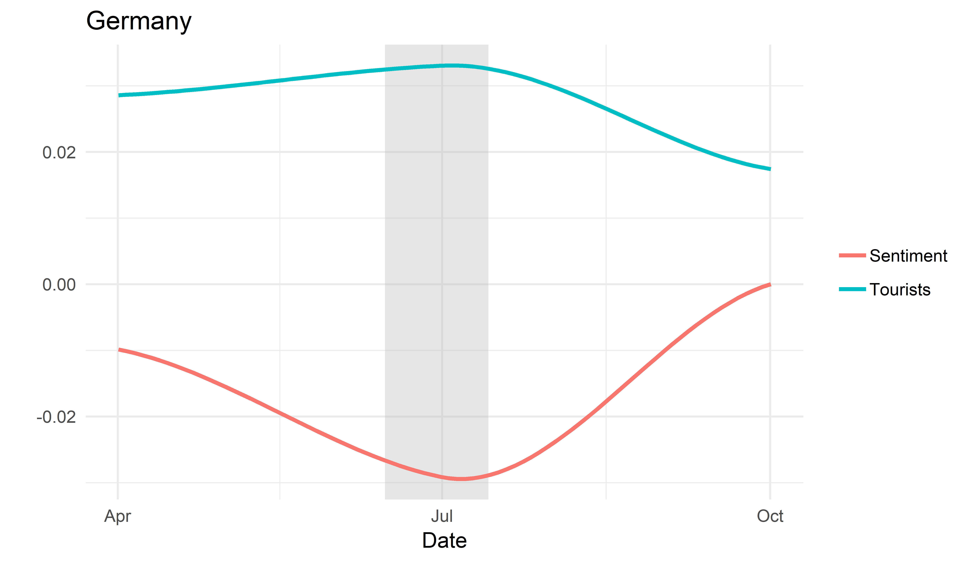
Tourism by countries
Notes:
If we combine the results of sentiment analysis and the tourists flows, we get interesting results
For 4 out of 5 countries we see the increase of tourist flow during WC and! The increase of news sentiment after that
The biggest improvement of news sentiment is observed for UK

Slide 17
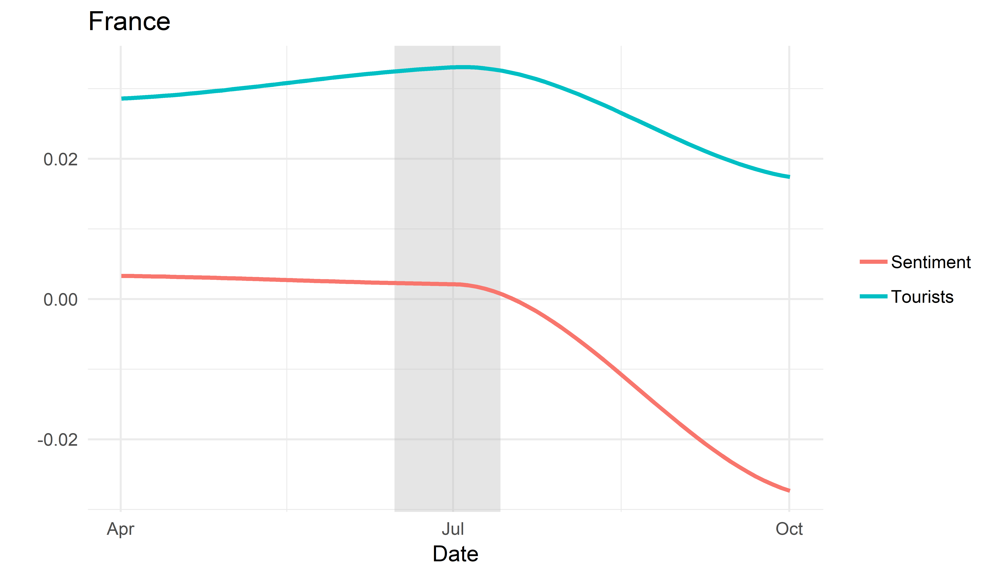
Tourism by countries (2)
Notes:
But we didn’t get the same result for France
Here both the tourist flow and news sentiment as a proxy for country image dropped after WC

Slide 18
Correlation analysis
 | Sentiment – Tourism | Lag(Sentiment) – Tourism
UK | - | -0.17*
USA | - | -0.22**
China | - | 0.20**
Germany | - | -
France | 0.20** | 0.20**
Notes:
In order to check these proposals, we conduct a correlation analysis
Firstly, we check the correlation between sentiment and touristic flow at the same periods
Here the only significant coefficient was obtained for France and it is positive
Next, we calculated correlation between the previous value for sentiment and tourist flow
Here, we get interesting results – for 4 out of 5 countries we observe significant relationships. For different countries we see different sighs, but it can be a reason to think that the country image measured through news sentiment influence the choice of people to visit or not this particular country
We checked whether the tourism can improve the country image, so we calculated also the correlation between sentiment and lag of tourism, but we failed to find significant correlation.

Slide 19
Sentiment before, during and after WC
 | Before | During | Difference
All news | -0.69 | -0.32 | 0.37**
Political news | -0.52 | -0.19 | 0.33**
 | Before | After | Difference
All news | -0.69 | -0.83 | -0.14**
Political news | -0.52 | -0.64 | -0.12 **
Notes:
One more thing we did, we compared news sentiment before, during and after WC through t-test.
We did it for all news and for each news topic, however, the significant results were obtained only for all and political news
Firstly, we compared the sentiment before and during WC (everybody is happy during the party, but what is going on after that)
The second table is about that, if we compare sentiment before and after WC, we see that sentiment of news became even worse
So this can be an indicator that such events are more likely about some SR effect on country image improvement

Slide 20
Conclusion
Sentiment analysis allows to measure country image continuously and for a longer period
Mega-events have mixed effects on country image in terms of politics, society and culture
The country image influences its destination image
Mega-events are likely to have a short-run impact on country image

Slide 21
Thank you for your attention!
snpaklina@hse.ru

Slide 23
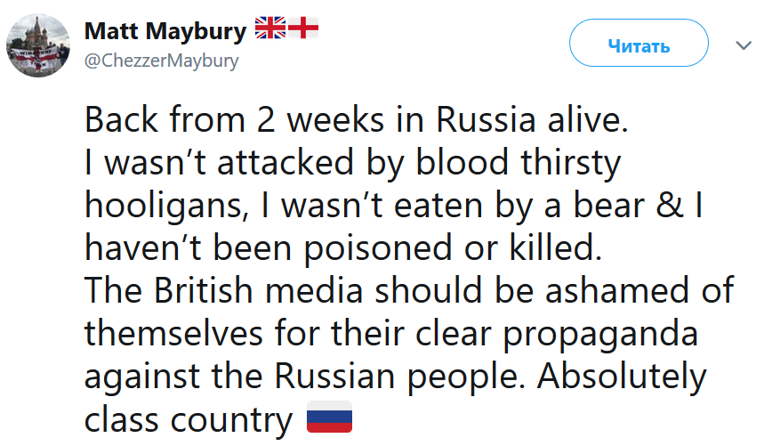
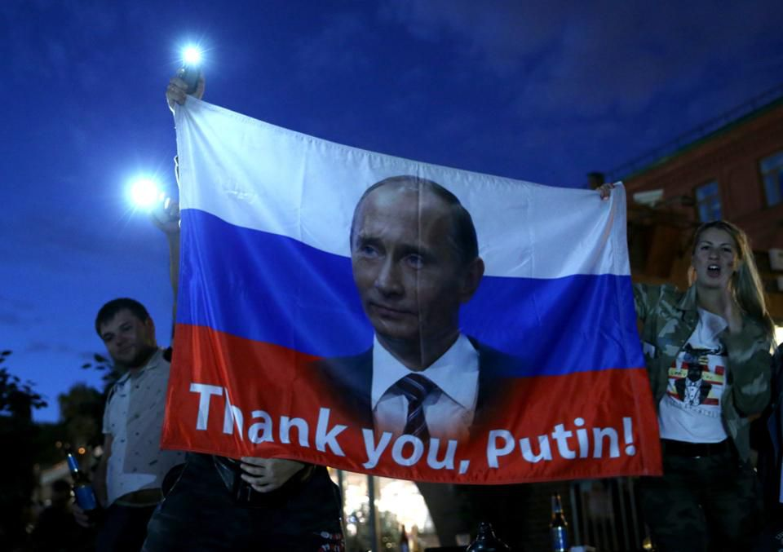

Slide 24
