Slide 1
Syllabus. Typical mistakes
Elena Semerikova

Slide 2
PLAN
Unclear grading and assessment
Determined Attendance/Withdrawal Policy
Ignoring course schedule and calendar
Using English
Notes:
I will focus on some aspects where we can

Slide 3
UNCLEAR Grading and Assessment
Offer a complete assignment list
we want them to learn, not argue with us about the difference between 10 and 9
How many points do they need — or what is the percentage cutoff — for 10, 9, etc.?
Make it clear. Students do care!
What are your grading policies?
How clear is your grading policy?
Do you face any problems in grading?
Notes:
Why do we specify all the grading schemes?
- we want them to learn, not argue with us about the difference between a B-plus and an A

Slide 4
UNCLEAR Grading and Assessment
Exceptions and distinct features.
Late submission, extra credit, participation points, rewrites
Frequency and distribution of assessments.
it’s important to ensure that students have some opportunities early in the course to receive both qualitative and quantitative (graded) feedback
make sure the workload and the pace are appropriate for the type of course and the level of students
Notes:
The assessment should not be too late (to get the feedback) and too early
Make sure the frequency is appropriate for the type of course

Slide 5
UNCLEAR Grading and Assessment
GRADING BREAKDOWN
Online quizzes | 14 (10 pts each) | 140
Online midterm | 35 questions (2 pts each) | 70
Online Final Exam | 35 questions (2 pts each) | 70
Weekly in-class participation | 15 (4 points each) | 60
Presentations | 3 (200 points each) | 600
Research Participation | 60 points | 60
TOTAL POINTS | 1000 points | 1000
Notes:
In order to make it trasparent

Slide 6
UNCLEAR Grading and Assessment
Clearly state what assessments you will use
• Exams
• Quizzes • Labs • Homework • Research Papers • Oral Presentations
• Participation Points

Slide 7
Determined Attendance/ Withdrawal Policy
Please clearly state your attendance policies.
NB! What you write is what have to do!
If a policy is written as “students WILL be withdrawn after missing x classes” then you must withdraw the student who misses x classes, no matter how valid the reason for the absence.
How would you correct the sentence?
Notes:
It is important how we formulate!
Be more tricky! What

Slide 8
Determined Attendance/ Withdrawal Policy
Please clearly state your attendance policies.
If a policy is written as “students WILL be withdrawn after missing x classes” then you must withdraw the student who misses x classes, no matter how valid the reason for the absence.
How would you correct the sentence?
A better language would be “The instructor reserves the right to withdraw.....”

Slide 9
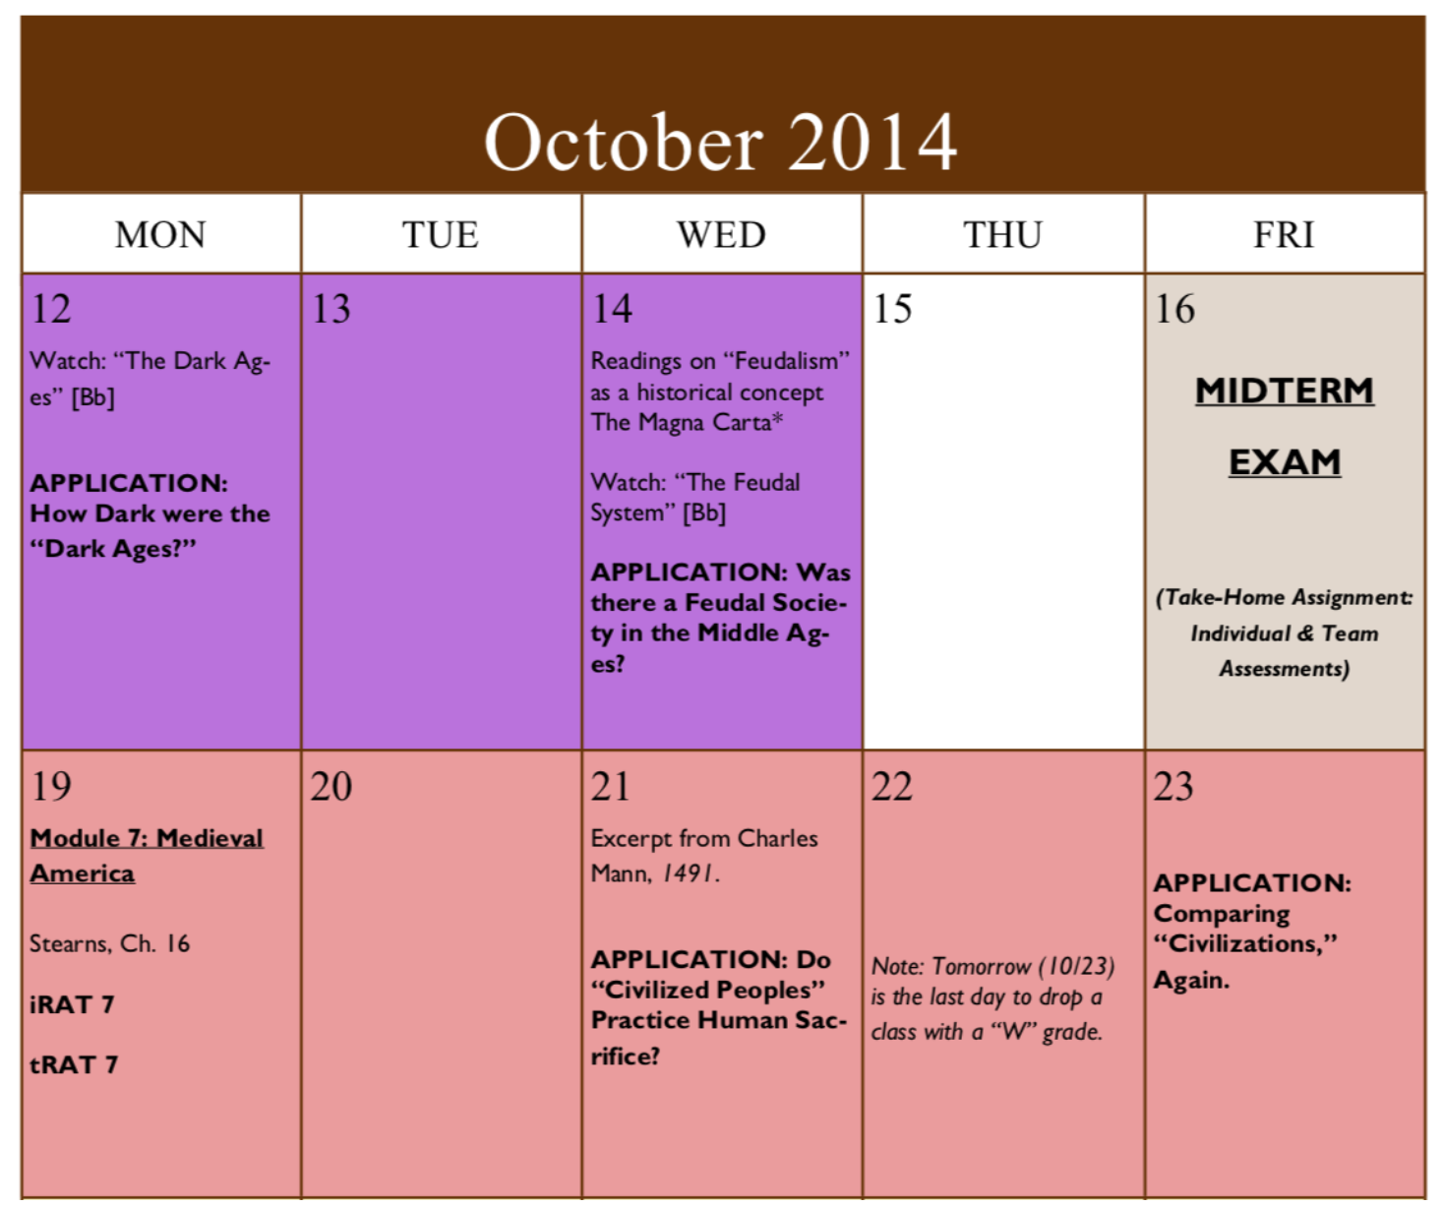
Ignoring Course Schedule and Calendar
Topics or unit descriptions.
Present your course organization
visually using calendar
Due dates for all assignments.
Any exceptions to the routine schedule.
Important campus dates and deadlines.
A clearly formatted and easy-to-read course schedule is a crucial part of your syllabus.

Slide 10
Using english. Inconsistency
Competence Indicators:
Explain the definition of measurement, quantities, and units
Identify physics quantities in daily life
Grouping the basic quantities and derived quantities
Using the International System units in measurement
Convert the units of length, mass, time, and volume
Notes:
Last but not least we write it in english!

Slide 11
Using english. Inconsistency
Competence Indicators
To mention some state of matter
To mention the properties of particles composing solid, liquid, and gas
To differ the cohesion and adhesion based on investigation/ experiment
Definition of capillarity
Relating capillarity phenomena in daily life
Relating cohesion phenomena in surface tension phenomena
Do you see inconsistency?

Slide 12
Using english. Inconsistency
“Definition of capillarity” in the above table is not appropriately written.
Competence indicators should be written in a verb phrase
It would be better if it is all written using gerunds only, verb base only

Slide 13
Using english. Typical mistakes
Grammatical error | Sentence | Correction
inappropriate diction | Looking for goodness and the weakness of alcohol as thermometric matter … to measure the length of some bodies. …to measure the mass of bodies Working safety in measurement Working test Doing basic measurement accurately using match instruments … | ?

Slide 14
Using english. Typical mistakes
Grammatical error | Sentence | Correction
inappropriate diction | Looking for goodness and the weakness of alcohol as thermometric matter … to measure the length of some bodies. …to measure the mass of bodies Working safety in measurement Working test Doing basic measurement accurately using match instruments … | Looking for the strength and the weakness of alcohol as thermometric meter

Slide 15
Using english. Typical mistakes
Grammatical error | Sentence | Correction
inappropriate diction | Looking for goodness and the weakness of alcohol as thermometric matter … to measure the length of some bodies. …to measure the mass of bodies Working safety in measurement Working test Doing basic measurement accurately using match instruments … | Looking for the strength and the weakness of alcohol as thermometric meter … to measure someone’s height

Slide 16
Using english. Typical mistakes
Grammatical error | Sentence | Correction
inappropriate diction | Looking for goodness and the weakness of alcohol as thermometric matter … to measure the length of some bodies. …to measure the mass of bodies Working safety in measurement Working test Doing basic measurement accurately using match instruments … | Looking for the strength and the weakness of alcohol as thermometric meter … to measure someone’s height …to measure someone’s weight …

Slide 17
Using english. Typical mistakes
Grammatical error | Sentence | Correction
inappropriate diction | Looking for goodness and the weakness of alcohol as thermometric matter … to measure the length of some bodies. …to measure the mass of bodies Working safety in measurement Working test Doing basic measurement accurately using match instruments … | Looking for the strength and the weakness of alcohol as thermometric meter … to measure someone’s height …to measure someone’s weight To measure precisely.

Slide 18
Using english. Typical mistakes
Grammatical error | Sentence | Correction
inappropriate diction | Looking for goodness and the weakness of alcohol as thermometric matter … to measure the length of some bodies. …to measure the mass of bodies Working safety in measurement Working test Doing basic measurement accurately using match instruments … | Looking for the strength and the weakness of alcohol as thermometric meter … to measure someone’s height …to measure someone’s weight To measure precisely. Practice test

Slide 19
Using english. Typical mistakes
Grammatical error | Sentence | Correction
inappropriate diction | Looking for goodness and the weakness of alcohol as thermometric matter … to measure the length of some bodies. …to measure the mass of bodies Working safety in measurement Working test Doing basic measurement accurately using match instruments … | Looking for the strength and the weakness of alcohol as thermometric meter … to measure someone’s height …to measure someone’s weight To measure precisely. Practice test Doing basic measurement accurately using proper instruments …

Slide 20
Using english. Typical mistakes
Grammatical error | Sentence | Correction
inappropriate tenses | Looking for the information by study of literature about … Stating the factors which is influences the length increases of a matter ….the factors which is influences amount of heat | ?

Slide 21
Using english. Typical mistakes
Grammatical error | Sentence | Correction
inappropriate tenses | Looking for the information by study of literature about … Stating the factors which is influences the length increases of a matter ….the factors which is influences amount of heat | Looking for the information by studying literature about …

Slide 22
Using english. Typical mistakes
Grammatical error | Sentence | Correction
inappropriate tenses | Looking for the information by study of literature about … Stating the factors which is influences the length increases of a matter ….the factors which is influences amount of heat | Looking for the information by studying literature about … Stating the factors which influences the length increases of a matter

Slide 23
Using english. Typical mistakes
Grammatical error | Sentence | Correction
inappropriate tenses | Looking for the information by study of literature about … Stating the factors which is influences the length increases of a matter ….the factors which is influences amount of heat | Looking for the information by studying literature about … Stating the factors which influences the length increases of a matter ….the factors which influences amount of heat

Slide 24
Using english. Typical mistakes
Gr. error | Sentence | Correction
inappropriate preposition | Doing experiment about melting and freezing phenomena Doing experiment the influences of pressure to the melting point Doing study of literature of heat transfer by conduction Noticing the differences between cohesion an adhesion by experiment Doing experiment of capillarity Doing experiment of surface tension Relationship between heat, specific heat, and temperature change. Study of literature to find the example of … | ?

Slide 25
Using english. Typical mistakes
Gr. error | Sentence | Correction
inappropriate preposition | Doing experiment about melting and freezing phenomena Doing experiment the influences of pressure to the melting point Doing study of literature of heat transfer by conduction Noticing the differences between cohesion an adhesion by experiment Doing experiment of capillarity Doing experiment of surface tension Relationship between heat, specific heat, and temperature change. Study of literature to find the example of … | Doing experiment on melting and freezing phenomena

Slide 26
Using english. Typical mistakes
Gr. error | Sentence | Correction
inappropriate preposition | Doing experiment about melting and freezing phenomena Doing experiment the influences of pressure to the melting point Doing study of literature of heat transfer by conduction Noticing the differences between cohesion an adhesion by experiment Doing experiment of capillarity Doing experiment of surface tension Relationship between heat, specific heat, and temperature change. Study of literature to find the example of … | Doing experiment on melting and freezing phenomena Doing experiment on the influences of pressure to the melting point

Slide 27
Using english. Typical mistakes
Gr. error | Sentence | Correction
inappropriate preposition | Doing experiment about melting and freezing phenomena Doing experiment the influences of pressure to the melting point Doing study of literature of heat transfer by conduction Noticing the differences between cohesion an adhesion by experiment Doing experiment of capillarity Doing experiment of surface tension Relationship between heat, specific heat, and temperature change. Study of literature to find the example of … | Doing experiment on melting and freezing phenomena Doing experiment on the influences of pressure to the melting point Doing study of literature of heat transfer through conduction

Slide 28
Using english. Typical mistakes
Gr. error | Sentence | Correction
inappropriate preposition | Doing experiment about melting and freezing phenomena Doing experiment the influences of pressure to the melting point Doing study of literature of heat transfer by conduction Noticing the differences between cohesion an adhesion by experiment Doing experiment of capillarity Doing experiment of surface tension Relationship between heat, specific heat, and temperature change. Study of literature to find the example of … | Doing experiment on melting and freezing phenomena Doing experiment on the influences of pressure to the melting point Doing study of literature of heat transfer through conduction Noticing the differences between cohesion an adhesion through experiment

Slide 29
Using english. Typical mistakes
Gr. error | Sentence | Correction
inappropriate preposition | Doing experiment about melting and freezing phenomena Doing experiment the influences of pressure to the melting point Doing study of literature of heat transfer by conduction Noticing the differences between cohesion an adhesion by experiment Doing experiment of capillarity Doing experiment of surface tension Relationship between heat, specific heat, and temperature change. Study of literature to find the example of … | Doing experiment on melting and freezing phenomena Doing experiment on the influences of pressure to the melting point Doing study of literature of heat transfer through conduction Noticing the differences between cohesion an adhesion through experiment Doing experiment on capillarity

Slide 30
Using english. Typical mistakes
Gr. error | Sentence | Correction
inappropriate preposition | Doing experiment about melting and freezing phenomena Doing experiment the influences of pressure to the melting point Doing study of literature of heat transfer by conduction Noticing the differences between cohesion an adhesion by experiment Doing experiment of capillarity Doing experiment of surface tension Relationship between heat, specific heat, and temperature change. Study of literature to find the example of … | Doing experiment on melting and freezing phenomena Doing experiment on the influences of pressure to the melting point Doing study of literature of heat transfer through conduction Noticing the differences between cohesion an adhesion through experiment Doing experiment on capillarity

Slide 31
Using english. Typical mistakes
Gr. error | Sentence | Correction
inappropriate preposition | Doing experiment about melting and freezing phenomena Doing experiment the influences of pressure to the melting point Doing study of literature of heat transfer by conduction Noticing the differences between cohesion an adhesion by experiment Doing experiment of capillarity Doing experiment of surface tension Relationship between heat, specific heat, and temperature change. Study of literature to find the example of … | Doing experiment on melting and freezing phenomena Doing experiment on the influences of pressure to the melting point Doing study of literature of heat transfer through conduction Noticing the differences between cohesion an adhesion through experiment Doing experiment on capillarity Doing experiment on surface tension

Slide 32
Using english. Typical mistakes
Gr. error | Sentence | Correction
inappropriate preposition | Doing experiment about melting and freezing phenomena Doing experiment the influences of pressure to the melting point Doing study of literature of heat transfer by conduction Noticing the differences between cohesion an adhesion by experiment Doing experiment of capillarity Doing experiment of surface tension Relationship between heat, specific heat, and temperature change. Study of literature to find the example of … | Doing experiment on melting and freezing phenomena Doing experiment on the influences of pressure to the melting point Doing study of literature of heat transfer through conduction Noticing the differences between cohesion an adhesion through experiment Doing experiment on capillarity Doing experiment on surface tension Relationship among heat, specific heat, and temperature change.

Slide 33
Using english. Typical mistakes
Gr. error | Sentence | Correction
inappropriate preposition | Doing experiment about melting and freezing phenomena Doing experiment the influences of pressure to the melting point Doing study of literature of heat transfer by conduction Noticing the differences between cohesion an adhesion by experiment Doing experiment of capillarity Doing experiment of surface tension Relationship between heat, specific heat, and temperature change. Study of literature to find the example of … | Doing experiment on melting and freezing phenomena Doing experiment on the influences of pressure to the melting point Doing study of literature of heat transfer through conduction Noticing the differences between cohesion an adhesion through experiment Doing experiment on capillarity Doing experiment on surface tension Relationship among heat, specific heat, and temperature change. Studying literature to find the example of …

Slide 34
Any Mistakes from your experience?

