Slide 1


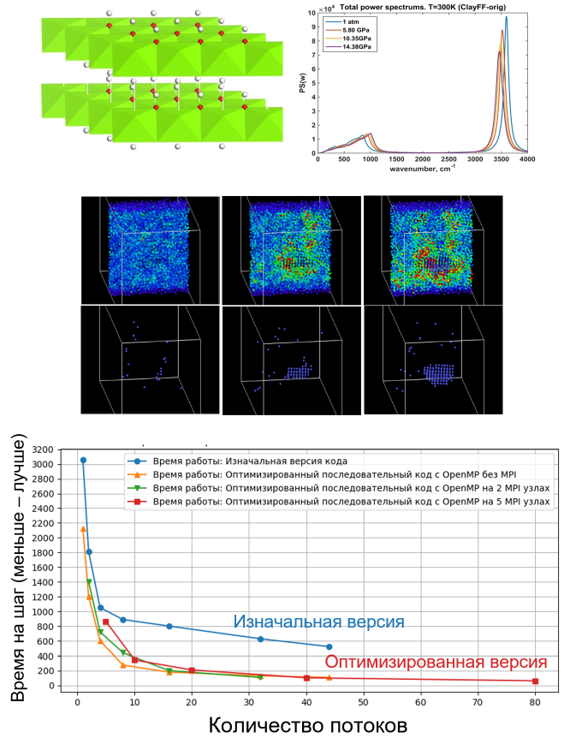
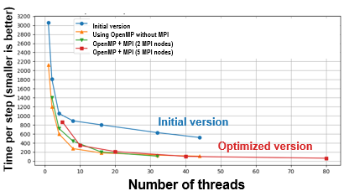
Atomistic and Continuum Modeling for Physical Problems
1
Customers: HSE University Basic Research Program
Executor: International Laboratory for Supercomputer Atomistic Modelling and Multi-scale Analysis, HSE University
Project manager: Pisarev V.V.
Purpose of the Research:
Study of materials properties using supercomputing modeling, development of computational methods and their optimization for the HSE HPC complex architecture
Results:
Properties of materials are computed using the MD method: equation of state and properties of brucite Mg(OH)2 at high pressures, transport coefficients of hydrocarbon fluids, crystallization mechanisms in amorphous metallic films.
A program for modeling a plasma jet is optimized and parallelized using OpenMP and MPI, which lead to 48x acceleration. Source code is open-sourced: https://github.com/kolotinsky1998/Ionwake/tree/develop
Published Articles:
Kondratyuk N., Pisarev V., Ewen J. P. Probing the high-pressure viscosity of hydrocarbon mixtures using molecular dynamics simulations // J. Chem. Phys, 2020 (Scopus: Q1, HSE Rank: A)
Kondratyuk N.D., Lenev D.Yu., Pisarev V.V. Transport coefficients of model lubricants up to 400 MPa from molecular dynamics // J. Chem. Phys, 2020 (Scopus: Q1, HSE Rank: A)
Pisarev V. V., Kalinichev A. G. Couette flow of pentane in clay nanopores: Molecular dynamics simulation // Journal of Molecular Liquids, Volume 366, 2022 (Scopus: Q1, HSE Rank: A)
Tararushkin E. V., Pisarev V. V., Kalinichev A. G. Interaction of Nitrite Ions with Hydrated Portlandite Surfaces: Atomistic Computer Simulation Study // Materials, 2023 (Scopus: Q2, HSE Rank: C)
Notes:
Executor (department): International Laboratory for Supercomputer Atomistic Modelling and Multi-scale Analysis, HSE University
Executor (full names): Pisarev Vasily, Sokolov Vladislav, Komarova Marina
Project (subject and No.): RSF No. 19-71-30020, "Using probabilistic neuromorphic generative models for the development of digital twin technology for nonlinear stochastic systems"
Project name: Atomistic and Continuum Modeling for Physical Problems
Project manager: Pisarev Vasily
Customers: HSE University Basic Research Program
Purpose: Study of materials properties using supercomputing modeling, development of computational methods and their optimization for the HSE HPC complex architecture
Description of the animation:
The top figure shows the standard behavior of the loss function on training data during neural network training. The training process of neural network with weights normalization of som type and weight decay may exhibit the periodic behavior. The bottom figure shows an example of the periodic behavior of the loss function on training data during the training of a neural network with batch normalization and weight decay.
Published articles with reference to the use of the HSE supercomputer:
Kondratyuk N., Pisarev V., Ewen J. P. Probing the high-pressure viscosity of hydrocarbon mixtures using molecular dynamics simulations // J. Chem. Phys, 2020 (Scopus: Q1, HSE Rank: A). DOI: https://doi.org/10.1063/5.0028393
Kondratyuk N.D., Lenev D.Yu., Pisarev V.V. Transport coefficients of model lubricants up to 400 MPa from molecular dynamics // J. Chem. Phys, 2020 (Scopus: Q1, HSE Rank: A). DOI: https://doi.org/10.1063/5.0008907
Pisarev V. V., Kalinichev A. G. Couette flow of pentane in clay nanopores: Molecular dynamics simulation // Journal of Molecular Liquids, Volume 366, 2022 (Scopus: Q1, HSE Rank: A). DOI: https://doi.org/10.1016/j.molliq.2022.120290
Tararushkin E. V., Pisarev V. V., Kalinichev A. G. Interaction of Nitrite Ions with Hydrated Portlandite Surfaces: Atomistic Computer Simulation Study // Materials, 2023 (Scopus: Q2, HSE Rank: C). DOI: https://doi.org/10.3390/ma16145026
!! To determine the level of the publication according to the HSE rating, please use the list of journals of the Science Metrics Center of the HSE: https://scientometrics.hse.ru/lists
!! To determine the Scopus quartile, please refer to the Scimago journal ranking: https://www.scimagojr.com/journalrank.php

