Slide 1
Science and Technology Policy Development in Energy in Russia and International Cooperation
Dr. Vladimir Likhachev,
IE HSE/ERI RAS
June 27, 2016, Moscow

Slide 2
Agenda
The scientific potential, performance and funding of science and technology development in Russia. Key indicators
Russian science and technology policy analysis and forecasting. Foresight in Russia. Priorities in energy.
Energy system research: Results
High school education in energy
International cooperation: possible areas of Russian – Korean scientific cooperation in energy

Slide 3
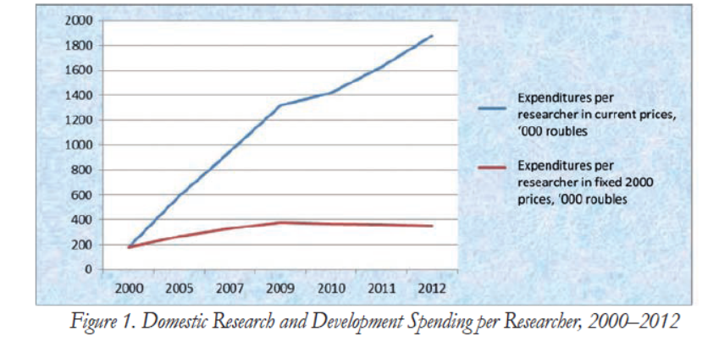
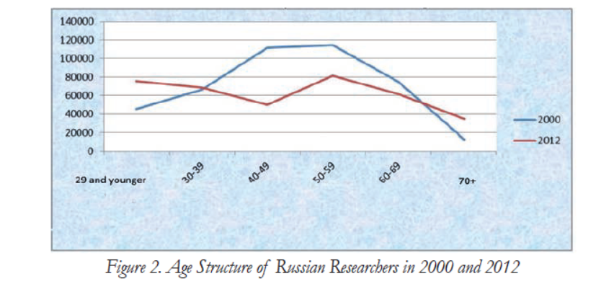
Science and technology development in Russia. Main indicators

Slide 4
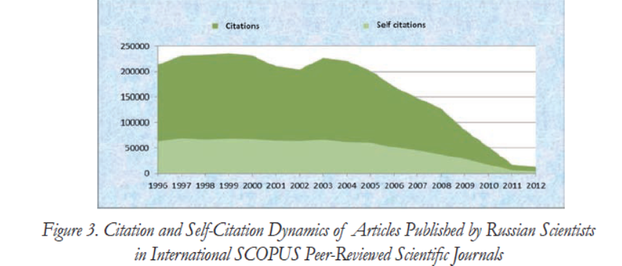
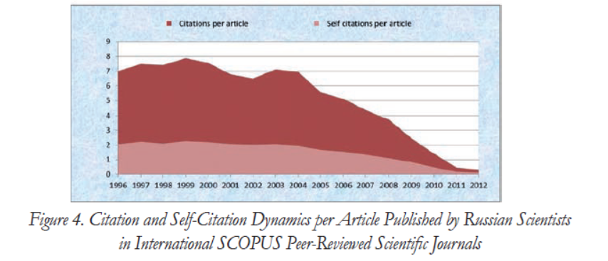
Science and technology development in Russia. Main indicators (2)

Slide 5
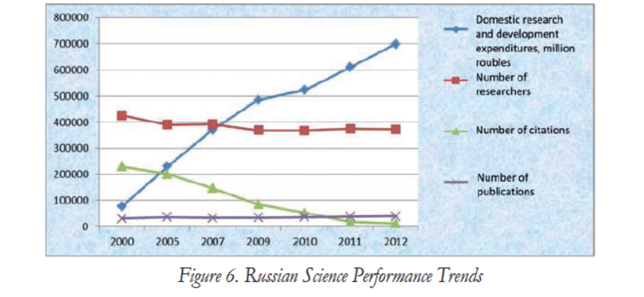
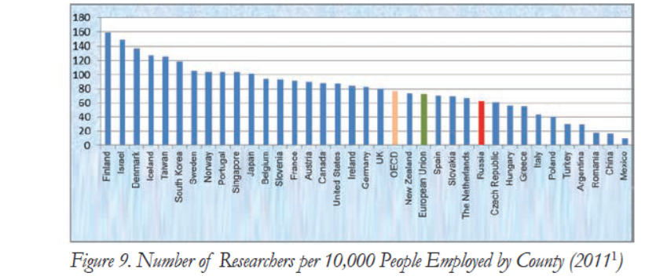
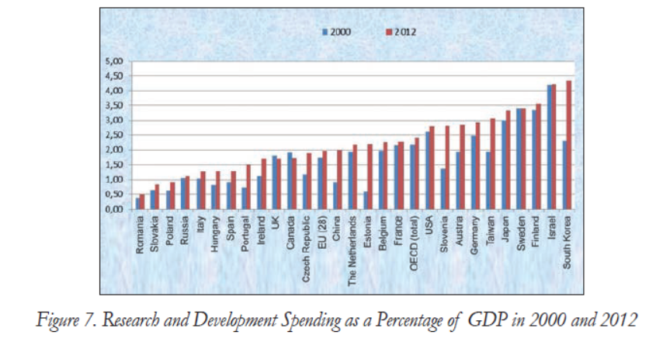
Science and technology development in Russia. Main indicators (3)

Slide 6
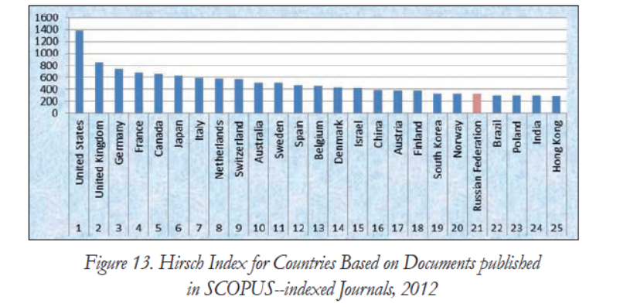
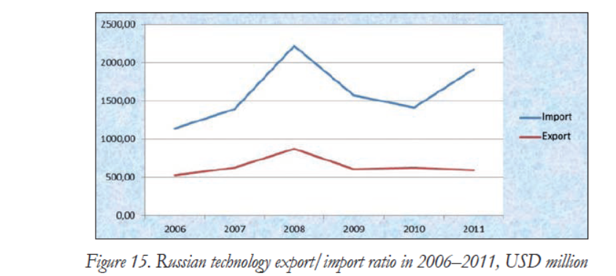
Science and technology development in Russia. Main indicators (4)

Slide 7
New understanding
From resource – based growth model
modernization of the traditional sectors of the economy
To global high-technology markets

Slide 8
New approach to science
Reforms of Russian Academy of Sciences
New innovation institutes
New role of universities
Growth of R&D/S&T international cooperation

Slide 9
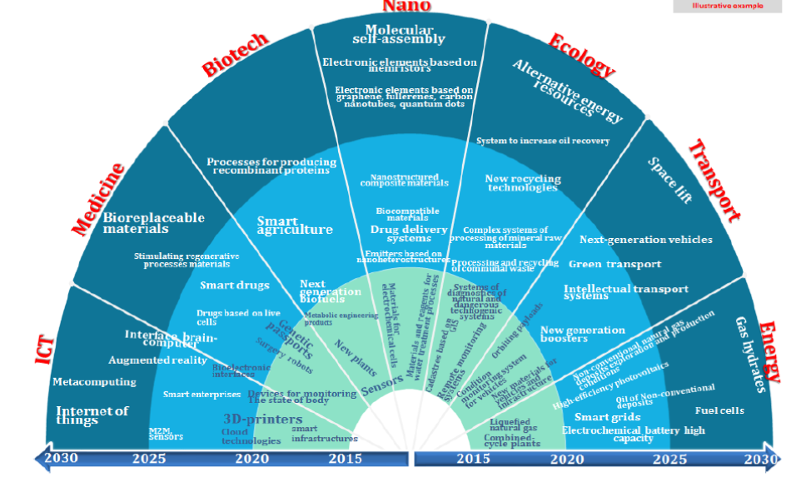
Priorities of S&T development

Slide 10
Breakthrough technologies
Hydrocarbon production and transportation technologies:
  Extraction of methane hydrates;
  Development of specific hydrocarbons sources;
  Production of liquid fuels from natural gas.
New energy:
  Renewable energy, distributed generation;
  Smart grids;
  Storage of energy.
New technologies in energy consumption:
  Hybrid cars (Hydrogen and electric vehicles);
  Energy Efficiency in households etc.

Slide 11
Government Policy in Innovations (RF Ministry of Energy)
Road Map for the implementation of innovative technologies and advanced materials in the fuel and energy complex for the period till 2018 (Decree of the Russian Federation from July 3, 2014 No 1217-p)
Policy of import substitution

Slide 12
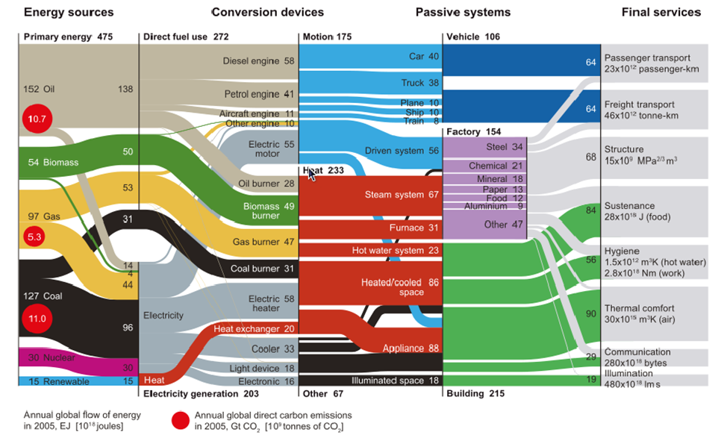
Energy System Analysis

Slide 13



High School Education Activities (2)
Joint Network Master Program “Strategic Management in Fuel and Energy Complex”

Slide 14
Possible areas of Russian – Korean scientific cooperation in energy.
Exchange of information and best practices on energy system and technology research between research centres;
specialized technology exhibitions, seminars, and presentations;
information and analytical support to activities involving the transfer and commercialization of technologies;
Support for international science and technology and investment projects;
Collaboration in education programs (exchange of students, exchange of professors, joint programs, education networks)

Slide 15
THANK YOU FOR YOUR ATTENTION!
Vladimir Likhachev
v.likhachev@gmail.com

