Slide 1
Public economics
Курс по выбору (optional course)

Slide 2

Lecturer
Rakuta Natalia
Vladimirovna
https://www.hse.ru/staff/rakuta#teaching

Slide 3
Public econ0mics – what is it?
How to allocate resources:
Market mechanism
Non-market allocative processes (‘allocative rules’)
The aim of PUBLIC ECONOMICS is to study the economic role of the government, and how government actions affect the economy
The government
Universal membership
Compulsion

Slide 4
Why to study government?
In every developed society there is some form of government organisation, which may or may not represent the members of the society collectively, but certainly has the coercive authority over them individually. The governing authority, whether central or local, is endowed with functions and duties, the detailed nature of which different in different places.
A.C. Pigou, A Study in Public Finance (1928)
Government actions have two important consequences:
They alter incomes
They change incentives

Slide 5
Why to study government…
Questions that PE tries to answer:
Why does government engage in some economic activities and not others?
Why has the scope of its activities changed over the past hundred years?
Does the government do too much?
Does it do well what it attempts to do?
Could it perform its economic role more efficiently?
How does the role of the government change in the XXI century?

Slide 6
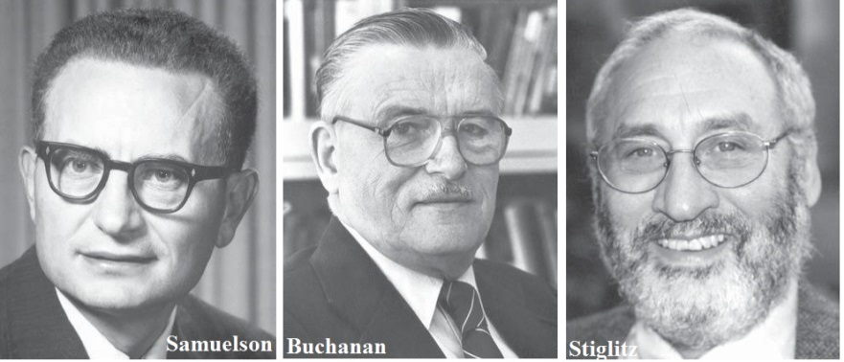
Nobel prise winners in economics
1970 Paul A. Samuelson
1972 Kenneth Arrow
1982 George Stigler
1986 James Buchanan
1996 James Mirrlees and William Vickrey
1998 Amartya Sen
2001 George Akerlof, Michael Spence, and Joseph Stiglitz

Slide 7
Course structure
1. Equity and Efficiency Principles
2. Market Failures and the Role of the Government
3. Public Choice
4. Introduction to Taxation
5. Taxation and economic efficiency
6. Optimal Taxation and Tax evasion
7. The Analysis of Expenditure Policy
8. Social Insurance, Welfare Programs and the Redistribution of Income
9. Cost-Benefit Analysis in the Public Sector
10. Fiscal Federalism
11. Managing the Public Sector's Assets and Liabilities

Slide 8
ASSIGNMENTS AND Grading
Information: Lectures, Classes, Reading materials (in English and in Russian)
Assignments:
2 Midterm exams (30% of Cumulative grade each)
2 written homework tasks (15% of Cumulative grade)
2 group presentations (10% of Cumulative grade)
Participation in class work (15% of Cumulative grade)
Final Exam
Total grade = 0,6*Cumulative grade + 0,4*Final Exam

Slide 9
Why to choose public economics course
To extend understanding of economic theory; it is a part of the classical core of Economics
To look at the government from a different perspective
To apply your knowledge of Microeconomic instruments to the analysis of new issues
To understand better what is going on in the Public sector and how to deal with current and future problems
To expand future career opportunities
To meet international students
Just an interesting subject
… your own reasons… _________________

Slide 10
Opinions on the course
“Very large but really interesting entity! I really liked how you challenged people to think more than just look for the numbers or make basic assumptions.” -4th year student (2018)
“I found the course highly relevant in a societal and political setting. A lot of public discourse revolve around many of the topics in this class. This made it very interesting for me.” - International student (2018)
“Overall, interesting course. Also I liked that it is in English”
3rd year student (2018)
“It is difficult for me to pick a favorite topic, as I genuinely enjoyed the entirety of this subject. If I must choose, I would say the topic about improving efficiency in the public sector.” - International student (2018)

Slide 11
QUESTIONS
???
AND ANSWERS

Slide 12

WELCOME
TO
PUBLIC
ECONOMICS

